Slide 1

VETERANS ADMINISTRATION CLAIMS
VA BILLING: TIPS AND RECOMMENDTIONS FOR BEST RESULTS

Slide 2
What We Will Cover Today
Agenda
Overview of Today’s VA
Types of VA Community Claims
  Emergent
  Purchased
  ChampVA
Billing and Collecting VA
General Recommendations
Questions

Slide 3
A Look at The Veterans Health Administration
Provides health care services and benefits programs for American’s Veterans
Nation’s largest integrated health care system
  Over 1400 sites of care
    Hospitals, clinics, nursing homes, counseling centers, etc.
Manages largest medical education and health professions training program in the US
  Train 90,000 health professionals each year

Slide 4
So why is your volume of VA patients increasing?
Increased volume of VA patients
  9 million veterans
  6 million are actively receiving treatment
  Downsizing Military means more VA traffic at non-VA facilities
VA facilities can not handle the volume alone
  Lack of available specialists
  Long wait times
  Distance between VA Medical Centers
Recent legislation changes have made it easier for the Veteran to obtain care at a non-VA facility

Slide 5
What does it mean for most medical providers?
VA claim process can be tedious, time intensive and complicated
A/R builds up quickly, even at smaller facilities
Low reimbursement makes it hard to allocate the resources necessary for successful collection
Lack of confidence in timely and accurate reimbursement
Multiple changes are occurring as the VA restructures to fulfill commitments made in the Mission Act of 2018

Slide 6
MISSION Act of 2018
Intent of the Mission Act
  Give Veterans access to health care where and when they need it
    Replace Veteran’s Choice
    Access to Urgent Care
    Established Community Care Network
  Improve community care for Veterans, their families, community providers and VA employees

Slide 7
Benefit to Veterans
  Access to Urgent Care/Walk-In Clinics for emergency services without authorization
  Streamlined eligibility criteria
  Improved customer service
  Telehealth– care through phone or computer
  Easier Access to community care providers
  Better coordination between regions

Slide 8
Benefit to Community Providers
Easier interaction with the VA
Faster payment
  Electronic claims paid within 30 days
    Denial response within 30 day
  Paper claims paid within 45 days
    Denial response within 45 days
Electronic platform for submissions
  Late 2019

Slide 9
Types of Non-VA Claims
Types of VA care
  Emergency Care
  Purchased Care
  Champ VA

Slide 10
EMERGENT CARE
Title 38
Mill Bill

Slide 11
EMERGENT CARE
Title 38
(Service Connected)
Title 38
  Service-Connected Conditions
  Adjunct conditions
  Patients with total permanent disability from SCC
  Chapter 31 Vocational Rehab Veterans
  Eligibility
    Tx is for medical emergency that they believe would have negatively affected their health
    Care at VA facility was not accessible or available
  Registration:
    Ask patient:
      Is this service connected?
      Which VAMC are you assigned to for treatment?
    Notify VA within 24-72 hours
    Obtain SS#
    Submit to TriWest/CCN contractor in accordance with timely filing requirements

Slide 12
EMERGENT CARE
Title 38
(Service Connected)
File no later than 2 years from DOS
Facility Charges
  837 EDI or UB-04 and Itemized bill
  Discharge Summary and ED records and notes
  VA form 5083
Physician & other charge
  837 EDI or CMS 1500 and Itemized bill
  Emergency department notes / progress notes
  VA form 5083
Payment
  Generally, 100% of Medicare

Slide 13
EMERGENT CARE
Mill Bill
(not service connected)
MILL BILL
  Non-Service-Connected
Eligibility Requirements
    Tx is for medical emergency that they believe would have negatively affected their health
    Care at VA facility was not accessible or available
    Patient must be registered with the VA
    Patient must have been treated at the VA within the past 24 months
    OHI is primary
Registration
  Ask Patient:
      Are you registered with the VA?
      What is the last date of treatment with the VA?
      Do you have any other insurance
  Obtain SS#
  Notify VA within 24-72 hours
  Submit to TriWest/CCN contractor in accordance with timely filing requirements

Slide 14
EMERGENT CARE
Mill Bill
Billing
    File within 90 days from DOS or date TPL action is exhausted
Facility Charges
    837 EDI or UB-04 and Itemized bill
    Discharge Summary and ED records and notes
    VA form 5083
Physician & other charge
    837 EDI or CMS 1500 and Itemized bill
    Emergency department notes / progress notes
    VA form 5083
Payment
  Generally, 70% of Medicare

Slide 15
VA as Secondary
EMERGENT CARE
VA as Secondary
Currently:
VA regulation
  Cannot pay Copay, Coinsurance or deductibles
Wolfe v. Wilkie United States court of Appeals for Veterans Claim
  Invalidated VA regulation
  VA must reimburse Veterans for out of pocket costs
    Deductible and Coinsurance
    Applies to private insurance. Unclear for Medicare
  Recommend submit to VA

Slide 16
PURCHASED CARE
Pre-approved treatment at a non-VA facility

Slide 17
Purchased Care Programs
(Pre-Approved Medical Care authorized by VA)
  Authorized by Veterans Choice Program (VCP)
    Healthnet – ended 09/30/2018
  Authorized by Patient-Centered Community Care Network (PC3)
    TriWest- coverage ends 09/30/2020
  Veterans Care Agreement
  Veterans Urgent Care Benefit
  Community Care Network- rolling out throughout 2019
    Optum
    TriWest Healthcare Alliance (dispute)

Slide 18
Authorizations
ALL VA Community Care from all programs require authorization in advance
  Initial start of care
  Reauthorization for a new episode of care
Local VAMCs manage consults, referrals and authorizations
  Receive/review consult or enter administrative consult
  Verify eligibility for Community Care
  Determine if prior authorization/clinical review is required
  Initiate and complete referral authorization and enter into system
  Manage secondary authorizations, obtain documents and close consult
    VA 10-7079 for Outpatient
    VA 10-7078 for Inpatient
    TriWest authorization form/ Standardized Episode of Care (SEOC)

Slide 19
VAMC Authorization/SEOC Form
VAMC Authorization
  Provider information
  Authorizing VAMC
  Veteran information
  Auth information
    authorized care, authorization number, valid dates
  Initial appointment date
  Service description, duration and overview
  Outlines situations where additional auth is needed.
  Required on claim or claim will deny
SEOC Authorization
  Provider information
  Authorizing VAMC
  Veteran Information
  Auth information
    authorized care, authorization number, valid dates
  Claim submission information
  Initial appointment date
  Service description, duration and overview
  Code Range: CPT codes that are covered under this authorization
    If CPT code is not listed, a Secondary Authorization Request (SAR) must be submitted.

Slide 20
Purchased Care Treatment
Only provide tx as indicated by the authorization
Facility must be listed on the authorization
Pay attention to which VA is submitting the auth
  Contact the authorizing VA or submit SAR:
    If care deviates from the approved care plan
    Additional treatment is needed
  The claim must be submitted to the appropriate payer as indicated on auth
    VAMC auth- submit claim and medical records directly to VAMC authorizing
    TriWest/SEOC- submit claim to TriWest, submit medical records to authorizing VAMC.

Slide 21
Purchased Care Considerations
Pre-approval is not required if emergent care becomes necessary during the authorized care/treatment
  Contact the VA within 24 hours but no later than 72 hours
  If VA has capacity, patient must be transferred when stabilized
  If patient refuses transfer, VA will only pay for treatment up to the point of stabilization.

Slide 22
Purchased Care
Claims and Payments
VA is the primary and exclusive payer for the Non-VA care it authorizes.
Both VA and other coverage can only be used if patient received authorized and non-authorized services and payers are not being billed for the same services.
Veterans may still be responsible for co-payments
  Some Veterans are exempt from co-payments

Slide 23
Claim Submissions
Preauthorized Claims
As soon as possible but no later than 2 years for NSC and 6 years for SC
Facility Charges
  837 EDI or UB-04 and Itemized statement
  Hospital Discharge summary or outpatient tx records and progress notes
  Authorization Form
Physician or other professional fees
  837 EDI or CMS 1500 and Itemized statement
  Outpatient Hospital Emergency tx records/progress notes
  Authorization form

Slide 24
VA Community Care Network (CCN)
4 private sector contractors
Develop and administer regional networks of high performing licensed health care providers
Provides local flexibility and increased access to care
Contract vehicle for VA to purchase care in the community.
“The CCN contracts were developed with a focus on transparency, accountability, quality, and increased communications between VA and Veterans.”- VA.gov
HealthNet and TriWest were temporary solutions, CCN will be a permanent solution to providing veterans with flexible and increased access to care.

Slide 25
CCN Eligibility Criteria
Best Medical Interest of the Veteran
Required care or services are not offered by VA
Lack of full-service medical facility
Care or services are non-complaint with VA’s standards for quality
Care or services not provided within designated access standards
Grandfathered eligibility from Veterans Choice Program

Slide 26
CCN-Eligibility Access Standards
  Primary Care, Mental Health, Non-institutional Extended care
    Drive Time 30 minutes
    Wait time 20 days
  Specialty Care
    Drive Time 60 minutes
    Wait time 28 days

Slide 27
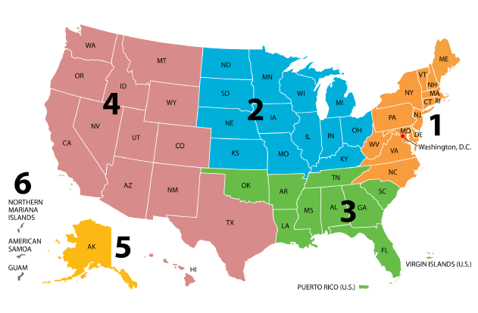
CCN-Optum
New Third-Party Administrator (TPA) for VA in Regions 1, 2, and 3.

Slide 28
CCN-TriWest
Previously awarded contract for Region 4.
As of 08/19/2019, under protest and “stop work order” until further notice.
Per Update from Veterans Health Administration: This does not impact community providers who are currently in partnership with TriWest as PC3.

Slide 29
CCN-Optum
Transition from TriWest (PC3) to Optum will take place:
  Region 1: July 29, 2019-December 28, 2019 and will be deployed in 5 phases.
  Region 2: October 8, 2019-April 9, 2020 and will be deployed in 5 phases.
  Region 3: TBD
TriWest will continue authorize care during the 30-day transitional phase of each VAMC.
For more information regarding which phase your VAMC is in and to sign up for training, visit: https://provider.vacommunitycare.com/tpa-ap-web/?navDeepDive=VACCN%20publicNewsAnnouncementsMenu

Slide 30
CCN-Optum
To become a registered provider with Optum, send the following information to the email listed below: vaccnprovidercontracting@optum.com
  Business Name:
  State located:
  Phone number:
  Email Address:
  Tax ID:
  NPI:
  Provider Type (medical, behavioral health, physical health, home health, etc.):
  How can we help you?: contract with VA CCN

Slide 31
CCN-Optum
Claim Submission Address:
    VA CCN Optum
    PO Box 202117
    Florence, SC 29502
    Electronic Claim Submission Payer ID:
    VACCN

Slide 32
CHAMP VA

Slide 33
CHAMP VA
Health Care Benefits program shares the cost of health care services with eligible beneficiaries
Managed by the CBOPC in Denver, CO
Eligibility checked 24/7 via IVR
  1-800-733-8387
No contract providers
Some pre-authorizations are required
  DME
  Mental Health/Substance Abuse
  Organ and Bone Marrow Transplants

Slide 34
BILLING AND COLLECTING ON VA CLAIMS

Slide 35
VA Claims Processing
VA encourages the use of electronic health care claims for timely payment.
Community Providers must use EDI for which care is authorized:
  PC3/CCN to TriWest or CCN Contractor (Optum)
  VCP Provider Agreements to VA
  Traditional Community Care (9/30/20) to VA

Slide 36
Claim Submission Process Overview
Past
  Mailed paper claims to local VA medical centers
  Manual entry and verification of paper claims
  Corrected errors manually throughout processing
Current
  Consolidating mailed paper claims and sending to single location
  Separating claims from attachments, scanning and converting to electronic format
  Automatically identifying errors up front based on industry standards
  Sending rejection letters to correct the errors
Future
  Nearly all claims will be submitted electronically
  Processing of exceptions for paper will require mailing to a new location directly for conversion to electronic format
  Enhancing current process to attach medical documentation to electronic claims submissions

Slide 37
Current Method for Submitting Claims
Submit electronically via Change Healthcare
  Preferred method
    If not connected to Change Healthcare
      Add payer ID to your EDI clearinghouse
        ‘12115’ for medical claims/ERA
        ‘VAFEE’ for an eligibility inquiry transaction (270/271)
  Expedites claims processing
    Future will include adding EDI 275 Attachments as supporting medical documentation
Mailing Claims
  Mail to designated claims processing unit
  Use original UB or 1500
  Strongly encouraged to transition to electronic format asap

Slide 38
Billing and Collection Resources
PFRAR
  Mailed weekly
  Explains the payment that will be issued or reason for denial/rejection
  Only access for any denial reasons
CEP- Customer Engagement Portal
  Obtain claim status- VA Fee Basis claims only
  Run payment reports
Availity
  Check eligibility
  Check VA Choice claim status
  TriWest Portal
  View authorization information
  View TW claim status
  eCAMS
  Modernizes the processing of claims received by community providers outside VA’s Community Care Network
  HSRM
    New portal allowing direct and immediate communication between VA provider and non-VA community care provider.

Slide 39
Classification of Processed Claims
Accepted
  Correctly billed and pre-authorized
Denied
  No pre-authorization
  Veteran not eligible for emergency care
Rejected
  Billing errors
  Additional information needed

Slide 40
Top Reasons for Rejected Claims
Duplicate Claims/Previously Paid
Medical Records needed
Billing/Coding Errors
Submit claim to wrong Contractor
Authorization Errors
  Exceeds Visits, Not Authorized, location of treatment, etc.

Slide 41
Top Reasons for Denied Claims
Not Timely Filed
Non Emergent Care
Not Authorized
Not registered and/or no treatment in 24 months
VA available
OHI

Slide 42
General Recommendations
Patient Access Training
  Identify correct VA payer
    Check Auth form
    Ask patient for SC emergency claims
    Send NSC emergency to closest VA Medical Center
  Eligibility Determination
    Use patient SS#, not DOD number or Benefits ID number
    Is patient registered with the VA?
    Last VA treatment date within 24 months?
    Where are they assigned for treatment?
  Be proactive about authorizations
  Timely Notification Requirements
Take advantage of VA training webinars
  www.va.gov/COMMUNITYCARE/providers
Provide Patient Education
  Eligibility for Emergency Care
  Transfer refusal consequences and consent

Slide 43
Billing
  Submit Electronically
  Submit paper claims quickly to allow time for scanning and identification within timely filing limitations
Follow up
  Establish process for PFRAR scanning
  Work with your VA to implement efficient follow up procedures
  Begin follow up at 30 days after claim submission*
Denials
  Track your denials to identify causes that can be corrected
Coding
  VA follows CMS guidelines
  Track your denials
Appeals
  Can be submitted with documentation within 1 year
  May need to involve the patient

Slide 44
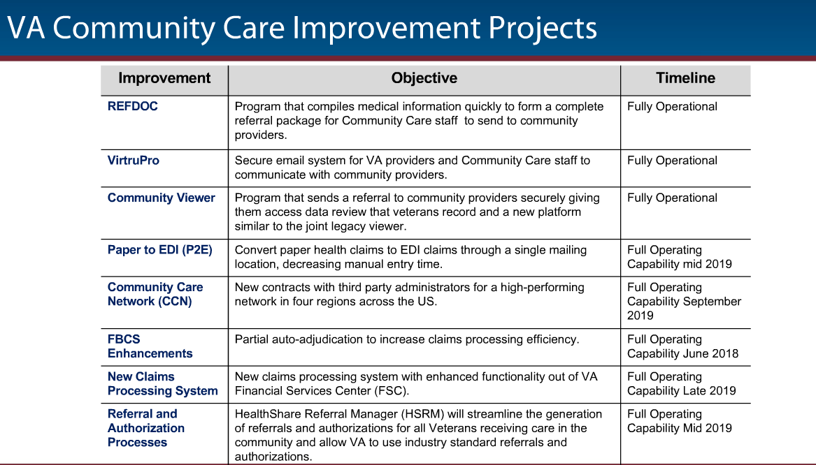

Slide 45
QUESTIONS?
Lori Lipocky, CPCU
Lori.Lipocky@AspirionHealth.com

