Slide 1
Built for This
A Marine Story

Slide 2
Today’s Objective
Testimonial of my life, experiences, and aftermath of what it takes to become a Marine, and fighting on the front lines of a major US conflict.
Disclaimer: Marines use curse words in almost every aspect our day, it’s almost an art form. There is an old adage, “Curse like a sailor.” Well who do you think taught those squids how to curse?
The Marine Corps is a department of the Navy. More importantly you should know we are the Men’s Department.
Please accept my apologies in advance for any unexpected used of colorful language.

Slide 3
Dirt Floor Poor
Born and raised, small town of Scottsburg IN
Hazard KY
Morgan’s Foods
Fire – living with Grandparents
  Eventually working our way to purchasing land next to a nature preserve in the middle of nowhere Indiana.
  This was our wonderland!!!

Slide 4
My First Love

Slide 5
Parents
Father – Lonnie White
  Tough life, grew up a foster child living in roughly 19 different homes
  Cold cheese Sandwiches
  Basketball was his outlet
Bill and Martha White
  Pure evil
  Slip and fall
  Karma (all the kids she got rid of)

Slide 6
Momma White
Teresa White
  2nd born and only girl (3 Brothers)
  Charismatic and goofy
  Full of love and devotion to her children
  Currently working for the VA
  Loves to dance
  She is the reason our childhood was so amazing
  I get it from my momma!

Slide 7
Not So Wonderful
Mid to Late 90’s my Dad’s company folded
Money was the root of OUR problems
Moved around liked gypsies
The divorce (1999)
Janea Francis was born (oops)
  She was the glue to keeping our family a family

Slide 8
WORK

Slide 9
James K. Burrell
City of Scottsburg Parks Department
Hired Jim during the start of my second summer
78 year old, WW2 Combat Veteran (Tail Gunner)
Worked for 40+ ATT on cable lines
I hated him (at first)
He worked with us sun up to sun down (non-stop)
The most influential person I have ever met

Slide 10
James K. Burrell
Value my work
Importance of saving (Great Depression)
Perpetual motion—move or die
Germs wont kill you—poop everywhere
Perseverance—never give an inch

Slide 11
First Time
Shotgun– someone was trying to kick our front door down
”Grab your brothers gun”
Jacob White – one of the best outdoorsman within southern Indiana
  State Team
  Hunter, Trapper
Cut from same male gene-pool
  I don’t hunt…..animals

Slide 12
Seventeen
Graduation (June 2001)
  Buddy Program was supposed to start 6/6—Marines
Momma White said NO
“Joshua you will go to war!”
  She was right, I just didn’t know it at the time
18 years old to serve
Meteorology was a no-go
Marines + College = US Marshall

Slide 13
College Sucks
Indiana University Southeast
  Same familiar faces, and I was just bored
Couldn’t move, family needed my support
Crestview Computer Lab
Illegally downloading songs, and burning them to compact discs
And then this happened...

Slide 14
Changed My Life
We all remember that day
Where you were at
How you felt
These attacks brought our nation together
…..have we forgotten?

Slide 15
Something is Happening
Our school went on lockdown
Friends in boot camp
James’s Marine Corps Influence—I needed that!
We went to the local recruiter & signed-up
Momma Cried…

Slide 16
Compromise
Mom let my recruiter have the business
  After speaking with the recruiter, he offered ”US” the reserves.
One weekend a month, 2 weeks a year, continue my college
Everyone wins
My Dad was pissed… why cant you just go to work son
  No member of my family had ever served
  No member of my family has ever graduated from college
…. He didn’t understand, nobody did!

Slide 17
College would have to wait…
I solemnly swore to support and defend the Constitution of the United States against all enemies, foreign or domestic

Slide 18
Get Some

Slide 19
November 26, 2001
Marine Corps has 2 recruit training depots
  Best known: Parris Island
Hollywood Marines are the very best
November 26, I arrive at MCRD, San Diego
  GET OFF MY BUS

Slide 20
Receiving
Week 1
72 hours of chaos
  No Sleep
  Physical Fitness Test ( 20 pullups, 100 sit-ups, 3 mile run)
  Paperwork
  Haircuts
  Gear
  The Shot Gauntlet
    Bloody Underwear—Drill Instructors love to play games
Meet your actual drill instructors

Slide 21
Non Stop Chaos
13 weeks, what did I get myself into
Drill Instructors: Rare breed
  Yell so much, they end up losing their voice or sounding like a frogs
  Super Funny
  Marine Platoon Melting pot of diversity: White, Black, Italian, Hispanic, and Texan

Slide 22
Typical Day
Reveille (wake up--zero dark thirty)
  Make our racks
Force Marched to Chow-Hall
  Eat Quick
Yelling
Physical Training
Extra Training (1 on 1 drill instructors)
More Yelling
Lights out when Taps Play

Slide 23
Semper Fidelis –Always Faithful
Weeks 2-3
Customs & Courtesies
  Importance of Saluting
  Nautical Terms
  Proper Formation
  Hymn
  Ranks
History
  November 10, 1775
  Born in a Bar
  Tun Tavern (Philly)
Esprit de Corps
  Pride that the Marine Corps instills, our conduct on the battlefield, that sets us apart from all other branches of the military
  The Few, The Proud

Slide 24
Hand to Hand Combat
Marine Corps Martial Arts
  Mash-up of various martial arts
  Each Marine Graduates with Tan Belt Certification
  Weekly Training / Qualification
  We beat the living tar out of one another
Confidence Courses
  American Ninja Warrior
  ….Everything is a weapon of opportunity

Slide 25
Men’s Department
Week 4
Entire week is devoted to learning how to swim
Each Marine must pass the swim qualification
Learn how to tread water for extended periods of time

Slide 26
Jingle Bells
Boot Camp Christmas
Torture—looking up into the hills of San Diego, and seeing Christmas lights—families enjoying the holiday
Woke up one morning, singing Christmas carols in our underwear
Special Meals
Oh you guys want to eat cake….

Slide 27
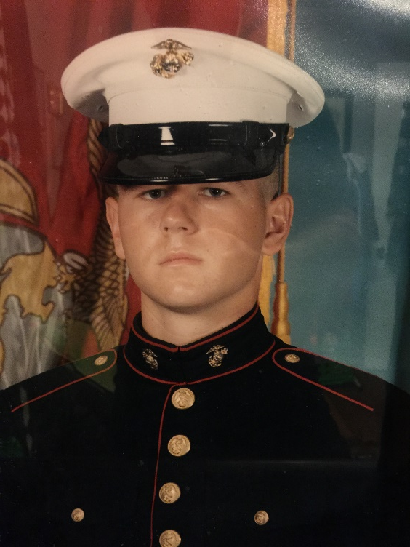
Team Week
Week 5
Short break from non-stop training
Broken up into small unit groups
  Mess Hall
  Maintenance
  Supply Chain
  Laundry
James had prepped me for team week—said its awesome!
SSGT Evans overheard me while cleaning under a rack…

Slide 28
Where Marines are Made
Week 6
MCRD San Diego is in the city
Camp Pendleton (home of 1st Mar Div)
  Mountains & Ocean
Every Marine is a Marksman
Practice shooting techniques (all day, every day)
  The hardest Marine to train, are those with prior hunting skills
Learn to shoot from 25 yard to 500 yards (open sites),
M16A2 Service Rifle is precision
Learn how to breath and squeeze your trigger

Slide 29
Lots of Humps
When we aren’t shooting…
Marines love to hump (hike)
  Combat Rigs are very heavy 50-60 lbs.
Week 7
Rifle Qualification (Live Rounds)
  Basic Rifleman, Sharpshooter, Expert
My eyes suck—BC’s

Slide 30
Learn How to Kill People
Weeks 8 – 9
Hump out into the middle of nowhere
Eat MRE’s
Paint our faces (proper concealment)
Get dirty
  Low crawl exercises
Learn how to kill people
  Squad movement tactics
Gas mask training
  That day sucks

Slide 31
The Crucible
11 Weeks of pain and one last challenge remains
Culmination of all our training
54 hour event
60+ miles humps, obstacles, and tests
2 meals
6 hours of sleep
Drill Instructors are with you every step of the way
Shifting gears to more of a mentor role
Teaching us about Medal of Honor recipients

Slide 32
The Night Before
7 mile hump out to the bivouac site
500 yards from the barracks…
Injured
My entire family is coming to graduation
I cant quit… NEVER GIVE AN INCH

Slide 33
The Reaper
The final night of the crucible is awesome
  Live fire with tracer rounds
The reaper hike
  Hungry, tired, injured—all we had to do was make it up this mountain
  “Leave no man behind, but do not offer assistance”

Slide 34
Easy Street
Week 12
Drill Instructors are treating us better
  Teaching us about how to act when we get to the fleet
Drill instructor event
  Test of unit command and execution
    Marine Corps Cadence
Our platoon took first place

Slide 35
UNITED STATES MARINE…
February 22, 2002
  My entire family came (Parents, Siblings, Aunts, Uncles, Cousins, friends)
Moto Run
  Momma was worried (hairline fracture)
Parade Deck

Slide 36
More Training
10 days leave
Marine Combat Training (MCT)
  School of Infantry
  Condensed Infantry Training for everyone with an MOS of grunts (03xx)
  I was set to go to Communications School
Injured again
  0621 Field Radio Operator (grunt w/target on my back)
  29 Palms

Slide 37
July 4th 2002
Surprised my family with a homecoming
Finally transitioning into the reserves
September was my first drill weekend
Work, School, Play Marines once a month, life is good

Slide 38
Something is Happening
October – USMC rolls out state of the art digital camo.
  Our unit receives the desert color scheme???
November –Marine Corps Birthday/ Ball
  Drink Beer, Eat Cake
December—deliver toys for “Toys for Tots”
  Signed up for weird series of shots
  Anthrax Vaccine-which was to be taken over a course of several weekends, meaning we had to come back to Indy just for shots

Slide 39
00:01
Arrive in Indy for our last Anthrax Vaccine
Met by our Company Brass
As of 00:01 last night, Communications Company HQ Battalion 4th Mar Div, has been activated to serve in direct support of Operation Enduring Freedom. You have 72 hours to get your affairs in order and report back to these orders….

Slide 40
Mom was RIGHT
I was going to war…but which one
My new GF Amber—we were getting serious
My family and friends were distraught
Orders
Reporting back was difficult
Nobody knew anything, and word constantly changed
We got small pox vaccines and packed our gear
Given 1 last night

Slide 41
Awkward Goodbyes
Nobody knows what to say or how to say it
My dad had to walk me to the gate…he cried
Proper Send Off
  Our unit played songs, everyone waved flags
  Everyone cries
  Remember how this makes you feel…bottle those feelings up and use it on the battlefield.

Slide 42
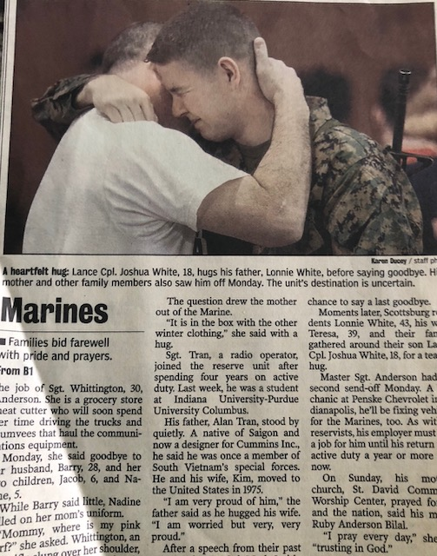
Haters Gonna Hate

Slide 43
Operation Iraqi Freedom
One last goodbye!
February 22, 2003
  Fly from North Carolina to Maine, to Frankfurt, to Kuwait
Arrive in Kuwait under the cover of darkness
Camp Matilda
  Middle of nowhere, close to Iraq border
  Tent City

Slide 44
Day 1
First ones to get assigned
  Gunnery Sgt. Trietch
  LCpl. Scott Howard
Combat Engineers (1st Mar Div)
  They enjoyed abusing their weekend warriors
  Immediate fight
  No respect

Slide 45
Fear of the Unknown
We were here to fight…
Nothing was happening
Boredom
Not enough training to pass the days fast enough
Matilda was in a flat, so nightly we were battling these sand storms trying to save our tent.
Helmets, googles, and hammers
Limited electricity

Slide 46
Mad Dog
Lance Corporal Wire
  Scuttlebutt suggests, Jennifer Lopez had died
  This sent shockwaves throughout the camp
  Our leaders had to follow up on this intel and squash the rumors
General James “Mad Dog” Mattis had arrived
  Gathered all personnel for mission directive
  Hands down, the best motivational speech ever!!!

Slide 47
Letter

Slide 48
Warrior Monk
“He told us to be polite, be professional, but have a plan to kill everyone you meet.”
My all-time favorite, to Iraqi tribal leaders once we liberated the country:
‘I come in peace. I didn’t bring artillery. But I’m pleading with you, with tears in my eyes: If you **** with me, I’ll kill you all.’

Slide 49
Sh*t Just Got Real
March 18th—Sgt. says, “grab 3 days worth of gear”
  Moving to the border, assist forward observers
Seeing the enemy for the first time (51st Mech)
A few weeks back I’m sitting around playing Xbox with friends—and now I am on the border of Iraq…about to fight.

Slide 50
Shock and Awe
March 19 – President Bush gives his warnings
Entire coalition force descends on our position
  Now I am going to war with 3 days worth of skivvies!
Gas, Gas, Gas
  SCARED TO DEATH
Front Row Seat

Slide 51
Dressed for Battle
Mop Level 4 (Woodland Green)
Humvee’s (Woodland Green)
  No armor, just sandbags
300 rounds
Flak jacket, with no armor places
Malaria pills for 1 month
Food for 2 weeks
3 pairs of socks and undies

Slide 52
Crossing the Line of Departure
March 20th, 2003
  We make our move into Iraq
First Mission:
  Clean up what the bombs didn’t get
  Nothing left
  Continue our push to Baghdad (snails pace)
  Communication was an issue

Slide 53
Messy Logistics
We are moving at a crawl
NVGs are difficult to use, and when we try to follow other vehicles that are completely blacked out
People are rear-ending, running off roads, getting lost

Slide 54
Slow Motion
Firefights
  Everything was in slow motion
  Come to my senses
  Rounds down range
21 Days of Major Combat Operations
  Drive, Engage, Rinse, Repeat
  We were all so tired, you never got a chance to relax…

Slide 55
Combat Poop
Marines don’t believe in privacy
Bootcamp – stalls have no doors
Fleet, what are stalls?
  Row of toilets
Slit trenches
My first combat poop
  You couldn’t step 3-4 feet from the vehicles unless we were changing positions in a fire fight
  Ammo box
  Painful

Slide 56
Sand Storm
Phone calls home were rare
  We got one call, and it was supervised
Sand Storm
  Entire sky turned orange
  We dug foxholes or shallow graves and hunkered down
  Fearful our enemies would take advantage

Slide 57
Death is Everywhere
War is not pretty and death is everywhere, it’s relative
The sight, the sounds, the smell, the bugs—awful
Rules of Engagement
Our enemies retired their uniforms and were giving up
Hard to distinguish bad vs good
Same guys shaking your hand during the day, would try and kill you at night
Ignoring roadblocks

Slide 58
Fix Bayonets!!!
The eve of Baghdad, we pull up next to an armored division
Coalition forces had the city surrounded, and we were about to begin our assault
Fix bayonets—the enemy will be dug in
Liberation happens
Statues fall
Iraqi’s celebrate by looting everything imaginable

Slide 59
Al Diwaniyah
Major Combat Operations have ended
But the war is still on—Saddam is still at large, and new enemies were arriving each day
We set up shop inside of a hanger in Al Diwaniyah
  Breaking up in small patrols day/night
  Going on raids
  Blowing up guns, ammo
  Fixing Infrastructure
  Clearing houses is single handedly the most intense thing you could ever do

Slide 60
Camp Diarrhea
Lack of hygiene
Supplies lines got cut off
  We ran out of food
  Bottled water
  Malaria pills
  EVERYONE GETS SICK!!!

Slide 61
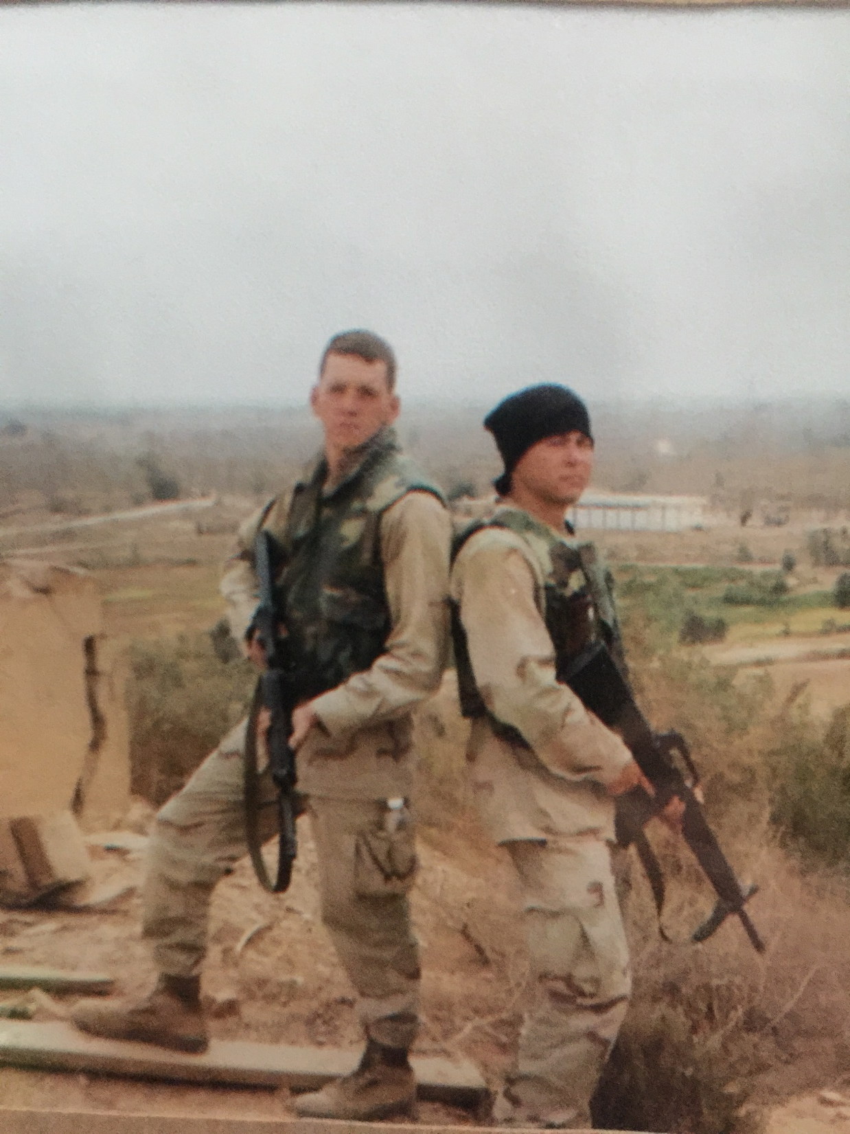
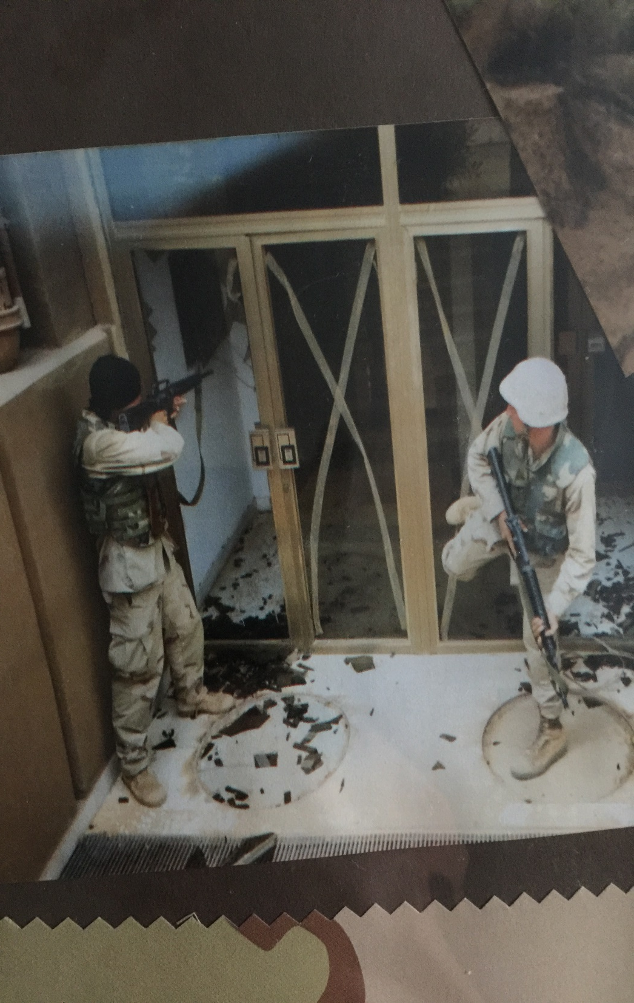

Slide 62
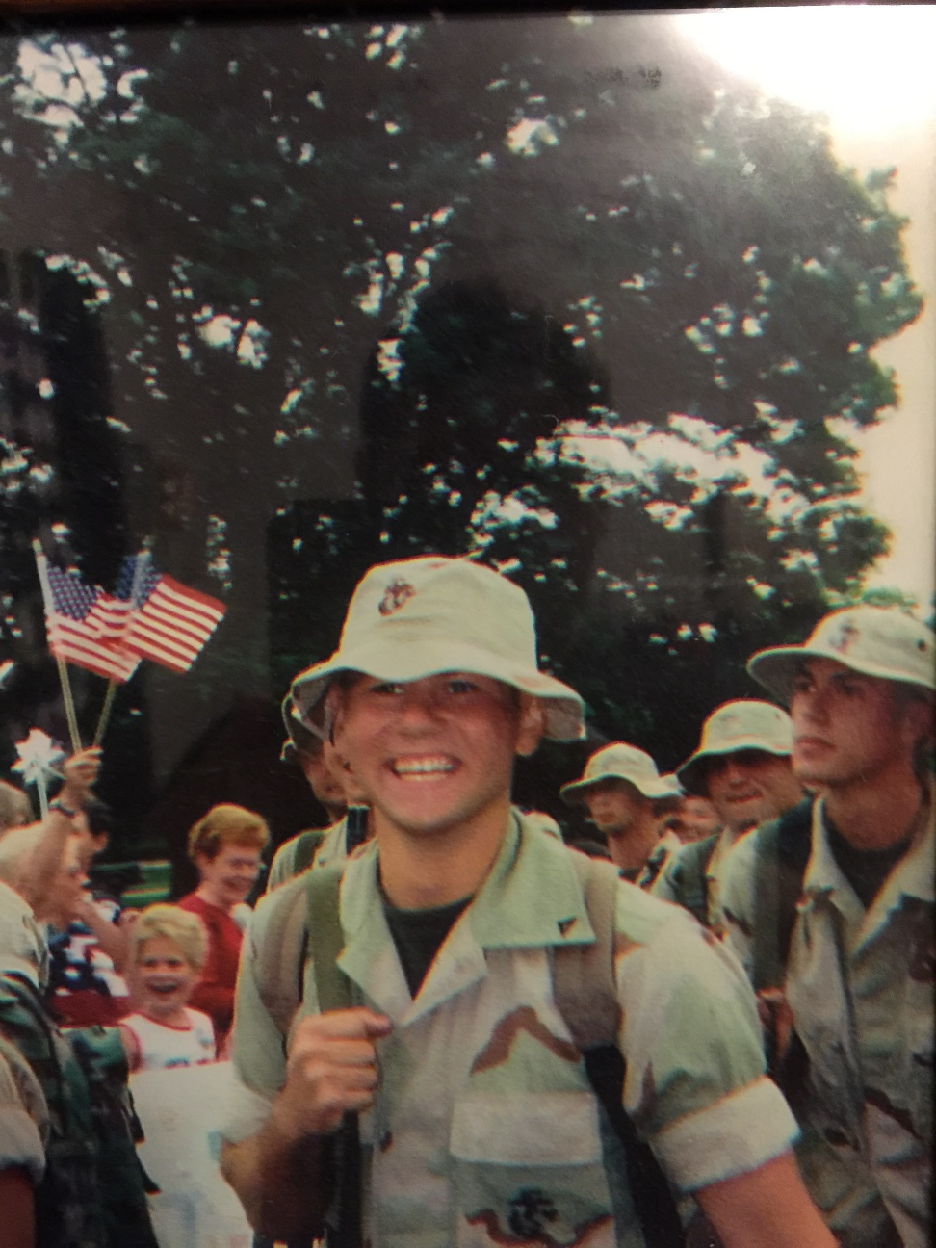
Home

Slide 63
War Never Ends
PTSD
  Depression
  Hypervigilance
  Anxiety
Living with friends
  Big mistake
  I was not in good place
Meds didn’t work I felt mental…

Slide 64
WORK
Circuit City – Just what I needed…
  Interacting with people
Printing dog food bags, 3rd Shift
  I quit and have never looked back
Found work in Louisville for HCA
  National Patient Account Services (NPAS)
  Started out entry level and worked my way up through the ranks

Slide 65
CSM
Due to Rapid Growth, NPAS was hiring for a coveted position in Client Services
All the top-notched managers-supervisors applied
  -NO way they would consider a junior supervisor with no college education
Learned something about myself
  Never discount real-life experience
  The WAR was helping me beat out the competition

Slide 66
Fire Service
Volunteer (5 years)
Chasing adrenaline, running into burning buildings
Death & Destruction:
Burn victims
Terrible wrecks
Drownings
Tornados

Slide 67
Fear. Hello Old Friend
Late Spring 2012
  Responded to an early morning fire
  Limited on resources
  Fire is beginning to get out of control, and we make entry to save the structure
  Retired Fire Chief from Louisville Fire
  Began to question my actions
  I felt fear…but rightfully so, was about to become a father

Slide 68
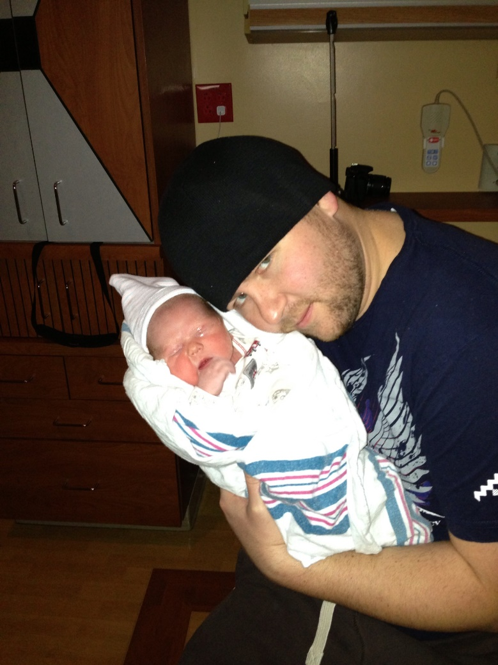
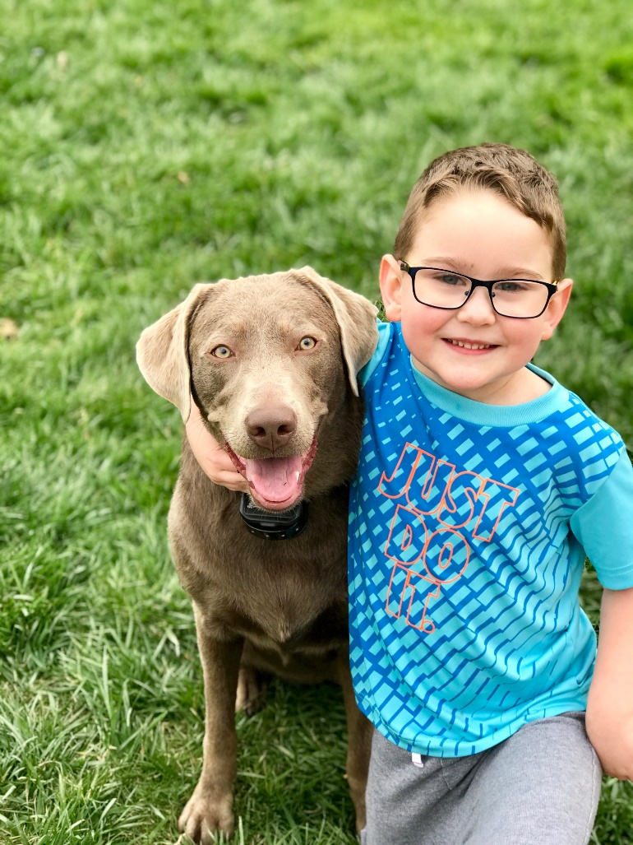
Numb meets Love
I had been dead inside for many years

Slide 69
Fate
Sales Needed Help—they started sending me out on the road to help (HFMA EVENTS)
Florida Spring Meeting (Tampa)
Joe was the very first person I ever met within HFMA
Joe would eventually take a huge chance on me….

Slide 70
Remember Wonderland
Factories left our town
  Limited work
  Middle class to unrecognizable
Drugs are everywhere
  2016 Austin Indiana had the most new cases of HIV per capita in the entire world… BBC ran a story
  State of Emergency

Slide 71
Drugs Destroyed My Family
Brother vs Brother
I am becoming everyone’s crutch
  Bail me out of jail
  Loaning out money
My only Grandmother passes in 2017
  Our last year together was rocky
  Family needs family…regardless of their issues
Host Thanksgiving
  My cousin, Morgan recently released from prison (23)

Slide 72
New Years 2018
Coldest day/night of all winter
My Mother calls…
Joshua…. Joshua…. Joshua…

Slide 73
They Got One of My Own
Morgan was found on the side of a gravel road, (dumped) and left for dead on the coldest night of the year.
500 yards from my grandparents home.
Her boyfriend was the last person with her

Slide 74
Fog
My entire family is distraught
Uncle Steve & Tyler are in bad shape
  News helicopters are hovering over
  Police is everywhere
  Someone has to call Robyn….

Slide 75
Built For This
What did you learn today?
  Outside of my life has been completely chaotic!
Departing Message

