Slide 1
Carisk Intelligent Clearinghouse Capabilities
November 2019

Slide 2

Today’s Agenda
Introductions
Challenges with E-Billing in WC & Auto including recent legislative update
Carisk Intelligent Clearinghouse Capabilities
Frequently Asked Questions
Questions/Demo Follow-Up’s

Slide 3

Introduction
Sally Balioni
Sales Director, Provider Partners
Carisk Intelligent Clearinghouse

Slide 4




Carisk Partners Vision
Solutions for clinical management & risk transfer
Carisk’s clinical expertise, combined with its unique approach to each patients’ situation, and best in class healthcare data, positions the company to effectively partner with the patient, provider and payor to achieve clinical and financial outcomes that work for all parties.
Carisk Partners provides best in class services through
Provides medical clearinghouse services for healthcare providers and payors nationwide, facilitating the electronic submission of workers' compensation and auto/no-fault bills along with all supporting documentation.
Delivers risk transfer and care coordination programs for workers' compensation and auto insurers by combining behavioral healthcare expertise with clinical resources to manage large case losses.
A risk transfer company
Managed Behavioral Healthcare Organization (MBHO) providing benefit administration and coordination of mental health and substance abuse services for HMOs, PSNs, commercial employers and other managed care organizations.
Registered Diagnostic Testing Network (RDTN) nationwide, specializing in workers' compensation and auto/no-fault sectors, providing patients with access to quality diagnostic testing services.

Slide 5

Nationwide electronic medical bill platform
Founded in 2000
Developed out of HealthCare Practitioner understanding of EDI needs
Specializing in Workers’ Compensation & Auto
  Connected to over 1,000 payers
Connects to any Medical Billing or Revenue Cycle Management (RCM) system
Carisk Acquired in 2018, integrated end-to-end solution in workers compensation

Slide 6












Payer Partners for Electronic Billing
Carisk Intelligent clearinghouse payer partners*
CiC is connected with >1,000 payers nationwide for electronic billing capabilities

Slide 7

Challenges With Electronic Billing In Workers’ Compensation & Auto

Slide 8

Electronic Billing
Statistics
95% of all Health Insurance bills are transmitted electronically including Medicare and Medicaid bills
< 30% of all Workers Compensation and Auto/PIP bills are transmitted electronically
The same medical billing systems produce these bills and supporting documents
Legislation is evolving mandating electronic processing of bills in workers’ comp and auto

Slide 9
Electronic Claim Processing
Typical reporting requirements for workers’ compensation & auto
“Complete electronic medical claim” meets all of the following criteria:
Are you submitting in the correct uniform claim format, with the correct uniform billing code sets, transmitted in compliance with the guidelines
Do your claims (CMS-1500 and/or UB-04) and electronic attachments (Medical Reports) provide all information required under the guidelines established by each state and payer
Has the hospital, health care provider or its billing representative provided all information that the insurance carrier or its third party administrator requested

Slide 10
Electronic Claim Processing
Clearinghouse responsibilities
Validate for Completion Prior to Transmission to Payer
Notify Provider if Data is Missing or in Error
Transmit Supporting Documents / Medical Reports to Payer with CMS-1500 or UB-04
Pass Payer Acknowledgement of Claim back to Providers
Assist in EFT Payment via 835 EOR transmission to Provider

Slide 11

Carisk Intelligent Clearinghouse Capabilities

Slide 12


Workers’ Compensation & Auto
E-billing administrative process
Submitters:
Hospital, Provider Practice, Management/Billing Systems
Files may be any accepted format as well as scanned or keyed data:
  EDI (ANSI x12 837)
  XML
  CSV
  NSF
Supporting documents attached
Receivers:
Payer, Carrier, or Bill Review Company
Files may be ANSI or custom formats for special data feeds such as B&E:
  EDI (ANSI x12 837)
  XML
  CSV
  NSF
Clearinghouse

Slide 13

Electronic Billing
Carisk Intelligent clearinghouse metrics*
97% of claims
received and processed
on 1st submission
33% increase of claims processed without manual intervention
*Top 5 largest Payer in the Nation data on file

Slide 14



End-To-End Solution
Benefits of the CiC Platform
Real-time claims with simultaneous document submission
Documents are attached to claims as part of the submission
Virtually no wait time for processing
No delays of 24 - 48 hours
as typical with other systems
and direct connect to the
largest payers

Slide 15

Carisk Intelligent Clearinghouse (CiC) Technology
Faster processing, greater accuracy, and increased cash flow
Increase Practice Profitability & Efficiency
No Implementation Fees, competitive pricing
Real-time payer acceptance acknowledgement
Claim verification within 24-hours of submission
Reduced administrative costs through increased productivity and fewer Provider follow-up calls
Faster processing and payments with electronic submission
Targeted recruitment efforts to grow payer network

Slide 16

Carisk Intelligent Clearinghouse (CiC) Technology
Faster processing, greater accuracy, and increased cash flow
Tech Enabled
Unlimited attachment & supporting documentation capabilities
Benefits & eligibility direct feed capabilities
Dedicated IT team delivering seamless integration
Cloud-based technology
Ability to generate 50 service lines of code for a single electronic bill vs. 6 for paper bill

Slide 17

Carisk Intelligent Clearinghouse (CiC) Technology
Faster processing, greater accuracy, and increased cash flow
Compliant
HIPAA
Meets mandatory state-level requirements
Trusted, established system

Slide 18

Frequently Asked Questions

Slide 19
How Long Does This Solution Take to Implement?
Turning on the clearinghouse functionality takes 2 easy steps:
Enroll
with CiC
Go-Live

Slide 20

How Quickly Can I Get Paid?
CiC Providers are seeing payments in
under 14 days in many cases*
Timing depends on payer and system connection specifics
*Top 5 largest Payer in the Nation data on file

Slide 21
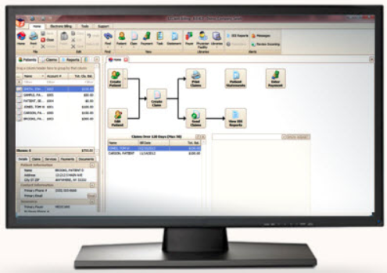
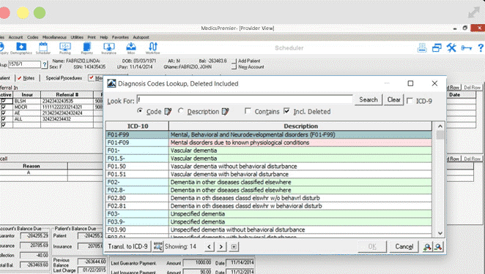


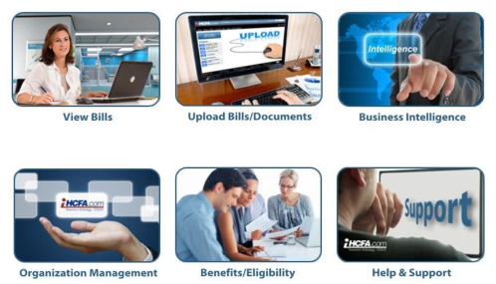
Can I See A Demonstration?
CiC helps their users save time and money by filing your worker’s comp and no-fault auto claims electronically
Connected
System

Slide 22


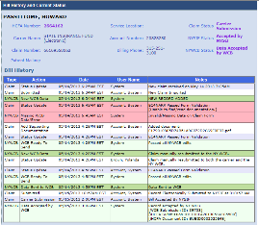
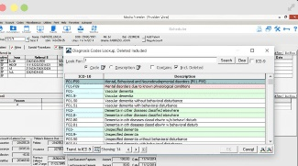

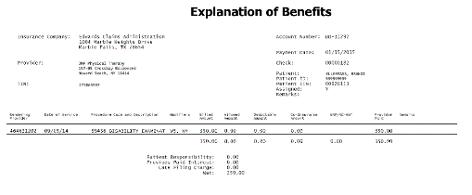

Can I See A Demonstration?
Simplified administrative process
1
2
3
4
Provider utilizes
to electronically submit claim data and supporting documentation or medical records to the Clearinghouse
Claim is validated and necessary edits are furnished by CiC.
Claim and attachments sent SFTP to Payer, TPA or MMC when complete
Payer accepts claim and acknowledges acceptance.
Payer processes and adjudicates the claim
Provider receives payment via
EOB/Check, 835/ERA and/or EFT from Payer

Slide 23

Implementation Best Practices

Slide 24
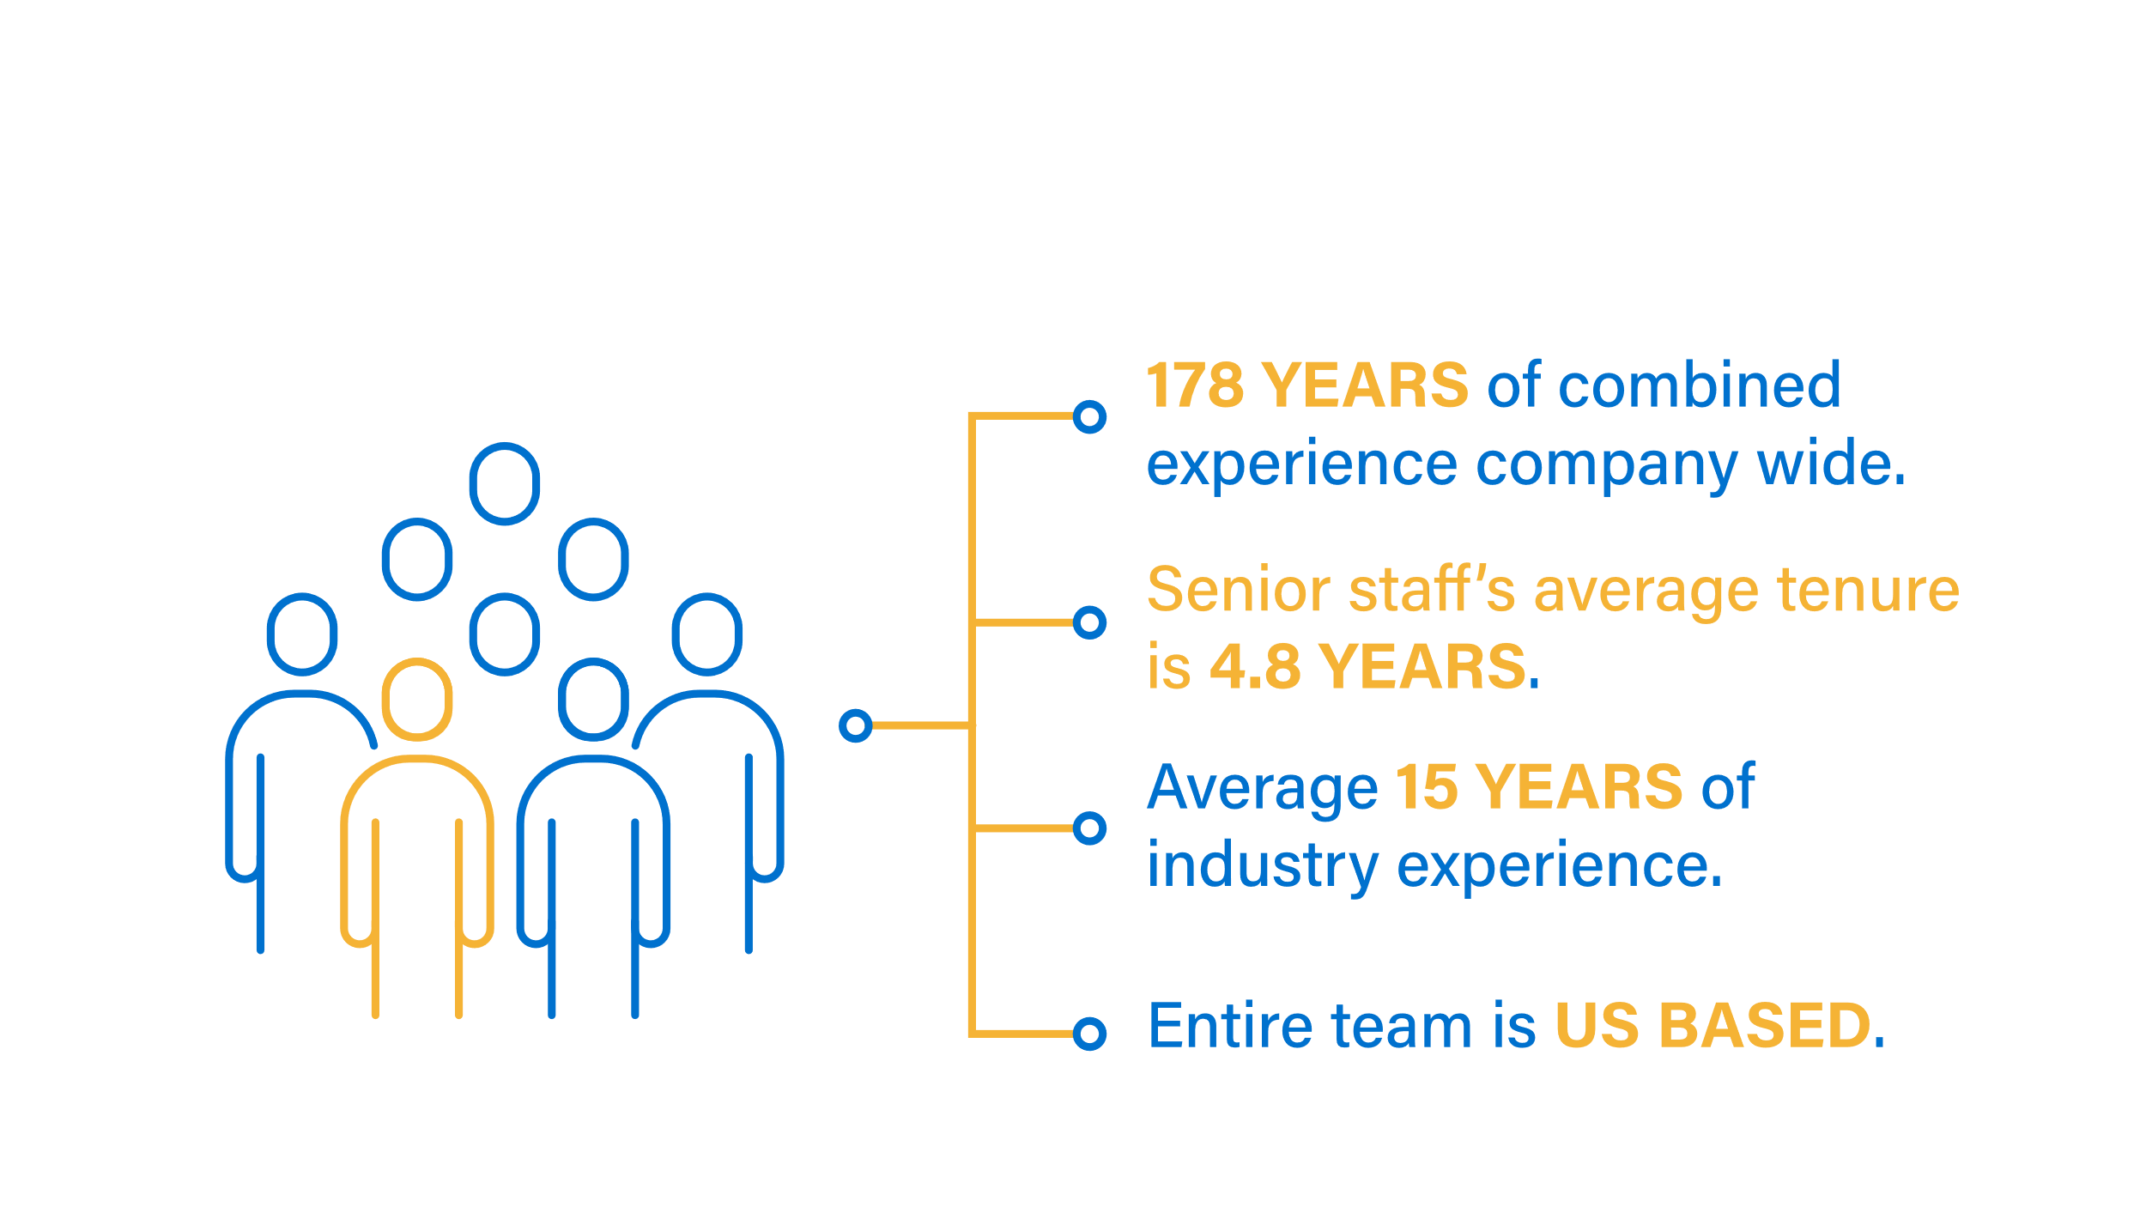
Team Stats

Slide 25
Legislative Updates
State-By-State

Slide 26

New Jersey Auto/PIP and Workers’ Compensation
EDI implementation timelines
September 1, 2019
New Jersey Auto/PIP
EDI LAW SENATE P.L.2017, C369
Auto/PIP EDI Law P.L. 2017, c369) approved January 2018 and currently in effect
November 1, 2019
Workers’ Compensation
EDI LAW SENATE P.L.2016, C64
Workers’ Compensation EDI Law P.L. 2016, c64
Approved May 2018 and currently in effect
Nothing prevents from earlier adoption of electronic bills transmission
Carriers retain right to investigate all claims within given timeframes as per current guidelines

Slide 27

New Jersey EDI Bills
Legislation Details
All Providers must submit electronic bills for Workers Compensation and Auto/PIP in accordance within the guidelines established pursuant to these acts
All Providers must submit Supporting Documents for Workers Compensation and Auto/PIP in order for the bill to be Accepted by a Carrier
Insurance carriers, medical management companies, and their third-party administrators must acknowledge receipt of a complete electronic medical bill to the sender of original bill

Slide 28

New York EDI Bills
Workers’ compensation REGULATIONS Details
Phase 1 – Voluntary Submission
  2019: providers may voluntarily transmit CMS-1500 medical bills, and required medical narratives, through an approved XML Submission Partner ("clearinghouse") to workers' compensation insurers/payers
Phase 2- Explanation of Benefits (EOB) Transmittal – TBD
  Carriers will electronically transmit EOB information it receives after adjudication and then CIC will transmit the EOB to the Provider at No Charge
  CIC will electronically transmit EOB information it receives after adjudication to the WC Board
Phase 3- Mandatory Submission – TBD
  Mandatory in 2020, The WCB will require electronic submission of the CMS-1500, supporting documentation and EOB data

Slide 29

Pennsylvania No-Fault Auto and
Workers’ Compensation
Jurisdictional billing requirements
All form types are accepted electronically based on payer capabilities
Mandatory EDI for:
  First Report of Injury (FROI)
  Subsequent Report of Injury (SROI)

Slide 30
Thank You
Sally Balioni
973-947-6588
sally.balioni@cariskpartners.com
www.cariskic.com

Slide 31
Thank You

