Slide 1

Summary Information for
New Jersey FamilyCare Providers
Geralyn D. Molinari
Director, Managed Provider Relations Unit
Office of Managed Health Care
NJ Department of Human Services
Division of Medical Assistance and Health Services

Slide 2

Presentation Topics
Overview of New Jersey Medicaid/NJ FamilyCare
Provider Relations Overview- DMAHS/OMHC
    Claims Submission
    Continuity of Care
    Appeals
2018-19 DMAHS Newsletters regarding Hospitals
Provider /Stakeholder Resources

Slide 3
What is Medicaid?
Medicaid is a joint Federal and State program that helps pay medical costs if individuals have limited income and resources or meet other requirements.
Medicaid is a voluntary program. If you want to participate, you must know, accept and abide by the rules and regulations
New Jersey Medicaid is referred to as NJ FamilyCare in member and provider communication

Slide 4
New Jersey Medicaid
Managed Care Contracts
The New Jersey Department of Human Services, DMAHS, has a contract with the following Managed Care Organizations:
  Aetna Better Health of New Jersey
  Amerigroup New Jersey, Inc.
  Horizon NJ Health
  UnitedHealthcare Community Plan
  WellCare Health Plans of NJ, Inc.

Slide 5

Administration & Oversight
The Medicaid program in New Jersey is administered and/or overseen by
Department of Law & Public Safety
Department of Human Services
Department of Treasury
Division of Criminal Justice
Division of Medical Assistance and Health Services (DMAHS)
Office of the State Comptroller
Office of the Insurance Fraud Prosecutor
Medicaid Fraud Division
(MFD)
Medicaid Fraud Control Unit
(MFCU)
Managed Care Organizations
(MCO)

Slide 6
Managed Care Organization
Provider Relations Unit Requirements
creating an annual provider manual and preparing updates as necessary;
offering provider education and outreach, and
provide a call center for claims troubleshooting for providers
establish process for claims and utilization appeals
assign Provider representative or contact to address Provider contract

Slide 7
Managed Care Organization
Claim Submission Requirements
Capture and adjudicate all claims submitted by providers
Support NJs NJ Family Care’s encounter data reporting requirements
Comply with "Health Claims Authorization, Processing and Payment Act“ (HCAPPA) for all Medical Services
Ensure Coordination of Benefits (exhaust all other sources of payment before NJ Family Care pays)

Slide 8
Claim Processing Compliance with Federal and State Laws and Regulations
1. The Provider/Subcontractor shall submit claims within 180 calendar days from the date of service.
2. The Provider/Subcontractor shall submit corrected claims within 365 days from the date of service.
3. The Provider and Subcontractor shall submit Coordination of Benefits (COB) claims within 60 days from the date of primary insurer’s Explanation of Benefits (EOB) or 180 days from the dates of service, whichever is later.

Slide 9
Claim Dispute
Adjudicate--the point in the claims/encounter processing at which a final decision is reached to pay or deny a claim, or accept or deny an encounter.
Contested Claim--a claim that is denied because the claim is an ineligible claim, the claim submission is incomplete, the coding or other required information to be submitted is incorrect, the amount claimed is in dispute, or the claim requires special treatment.

Slide 10
Prior Authorization Parameters
Prior authorization decisions for non-emergency services shall be made within 14 calendar days
Prior authorization denials and limitations must be provided in writing in accordance with the Health Claims Authorization Processing and Payment Act, P.L. 2005, c.352.
Source: Health Claims Authorization Processing and Payment Act, P.L. 2005, c.352.

Slide 11
Prior Authorization Guidelines for
NJ Family Care Services
New Member No Existing Plan of Care | Member Transitions to MCO with existing Plan of Care for LTCE
MCO must prior-authorize service | MCO must honor continuity of care parameter of contract
Provider must be in Network with MCO and/or have a single case agreement to serve member | MCO and Provider must set up SCA or join network. Approved services as per existing plan will be reimbursed until new plan of care established

Slide 12
Continuity of Care

Slide 13
Continuity of Care
Definition: The plan of care for an enrollee that should assure progress without unreasonable interruption
The Contractor shall ensure continuity of care and full access to primary, behavioral, specialty, MLTSS and ancillary care as required under this contract and access to full administrative programs and support services offered by the Contractor for all its lines of business and/or otherwise required under this Contract.
Source: Article 2.B of the July 2017 NJ FamilyCare Managed Care Contract
Notes:
If a change in Managed Care Organization or Fee for Service Enrollment occurs approved Custodial services with an active authorization will be honored for 60 days unless there is a change in treatment plan. (4.6.5. D 6)
The new contractor will visit the member within 45 calendar days of the members enrollment to review existing NJ Choice assessment (4.1.1.F)

Slide 14
Utilization Appeals

Slide 15
UM Appeal Process: Definitions
UM Appeal: An appeal of an adverse Utilization Management determination, initiated by the Member (or a provider acting on behalf of a Member with the Member’s written consent)
Utilization Management Determination: A decision made by a Managed Care Organization (MCO) to deny, reduce, suspend or terminate a service based on medical necessity

Slide 16
Utilization Appeals Guidelines for
NJ Family Care Services
 | IURO (External Appeal) Time Frame | Medicaid Fair Hearing | Continuation of Benefits
NJ FamilyCare A and ABP Members | Yes* | Yes | Member and/or Provider on behalf of member must request within appeal timelines
Appeal Process for NJFC B, C, and D Members | Yes | Not Available | Member and /or Provider on Behalf of member must request within appeal timelines
(Select services are not eligible for IURO: Adult Family Care, Assisted Living Program, Assisted Living Services, Caregiver Participant Training, Chore Services, Community Transition Services, Home Based Supportive Care, Home Delivered Meals, PCA, Respite, Social Day Care, Structured Day Program )

Slide 17
2018-19 DMAHS Newsletters regarding Hospitals
Volume 28 No. 20 November 2018
  Triage fee reimbursement for non-emergent emergency room visits
July 2019 MCO contract includes provisions for MCOs to implement
8.5.13 | Non-emergent Low Acuity Hospital Reimbursement Methodology | (new) The contractor shall implement a non-emergent low acuity hospital reimbursement methodology, utilizing the same parameters as the State implemented in its Fee-For-Service system in response to legislation signed into law June 2018, NJSA 30:4D-7p. The contractor may choose a less restrictive methodology but the methodology must be approved by the State prior to implementation
Notes:
Addresses provider inquiries and/or complaints as it relates to Managed Care Organization (MCO) contracting, credentialing, reimbursement, authorizations and appeals, and conducts complaint resolution tracking/reporting

Slide 18
2018-19 DMAHS Newsletters regarding Hospitals
Volume 29 No. 12 August 2019
  Diversionary Bed Update
  Regardless of insurance coverage N.J.A.C. 10:37G-21(h) requires that individuals who require long term hospitalization after inpatient treatment in a STCF may be transfered to a hospital that has a Diversion Contract.
Volume 29 Number 8 September 2019
  Introduction to Plan First-
  FFS only family planning program for individuals with income between 138% and 205 of FPL.
Volume 29 No. 15 October 2019
  Contract Procurement to Permedion, for NJ FamilyCare Utilization Review Audits
  Under the new Permedion contract, Permedion expanded the scope of the hospital UR audits to include MCO encounter records. Hospitals are required to respond to Permedion’s request for documentation and/or findings concerning reviewed encounter claims within the specified time periods.
Notes:
Addresses provider inquiries and/or complaints as it relates to Managed Care Organization (MCO) contracting, credentialing, reimbursement, authorizations and appeals, and conducts complaint resolution tracking/reporting

Slide 19
Resources for Providers and Stakeholders

Slide 20
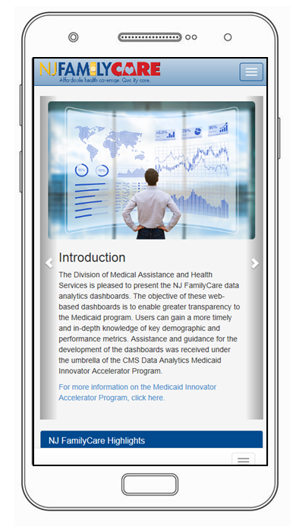
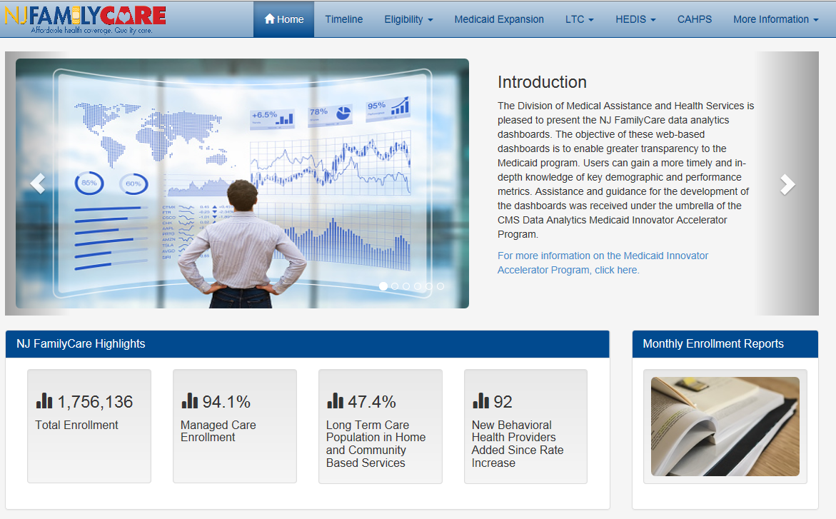
Mobile Friendly & Browser Independent

Slide 21
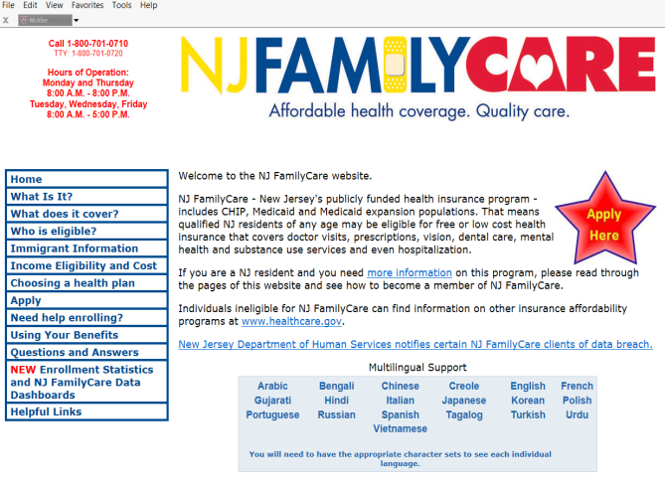
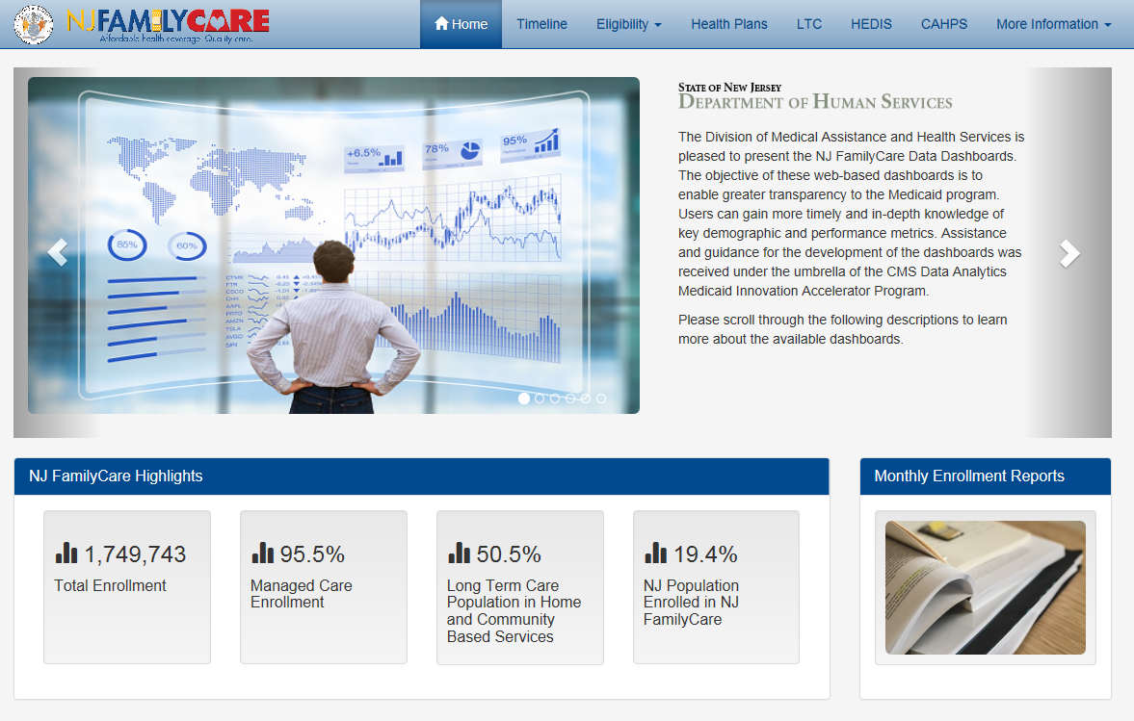

Link to Website with Enrollment informtion
http://www.njfamilycare.org
http://www.njfamilycare.org/analytics/home.html

Slide 22
DMAHS Office of Managed Health Care (OMHC)
Provider Relations Inquiry Process
Provider and/or Member contact DMAHS:
Provider must submit claim detail to DMAHS: Providers must submit detail indicating that Medicaid guidelines were followed and MCO was contacted prior to outreach to OMHC
  check eligibility
  request prior authorization,
  timely claim submission
  Submission of appeal timely
Member: Submits copy of balance bill
DMAHS will contact the MCO
Notes:
Addresses provider inquiries and/or complaints as it relates to Managed Care Organization (MCO) contracting, credentialing, reimbursement, authorizations and appeals, and conducts complaint resolution tracking/reporting

Slide 23
DMAHS Office of Managed Health Care (OMHC)
Provider Relations Inquiry Process
OMHC completes inquiry upon receipt of detail indicating that MCO contract guidelines were followed
OMHC will review and follow-up with MCO on behalf of the Provider if initial response does not meet contract guidelines. All inquiries sent to MCO are logged into a SharePoint database
Example: Claim inquiries are closed upon receipt of claim number and amount and /or letter to Provider.
Notes:
Addresses provider inquiries and/or complaints as it relates to Managed Care Organization (MCO) contracting, credentialing, reimbursement, authorizations and appeals, and conducts complaint resolution tracking/reporting

Slide 24
MCO Provider Relations Reporting
MCO Contracted Quarterly Report (Table 3C) includes all inquires submitted to MCO on behalf of Provider by the Office of Managed Health Care (OMHC)
DMAHS prepares a Quarterly Provider Inquires Report (Feb 15th, May 15th, Aug 15th and Nov 15th )
Quarterly Report documents all reported inquiries and identify inquiries that remain open beyond a designated quarterly period
Notes:
Addresses provider inquiries and/or complaints as it relates to Managed Care Organization (MCO) contracting, credentialing, reimbursement, authorizations and appeals, and conducts complaint resolution tracking/reporting

Slide 25
DMAHS Follow-up
Based on trends across plans and /or service types
  Develop Provider Education
  Develop policy guidance
  Develop contract changes / updates
  Present MCO Notices of Deficiencies or Corrective Action Plans if necessary

Slide 26
NJ FamilyCare MCO Resources
NJ FamilyCare Health Plans Currently Under Contract and Providing Medicaid Managed Care Services in New Jersey
https://www.state.nj.us/humanservices/dmahs/clients/medicaid/hmo/index.html
Member Relations- Access Member Manual
Provider Relations -Provider Quick Reference Guide

Slide 27
Access
State Resource for Managed Care Providers:
Office of Managed Health Care (OMHC)
Managed Provider Relations Unit
MLTSS Resources
http://www.state.nj.us/humanservices/dmahs/home/mltss_resources.html
Behavioral Health Resources
https://www.state.nj.us/humanservices/dmahs/news/ebhb.html
Form to submit inquiry is located by clicking on highlight
DMAHS Provider Relations Inquiry Information
Provider Relations Inquiry Request form – single case
Provider Relations Inquiry Request form – multiple cases
Email detail via secure email to mahs.provider-inquiries@dhs.state.nj.us
Separate emails should be sent for individual MCOs.
Multiple cases must include excel summary of information.

Slide 28

Questions

