Slide 1

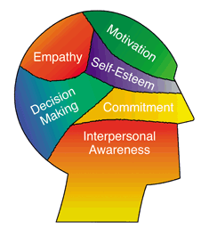
Emotional Intelligence Primer
Rich McLaughlin
McLaughlin Consulting Services
Rich@mclaughlincommunity.com

Slide 2
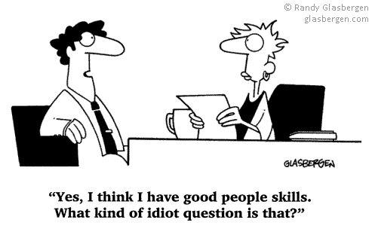

Slide 3


The World We’re In
World interconnectedness
System Complexity
System Predictability
People’s Anxiety

Slide 4
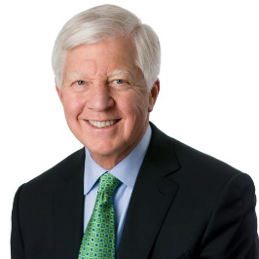
Opening Thought
“The most empowering leaders are those who engage a wide range of people. That means being with them face-to-face; inquiring about their work, their families, their personal lives, and their careers; and being open and vulnerable with them. This degree of intimacy with people they don’t know well makes some leaders uncomfortable, but it is a powerful means of establishing deeper connections.”
Bill George, former CEO
Medtronic

Slide 5
Low E.Q. Shows up as “Culture”
Tasks
Results
Outcomes
Tasks
“What”
Relationships
Relationships
Process
Listening
“How”
Culture

Slide 6
Where are we going?
Emotional Intelligence – what is it?
Coaching situations requiring high EQ
Final thoughts

Slide 7

Rich
shuts
down!

Slide 8


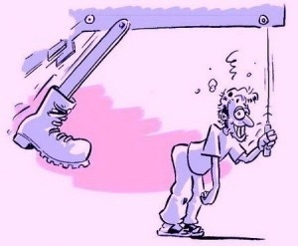


Emotional Intelligence
Self Awareness
You
Managing your emotions
Motivating oneself
Recognizing emotions
in others
Others
Social Skills

Slide 9
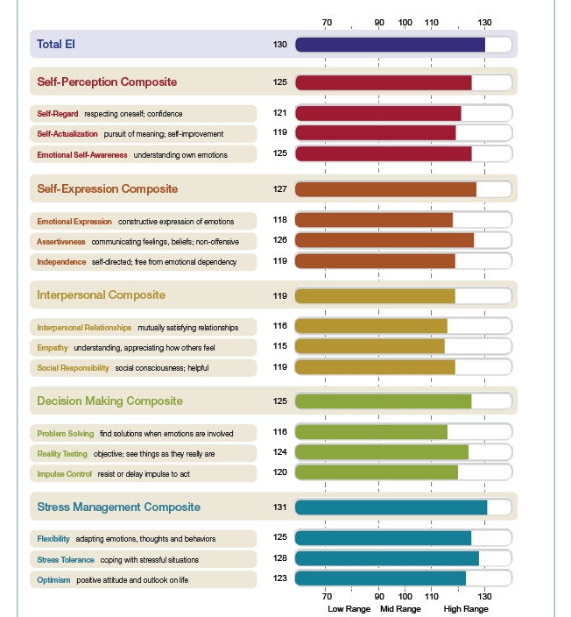
Self-Perception
EQi 2.0
Self-Expression
Emotional
Expression
Interpersonal Skills
Impulse
Control
Decision-Making
Empathy
Stress Management

Slide 10


Coaching Scenarios Requiring EQ
Coaching
in a new task
Coaching to
“check in”
Coaching
to confront
More “Task,”
Easier
More “Relationship,”
Harder

Slide 11
Empathy vs. Sympathy
Low
Ignoring
Pretend Listening
Energy
Required
Selective Listening
Relationship
Built
Attentive Listening
Empathy
Sympathy
High

Slide 12
Showing Caring without Caretaking
“Where do you want to
go with this?”
“What do you think is the
best thing to do?”
3)
Prompt to Action
2)
Get details
“Tell me more…
1)
Reflect Emotion(s)
“Sounds like…”
“I’m guessing that was…”

Slide 13
Coaching to “check-in” Practice
Find someone at your table you don’t know/know well
Take turns sharing a current situation challenging you
“Listener” no advice giving
  You can:
  Summarize
  Clarify
  Ask questions
  Empathize where appropriate
Take :15 total

Slide 14
Coaching Scenarios Requiring EQ
Coaching
in a new task
Coaching to
“check in”
Coaching
to confront
More “Task,”
Easier
More “Relationship,”
Harder

Slide 15
3 Good “Why’s” for Hard Conversations
1) Confront an incident or troubling pattern
2) Understand their story
3) Express your feelings

Slide 16
Demo

Slide 17
Hard Conversation Demo
Rich
shuts
down!

Slide 18

Hard Conversations – Process
Find a neutral location to have the conversation
1) Ask to collaborate “Help me with something…”
2) State your observations “This is the pattern I’m starting to see..”
3) Explain why it concerns you (impact on you, the team
and/or organization)
4) Ask if your “story” is legit “Is that fair?”
5) Wait for their response
Ready
to own?
Yes
Move to
problem-solving
No

Slide 19
Hard Conversations Practice
Same partners, decide who’s going first
Share some context so partner can “play the role”
Tryout the process
Ask for some feedback
Take :10 total

Slide 20
Phrases That Engage…
“Tell me more…”
“What do you guys think?”
“Help me understand that…”
“What don’t I know that I need to know?”
“Check my thinking on this. I want to make sure
I’m not overreacting…”

Slide 21
E.I. Summary
Pay attention (what’s going on in me?)
Listen with empathy
Follow HC structure:
  Ask for their help
  Describe don’t label
  Explain why it’s a concern
  Ask if your story/perception is “fair”

Slide 22
Commercial
1) Develop Leaders:
New Leader assimilations
Coaching and 360 Feedback
Leadership workshops
2) Accelerate Teams:
Team building
Exec Team Functioning
Styles and Strengths
Helping leadership
teams move their
change agenda forward!
3) Engage Employees:
Large (80+) group processes
Design/facilitate training
curriculum
Emotional Intelligence Primer
4) Innovation
Design Thinking
competencies
Managing change

Slide 23
Questions?

Slide 24


Closing Thought
“This is what emotional competence looks like at work. People honor their feelings as important data, and they talk about them with each other. When decisions are made in emotionally competent organizations, emotional data is treated as seriously as market studies, cost-benefit analysis and return on investment studies. We don’t choose one or the other, all are considered sources of critical data.”
~ Kay Gilley

Slide 25
Thank You!

Slide 27
Emotional Intelligence
Limbic
System
(I feel here)
I Think
Rationally
(way over here)
Spinal cord enters brain here
“Since our brains are wired to make us emotional creatures, your first
reaction to an event is always going to be an emotional one.”
~ T. Bradberry and J. Greaves, Emotional Intelligence 2.0

Slide 28
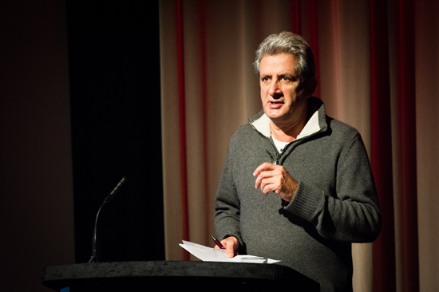
Closing Thoughts
"All businesses have one thing in common. They are made up of people. If you treat your people correctly, the business should operate more smoothly. This is true of all businesses, manufacturing and service alike, but it is particularly true of service industries, for human beings are the most critical element.”
Andy Law
Founder, St. Luke’s
Advertising Agency

Slide 29

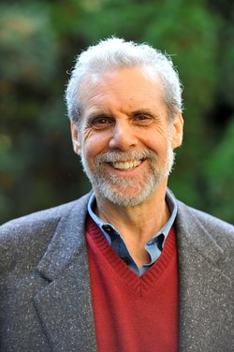
Opening Thought
“The best bosses are people who are trustworthy, empathic, and connected, who make us feel calm, appreciated and inspired. People who feel their boss provides a secure base, are more free to explore, be playful, take risks, innovate and take on new challenges. And if leaders establish such trust and safety, then when they give tough feedback, the person receiving it not only stays more open but sees benefit in getting even hard to take information.”
~ Daniel Goleman, Harvard

Slide 30

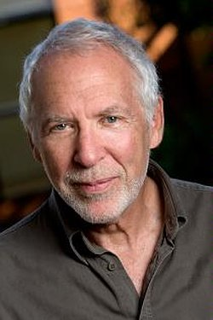
Emotional Intelligence
“A critical task of leadership is to protect space for the expression of people’s doubts. The act of surfacing doubts and dissent does not deflect the communal intention to create something new. What is critical, and hard to live with, is that leaders do not have to respond to each person’s doubts. All we have to do with the doubts of others is get interested in them. We do not have to take them on or let them resonate with our own doubts.”
~ Peter Block

Slide 31
Emotional Intelligence
To what degree is it ok to
express doubts here?

Slide 32

9 Potential Hard Conversations
5) Boss
3) Supplier
2) Peer
4) Customer
6) Neighbor
7) In law
8) Family member
9) Spouse
1) Direct
Report

Slide 33
When Giving Tough Feedback…
Check your intent (if it is to “get even” or take someone down a notch, don’t do it)
Be specific (“you didn’t do a very good job” or even the positive “you did a great job!” is not very helpful)
Describe vs. label (“I was getting frustrated when you interrupted Maria for the 3rd time in our meeting this morning”… is better than “Why were you so rude to Maria today?”)

Slide 34
When Receiving Tough Feedback…
Make sure you are ready
Summarize to confirm your understanding (you don’t have to agree, but you should at least make sure you understand how the other person perceives things)
Treat it like a gift (say “thanks” if their intention was to help and remember you get to decide what to do with the gift)

