Slide 1

Site of Administration for
Infusion & Injectable Prescription Medications
Michelle Merchant
Manager, Hospital Relations, Horizon BCBSNJ
Presented March 21, 2018 to the American Association
of Healthcare Administration Management
Proprietary & Confidential

Slide 2
Background
Horizon BCBSNJ Medical Injectables Program (MIP)
As part of our commitment to providing our members with access to high-quality health care that is consistent with nationally recognized clinical criteria and guidelines, Horizon BCBSNJ implemented a Medical Injectables Program (MIP) in 2013.
Through this program, Magellan Rx Management (MRxM), conducts medical necessity and appropriateness reviews of certain intravenous/injectable medications on our behalf and in accordance with our Medical Policy criteria and guidelines.
Since 2013, Ordering Physicians have contacted MRxM and provided information for them to review and make determinations about injectable medications to be administered in:
  A freestanding or hospital-based dialysis center
  An outpatient facility
  A physician’s office
  The patient’s home

Slide 3
Policy Details
Site of Administration for Infusion & Injectable Prescription Medications
On February 5, 2018, Horizon BCBSNJ announced the coming implementation of a new medical policy to be implemented on May 7, 2018.
This policy the medical necessity of the administration of certain infusion and injectable prescription drugs in a hospital outpatient setting.
infliximab (RemicadeTM)
infliximab-dyyb (InflectraTM)
infliximab-abda (RenflexisTM)
infliximab-qbtx (IxifiTM)
tocilizumab (ActemraTM)
certolizumab pegol (CimziaTM)
abatacept (OrenciaTM)
vedolizumab (EntyvioTM)
golimumab (Simponi AriaTM)
ustekinumab (StelaraTM)

Slide 4
Policy Details
 | infliximab | tocilizumab | certolizumab pegol | abatacept | vedolizumab | golimumab | ustekinumab
Rheumatoid Arthritis | X | X | X | X |  | X
Psoriatic Arthritis | X |  | X | X |  | X | X
Crohn’s Disease | X |  | X |  | X |  | X
Ankylosing Spondylitis | X |  | X |  |  | X
Ulcerative Colitis | X |  |  |  | X
Plaque Psoriasis | X |  |  |  |  |  | X
Uveitis Associated with Behcet’s Syndrome | X
Polyarticular Juvenile Idiopathic Arthritis |  | X |  | X
Systemic Juvenile Idiopathic Arthritis |  | X
Giant Cell Arteritis |  | X
Refractory Granulomatosis with Polyangiitis | X (off label)
NHL - Castleman's Disease |  | X (off label)

Slide 5
Policy Guidelines
According the guidelines of this policy, hospital outpatient administration of these infusion and/or injectable drugs is considered medically necessary for up to a 60-day duration for:
Initial treatment of patients new to this type of treatment, or
Patients re-initiating therapy after a period of at least six months of discontinuation of therapy unless a patient meets certain criteria as identified in the medical policy.

Slide 6
Policy Guidelines
According the guidelines of this policy, hospital outpatient administration of these infusion and/or injectable drugs is considered medically necessary for 6 months when all of the following are present:
Inherent complexity of the infusion is such that it can be performed safely & effectively
only by or under the supervision of physician; AND
Immediate access to services within a hospital setting is necessary because the patient is at significant risk of sudden life-threatening changes in medical status based on clinical conditions including, but not limited to:
Intolerable fluid overload, including impaired or unstable renal function, or
History of anaphylaxis to prior infusion therapy with a related pharmacologic or biologic agent despite standard premedication, or
Acute mental status/cognitive changes or physical impairment AND no home caregiver available; or
Vascular access not stable; or
Documented clinical history of cardiopulmonary conditions that may cause an increased risk
of severe adverse reactions; or
The member does not have access to home infusion AND the hospital-outpatient center is
45 miles closer (no more than 60 min. away) than the nearest office based provider who can provide that service OR
The prescribed drug has a site-of-administration restriction based on the FDA-approved label.

Slide 7
Policy Scope
This new policy applies to Horizon BCBSNJ members who reside in New Jersey & who receive outpatient services at a Horizon Network Hospital.
This policy will not apply to patients enrolled in:
BlueCard® plans
Federal Employee Program®
Horizon NJ Health plans
[Medicaid Managed Care, NJ Family Care, Horizon NJ TotalCare (HMO SNP), Managed Long Term Services and Supports program]
Medicare Advantage plans, including State Health Benefits Program Medicare Advantage (MA) PPO

Slide 8
Authorizations & Claims
Ordering physicians are responsible for submitting requests to Magellan Rx Management for patients to receive one of these infusion/injectable drugs in a hospital outpatient setting.
MRxM will review the request and determine the medical necessity of both the infusion/injectable drug and the site of that drug’s administration.
Hospitals at which a patient is seeking to have one of these infusion/injectable drugs administered should ensure that a MRxM authorization has been approved.
Claims received for services without an authorization on file will pend while MRxM requests & reviews information from the rendering physician to conduct a medical necessity review.
Authorizations of injectable medications that are approved before the May 7, 2018 effective date of this policy will be honored through the period approved.

Slide 9
Questions
Questions?
You ask …
I’ll answer.
Proprietary & Confidential

Slide 10
Contact Information
Michelle Merchant
Manager of Hospital Relations, Horizon BCBSNJ
Phone: 1-973-466-4048
Email: michelle_merchant@horizonblue.com
Horizon Blue Cross Blue Shield of New Jersey is an independent licensee of the Blue Cross and Blue Shield Association.
The Blue Cross® and Blue Shield® names and symbols are registered marks of the Blue Cross and Blue Shield Association.
The Horizon® name and symbols are registered marks of Horizon Blue Cross Blue Shield of New Jersey.
© 2018 Horizon Blue Cross Blue Shield of New Jersey. Three Penn Plaza East, Newark, New Jersey 07105.
Proprietary & Confidential

Slide 11
Blue Distinction Specialty Care
Blue Distinction Centers (BDC & BDC+)
Michelle Merchant
Manager, Network Hospital Relations
Horizon BCBSNJ

Slide 12
What is a Blue Distinction Center (BDC)?
Blue Distinction® is a designation awarded by the
Blue Cross and Blue Shield Association (BCBSA) to participating facilities that have demonstrated expertise in delivering quality healthcare.
The goal is to help consumers find quality specialty care on a consistent basis, while enabling and encouraging healthcare professionals to improve the overall quality and delivery of care nationwide.
Blue Distinction Specialty Care program started in 2008.

Slide 13
Blue Distinction Center (BDC & BDC+)
In February 2013, the BCBSA announced a program expansion.
In this updated designation process, facilities may be recognized as either:
    Blue Distinction Center
    Meets quality-focused criteria that emphasize patient safety
    and outcomes.
    Blue Distinction Center+
    Meets the same quality-focused criteria that emphasize patient safety and outcomes, as well as cost-of-care measures.

Slide 14
Blue Distinction Center Specialty Care Programs
BDC and BDC+ Specialty Care Programs are offered in:
  Bariatric Surgery
  Cancer Care
  Cardiac Care
  Knee and Hip Replacement
  Maternity Care
  Spine Surgery
  Transplants

Slide 15
Benefits of Blue Distinction Center Designation
There is a significant value to facilities that earn this designation:
Market Differentiation
Enhanced Patient Preference
Recognition Among Employers
Increased Physician Referrals
Ability to Benchmark Performance
Participating Provider Recognition

Slide 16
Overview of the Designation Process
The Designation Process consists of 3 key components:
  Application/Survey completion
  Feedback Report with Designation Eligibility
  Execution of BDC Agreement

Slide 17
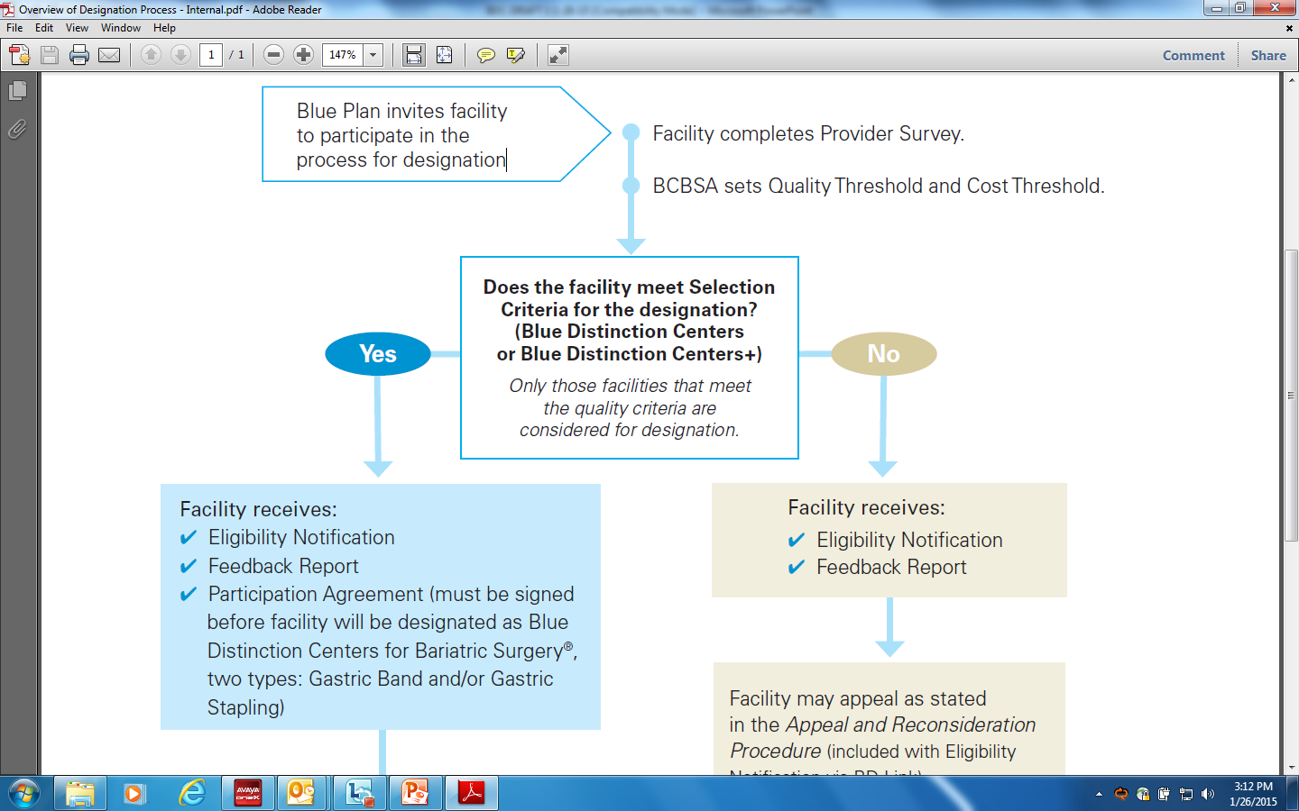
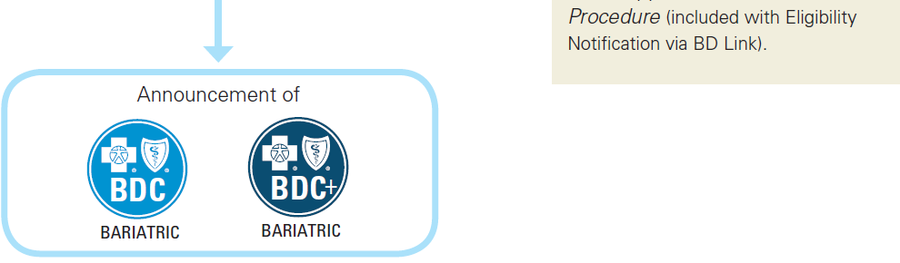
Overview of the Designation Process

Slide 18
Evaluation Components for Designation
The following evaluation components are used to identify facilities that meet the program’s selection criteria.
  Quality
  Business
  Cost of Care

Slide 19
Evaluation Components for Designation
Quality
Blue Distinction Centers for Specialty Care programs establish a nationally consistent approach to evaluating quality and safety, by incorporating quality measures with meaningful impact, with criteria that evolve over time with medical advances in that specialty area.

Slide 20
Evaluation Components for Designation
Business
The following components are evaluated to determine if the facility and its program meet the business selection criteria.
  Facility is a participating provider in the local Blue Plan’s BlueCard Preferred Provider Organization (PPO) Network.
  All surgeons who perform surgeries at the facility are participating providers in the local Blue Plan’s BlueCard PPO network.

Slide 21
Evaluation Components for Designation
Cost of Care
The process to incorporate cost of care measures into the program’s selection criteria is designed to provide a nationally consistent, reasonable, objective evaluation. The following components are evaluated to determine if a facility meets the
cost efficiency criteria:
  Cost Data Source
  Risk and Geographic Adjustments
  Deriving a Cost Measure and Setting the Cost Threshold
  Use of Facility-level Cost Information

Slide 22
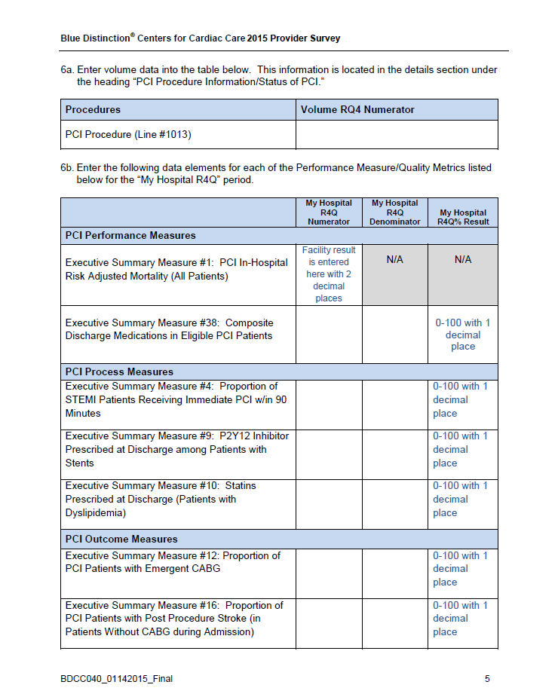
Sample Application/Survey

Slide 23
Components of the Feedback Report
Each facility that applies for the BDC/BDC+ designation receives a feedback report with valuable performance information.
The feedback report creates a foundation for internal discussions within the hospital’s executive management team or medical staff to assess and improve the facility’s quality and cost performance in comparison to national benchmarks.

Slide 24
Components of the Feedback Report
The report has five sections:
Summary of Eligibility Decisions - High level summary of results, to help you understand if your facility met the selection criteria to be considered a BDC
Descriptive Overview of Quality Selection Criteria - Descriptive summary of the types of metrics used in the evaluation process.
Quality Selection Criteria - Detailed summary of results, to help you understand how your facility performed on the quality metrics. A facility must meet all quality and business selection criteria to be considered eligible for designation as a Blue Distinction Center
Business Selection Criteria - Information on Facility Participation, Surgeon Participation and local Blue Plan Criteria, if applicable. A facility must meet all quality and business selection criteria to be considered eligible for designation as a Blue Distinction Center.
Cost of Care Selection Criteria - Summary of results, to help you understand if your facility met the cost of care selection criteria. A facility must meet all quality, business and cost of care selection criteria to be considered eligible for designation as a Blue Distinction Center+.

Slide 25
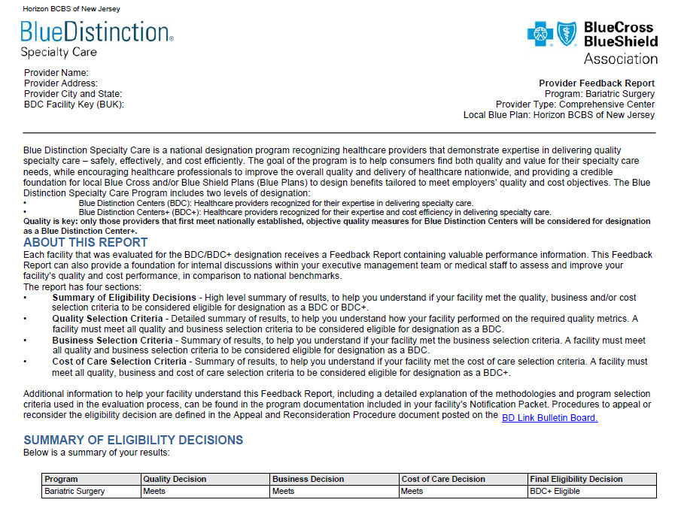
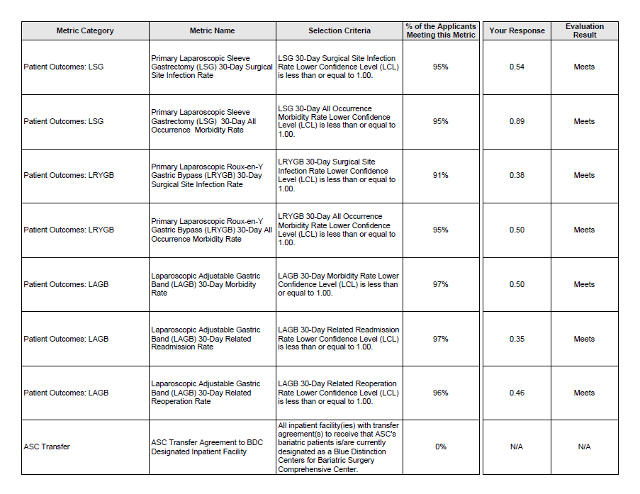
Sample Feedback Report

Slide 26
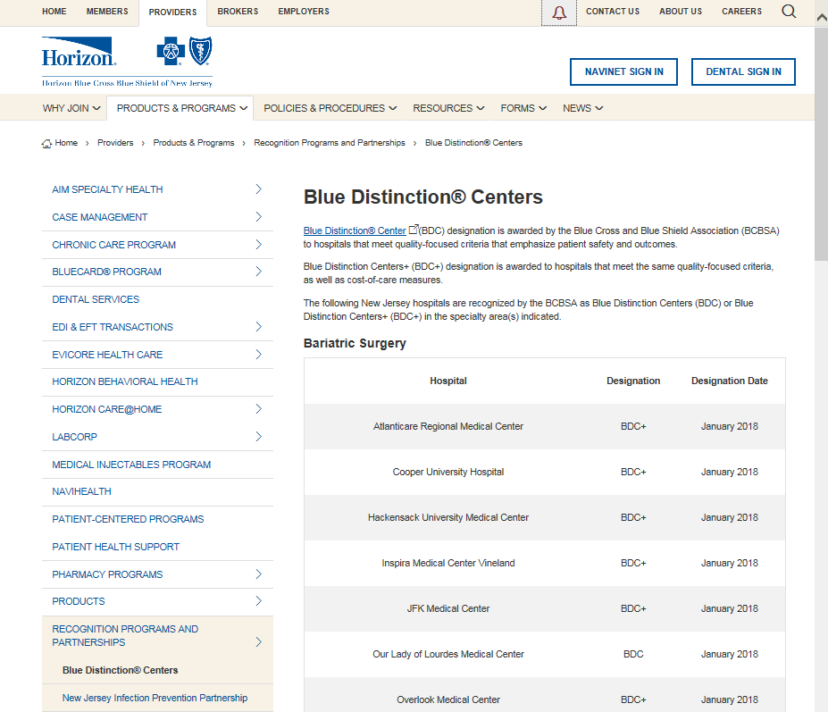
Horizon BCBSNJ’s BDC/BDC+ Network Hospitals

Slide 27
BDC Hospital and Specialists Match
  Bariatric Surgery
AtlantiCare Regional Medical Center
Alexander Onopchenko
Samir Patel
Lucian Panait
Cooper University Hospital
Brendan O'Connell
Rohit Patel
Hackensack University Medical Center
Sebastian Eid
Douglas Ewing
Hans J. Schmidt
Toghrul Talishinskiy
Amit Trivedi
Inspira Medical Center
Ahmed Attia
Naveed Iqbal
Derek Stephenson

Slide 28
BDC Hospital and Specialists Match
  Bariatric Surgery (continued)
JFK Medical Center
Alexander Abkin
Mikhail Botvinov
Aram Jawed
Anish Nihalani
Our Lady of Lourdes Medical Center
Mark A. Salcone
Overlook Medical Center
Robert Bell
James Lopes
The Valley Hospital
Melissa Bagloo
Vadim Gritsus
University Medical Center of Princeton at Plainsboro
Wai Yip Chau
Yelizaveta Dobruskin

Slide 29
BDC Hospital and Specialists Match
  Cardiac Care
Hackensack University Medical Center
Irfan Admani
Arvind Agarwal
Paul Andrews
Stephen Angeli
Thomas Cocke
Michael Cohen
Felix Dailey-Sterling
Gabriel Diluozzo
Leonardo Divagno
Haroon Faraz
Neil Goyal
Kamran Hamirani
Omar Hasan
Syed Husain
Umesh Katdare
Dennis Kelly
Steve Kim

Slide 30
BDC Hospital and Specialists Match
  Cardiac Care (continued)
Hackensack University Medical Center
David Landers
Joel Landzberg
Edward Julie
John Luizzo
Angel Mulkay
Rajeev Narayan
Ankitkumar Patel
Kumar Satya
Fernando Segovia
Evan Sehgal
Virender Sethi
Rajiv Singh
Bruce Skilnick
George Stoupakis
Tariqshah Syed
Stanley Szwed
Pranaychangra Vaidya

Slide 31
BDC Hospital and Specialists Match
  Spine, Knee & Hip
AtlantiCare Regional Medical Center
Frederick Dalzell
Joseph Harhay
Alvin Ong
Fabio Orozco
Zachary Post
Richard Rothman
University Medical Center of Princeton
at Plainsboro
Harvey Smires
Jeffrey Abrams
Hari Bezwada
W. Thomas Gutowski
Michael Jolley
Melan Patel
Mark Pressman
Frederick Song
David Lamb
Ronniel Nazarian
Nirav Shah
Brian Vannozzi

Slide 32
BDC Hospital and Specialists Match
  Spine, Knee & Hip (continued)
Virtua Memorial Hospital
of Burlington County
Orin Atlas
Gerald Hayken
James Sanfillipp
Virtua - West Jersey Health System (Marlton)
Jeffrey Daniels
Robert Greenleaf
Michael Harrer
Michael Levy
Todd Lipschults
Thomas O'Dowd
Joan O'Shea
Mark Reiner
Craig Rosen
Larry Rosenberg
Tariq Siddiqi
Mark Sobel
Merrick Wetzler

Slide 33
BDC Hospital and Specialists Match
  Transplants
Hackensack University Medical Center
Michele Donato
Alfred Gillio
Jennifer Krajewski
Andrew Pecora
Scott Rowley
Allen Skarbnik
David Vesole
Notes:
Steve Kim David Landers Joel landzberg Michael Cohen Edward Julie John Luizzo Angel Mulkay Rajeev Narayan Ankitkumar Patel Kumar Satya Fernando Segovia Evan Sehgal Virender Sethi Rajiv Singh Bruce Skilnick George Stoupakis Tariqshah Syed Stanley Szwed Pranaychangra Vaidya Gabriel Diluozzo

Slide 34
Questions:
You ask …
We’ll answer.

Slide 35
Contact information
Michelle Merchant
Manager of Hospital Relations, Horizon BCBSNJ
Phone: 1-973-466-4048
Email: michelle_merchant@horizonblue.com
Horizon Blue Cross Blue Shield of New Jersey is an independent licensee of the Blue Cross and Blue Shield Association.
The Blue Cross® and Blue Shield® names and symbols are registered marks of the Blue Cross and Blue Shield Association.
The Horizon® name and symbols are registered marks of Horizon Blue Cross Blue Shield of New Jersey.
© 2018 Horizon Blue Cross Blue Shield of New Jersey. Three Penn Plaza East, Newark, New Jersey 07105.

