Slide 1


Slide 2












Notes:
THANK YOU
Executive Coach: working 1 on 1 with senior level managers, officers, physicians and leaders to create high performing low stress outcomes
Strategic Alignment work creating Organizational Awareness
Work with organizations and their Teams to create Happy, Low Stress work environments.

Slide 3
Allow me to Introduce Myself…
Notes:
If I could give you one picture that helps you know me the best…this is it.
Brylcream: “a little dab will do ya.
“Raise you right hand and repeat after me. “I state you name in full. Do hereby give Kevin permission to come out and play and generally have a good time…”
THERE IS A LITTLE BOY & GIRL STILLINSODE OF YOU.

Slide 4
And My Wife…Debbie
Notes:
Makes me tell you that the kitty survived.
You would like me more if she was here.
I’m so in love with you…
LAUGH EXERCISE: 1.2.3 laugh like yoo just heard the funniest thing yo have ever heard.

Slide 5
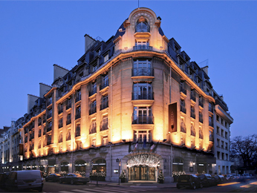
“You’ve Been Upgraded”
Paris! The Eiffel Tower! The Food!
Notes:
Introduction
Start by telling you “y’all” a story. My wife and I had the good fortune of taking a trip to Paris, France (not Tennessee) a few years ago.
A friend of ours had a 35% off coupon to the Hotel Sofitel and gave it to us. Called the hotel and ended up booking a room on the outskirts of Paris as downtown was way beyond our budget. The Hotel Sofitel at the Arc de Triumphe was $800 a night. So, we get the room @ $140US/night or $91 with coupon! I’m happy.
We booked our flight in coach but later than I should have. Still, the bulkhead was available and I’m happy…room to stretch out.
2-3 weeks before our trip the Hotel Sofitel calls.
“We are so sorry. The Hotel you have booked is undergoing renovation. It is not available. You may pick from any of our other hotels and that have availability we will honor your rate even if it is more expensive.
I said…Arc de Triumphe available? “Yes sir.” We’ll take it.” They said, “Yes sir you can have that room for $140/US a night.” I said, “I have a 35% off coupon.
Weeks later we’re on our way. As we board the plane heading to our coach seats…
A couple with their crying baby is being told that they cannot stay in Business class. They are angry. Being the big hearted guy that I am I offer our coach but bulkhead seats to them. “It’s not business class but there is room for your bags, your child…probably the best you’ll find in coach.” The stewardess said it was “OK”. Done.
As this deal is transacted and as my wife recalls, we overhear a conversation between a steward and 2 passengers at the bottom of the spiral staircase leading to first class. The elderly lady of this couple was uncomfortable navigating the staircase and asked they be seated in Business class. The stewardess who had helped us previously joined that conversation and then I interjected, “It just so happens that we have 2 seats in Business Class and if you would like to trade with us then it would be our pleasure.” First Class here we come.
We arrive at the Hotel. It’s a palace.
As we get out of the car, the doorman walks up…Mr & Mrs. McDaniel, Welcome to the Hotel Sofitel.” To Debbie I say, “How do they know our names?”
We walk in the door… “Mr. McDaniel, how was your trip?” “It just keeps getting better.”
Bellman before I have checked in…”May I take your bags up to your room?” “Sure”.
The concierge then escorts us over to Pierre at the wine bar and he has already mixed his award winning creation which we accepted…or course, there was no charge.
How do you think we were feeling about our trip to Paris? Let me tell you.
We felt like royalty.
Better treated by far than we were expecting.
Facts was: Upgraded service all along the way.
Helped to the point where we had nothing else for which to ask.
Overwhelmed by the unexpected even unimagined good service.
We were the most important people who walked in that hotel that day.
Ever been in someone’s presence that made you feel better just because you were in their presence?
They did something for you that was meaningful but also difficult for you to “get” exactly what they did.
Maybe they were a very upbeat person and it just kind of spilled over on you.
Possibly, they were happy-go-lucky and were like a black hole for your stress and furrowed brow.
Conceivably, they were just funny and brought a smile to your face but more importantly they did something for you on the inside.
Perhaps, they communicated something more profound like a sincere concern for your well being.
Regardless, you… got it.
You caught it
Sought it
Bought it and with a few people you may have even
Fought it
However, you gained something meaningful from their presence, their convictions about life and it was awesome.

Slide 6
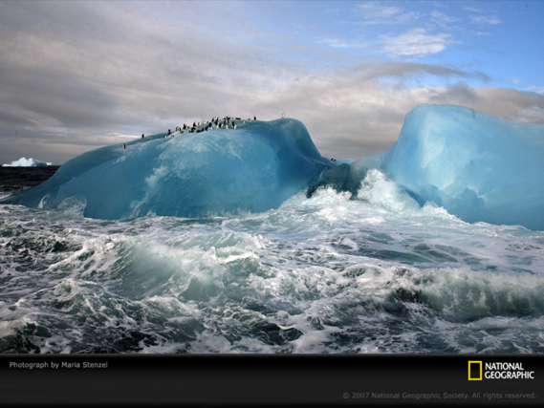
Giving You An Opportunity To:
Be Happier in 45 minutes & 21 Days
Gain Insight Into Who You Are:
  Choice Theory,
  Internal Dialogue
Use simple QUANTUM TOOLS
Notes:
Senator Tom Daschle at Senior Assisted Living home and trying to get a response and was getting frustrated. Don’t you know who I am, the power I have and what I can do for you? No response. Does anyone know who I am? Older man at front of the room says, “Young fella…if you ‘ll go up to the nice lady at the front desk and ask…she’ll tell you who you are.”

Slide 7
INSIGHT INTO
MOTIVATION & INFLUENCE
CHOICE VERSUS CONTROL
Notes:
We are not creatures of circumstance. We are creators of circumstances.

Slide 8
The Two Psychologies
Understanding Control
Consider: The seeds of almost all our unhappiness are planted when we encounter people who have discovered not only what is right for them…but what is, also, right for us.
  Corollary: Almost all “unsolvable” human problems are relationship problems.
The Operational Premise: Inject external control, punish the people who are doing wrong, so they will do what we say is right: then reward them, so they keep doing what we want them to do.

Slide 9
The Two Psychologies
Descriptions of Control
External Pressure & Demand
“Naturally” Coercive
“Trying to force me”
Disapproval (a disapproving glance)
“I feel threatened”
Damages personal freedom
“Bulldozes” personal boundaries

Slide 10
The Two Psychologies
Understanding Choice
Consider: Choice explains that for all practical purposes, we choose everything we do including the misery we feel.
  Corollary: Other people can neither “make us” miserable nor happy. They simply give us information that we process and then decide what to do.
The Operational Premise: Embrace internal control by understanding why and how we make choices that determine a course for our lives. (NGO)
Notes:
NGO is about creating what you want to create. It’s about expanding your opportunities to CHOOSE and build the life or life experience that you want.
Have handout for everyone.

Slide 11
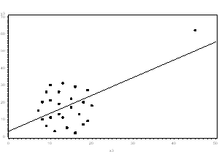
Psychology
& The Addiction to Normal
Notes:
Here I have graphed bogus data to demonstrate scientifically the point I am getting ready to make.

Slide 12

How do we make the Outlier…Normal?

Slide 13
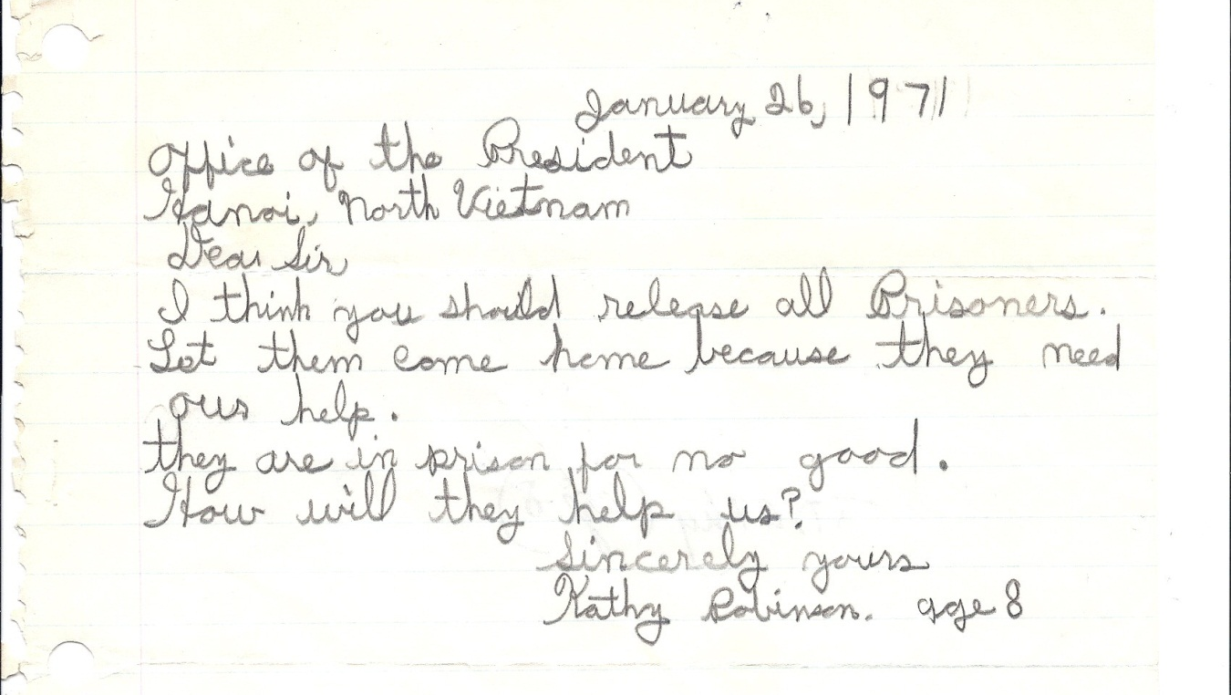
She Started With Dreams…Then Lost Them
Sent this to me the following day.
Notes:
Client in Los Angeles:
Felt stuck in her job
Always struggling with money
Worked on Being present, Living in the NOW…
recognized she had a JUDGE & DREAMER at battle inside of her and the JUDGE was winning.
Was never just enjoying life
Next day she sent this in an email to me…I want to dream again.
Coaching her husband:
“Never make more than $60K
2 years later he is on pace to triple his income.
HOW? Overcame his “constraints to growth”. Changed his story or internal narrative.

Slide 14
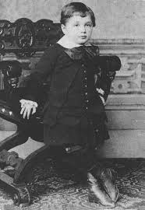
High School Drop Out at 15.
Perfect!
Notes:
I propose to you that none of us would recommend for this kid was exactly what he needed to BE who he was to BECOME!

Slide 15
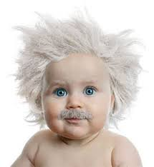
Who Is He?
At 23…Administrative Clerk

Slide 16
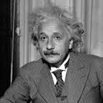
When He Started He Was No Einstein…

Slide 17
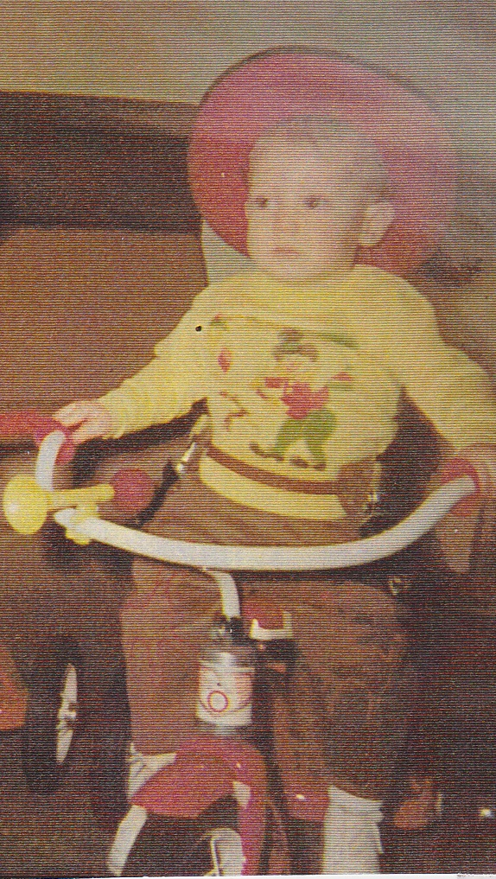
This is your big tough intimidating “Boss”
Notes:
Have a “tough boss”… a story may be getting in your way.
He was once “Cowboy Dave”…and still may be.
Recently a Financial Healthcare Executive was FRUSTRATED…Can you believe that?
Was making presentation for needed software the CEO was denying.
There had been some conflict.
Exec was Blue-Green, CEO was Red-Yellow
We designed a Red-Yellow Presentation… every one is happy and back on the same team again.

Slide 18
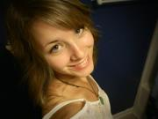
Met Kat at Barberitos…Last Year
Notes:
Wants to be successful so that her dad will know that at least one of his kids has done something with their life.
Have her permission for all of this.

Slide 19
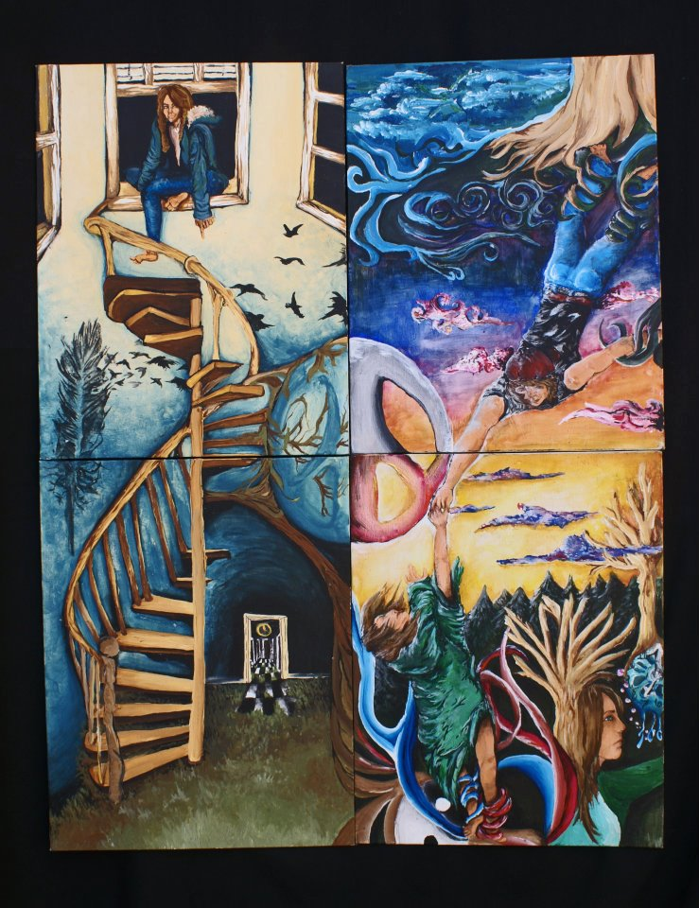
Kat wants to be a “success someday”…I think She is…NOW!
What do you think?
Notes:
Does this work show talent?
I think she is a success now. Still needs and wants training but she does not have to wait to feel “successful”.
She can feel this all along the way.
BTW, I told her what I was going to do and she said… “I think I’m going to cry” (flapping with her hands)

Slide 20
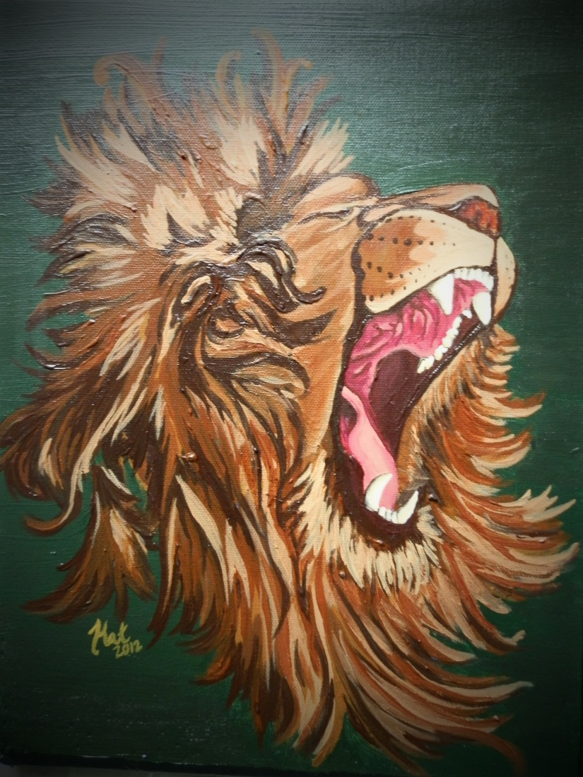
She wants to make her Dad proud.
Notes:
Drew and painted this from a picture

Slide 21
Our Internal Narrative, Language & Beliefs
Create Our Experience
“Patternize” Our Responses
Get us Stuck or Create Adventure
Open us to POSSIBILITIES

Slide 22
Positive Psychology
External world does not predict happiness. How wealthy you are does not predict happiness.
Traditional Success Model: Have…Do…Be Successful
Current Science of Success: BE HAPPY…Do…Have
75% of job success predicted by “how positive” we are. (Hom & Arbuckle, 1988)
We are more intelligent when we are happy (Estrada, Isen & Young, 1997)
  When happy dopamine is released that sustains feelings of happiness and “TURNS ON” learning centers of the brain.

Slide 23
When we are happy…
(Lyubomirsky, 2005; Losada 1999; Fredrickson, Branigan, Kaufman 2003)
Better at keeping our job
Superior productivity by 31%
37% Better at sales
19% Increase in physician performance
More resilient
Less burnout
Less turnover
Increase in immune function

Slide 24
When we are happy…
(Lyubomirsky, 2005; Losada 1999; Fredrickson, Branigan, Kaufman 2003)
Enhanced creativity
Expands ability to build competencies
Primes cognitive flexibility, speed and accuracy
Improves Team Function (High functioning teams had a 3 to 1 ratio positive to negative)
Improves employee “bounce back” after criticism
Clarifies difference between “flourishing” and “languishing” corporate teams

Slide 25
Complete These Thoughts
Peanut Butter and _________.
Scrambled Eggs and ________.
Cookies and __________.
Steak and __________.
Let’s go a step further.
Notes:
Must be intentional to break out of the pack.

Slide 26

Mind Freak

Slide 27
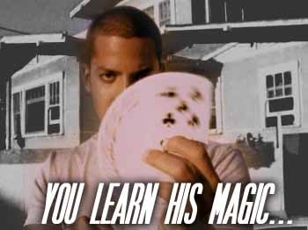
David Blaine…Street Magic

Slide 28

The Great Karnac Knows All!
Notes:
WE HAVE PATTERNS IN HOW WE SEE THINGS.
7,9, 53, 68, 101, 27, 34
Write down the first color that comes to your mind?
RED…..Blue, green, yellow
27, 78, 93, 6, 61, 5, 24
Write down the first piece of furniture that comes to mind?
Chair, sofa, bed, table
Draw a picture of a flying horse?

Slide 29
Increasing the Level Of Difficulty
I am going to predict your answers to two questions.
I am going to recite a series of numbers that I want you to write down and then I am going to ask you a question.
We will do this twice.
Notes:
7,9, 53, 68, 101, 27, 34
Write down the first color that comes to your mind?
RED…..Blue, green, yellow
27, 78, 93, 6, 61, 5, 24
Write down the first piece of furniture that comes to mind?
Chair, sofa, bed, table
Draw a picture of a flying horse?

Slide 30
The Possibilities
How many colors are there?
Unlimited
Your computer displays 16.8 million colors.
The human eye can distinguish about 10 million.
How many furniture items are there?
Limitless…
How many types of trees are there?
How many types of covering are there?

Slide 31
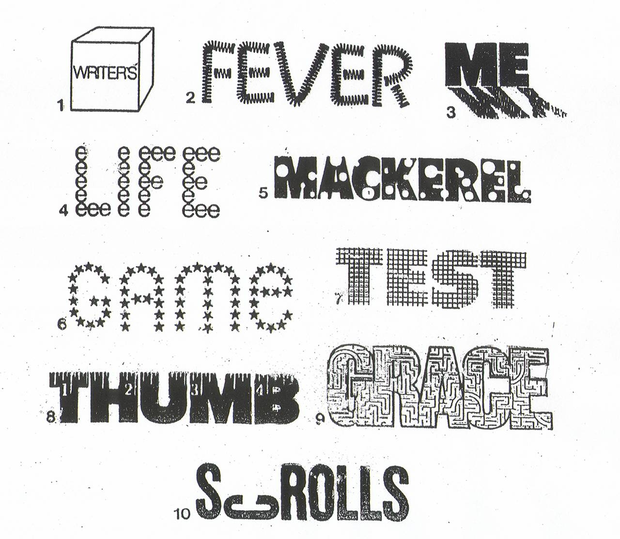

Slide 32

Notes:
SEE ARROW…RIGHT IN FRONT OF US AND DON’T SEE IT. You have always known who you are.

Slide 33
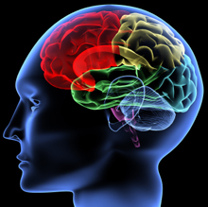
You are the best STORYTELLER you know…You believe your own stories.
Notes:
Go from science of the brain to the Stories we tell.

Slide 34
We get Emotionally behind the stories we BELIEVE…whether
True or Not
Notes:
Go from science of the brain to the Stories we tell.

Slide 35
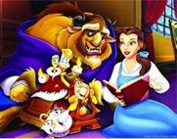
Willing Suspension of Disbelief:
Emotionally Respond to What is Not True
Notes:
Poet and philosopher, Samuel Coleridge, coined a phrase in 1817, “the willing suspension of disbelief” which he further described as “poetic faith”. In other words, disbelief is really a belief or poetic faith. In short, this disbelief can be defined as temporary acceptance as believable events or characters that would ordinarily be seen as incredible. Coleridge suggested that if a writer could infuse “human interest and a semblance of truth” into a fantastic tale, the reader would suspend judgment regarding the implausibility of the tale.
Notice that somewhere inside you is a place where you can acknowledge or at least suspect something is not true but you still allow its influence.
Is it possible that what we can see and speak about as the “willing suspension of disbelief” is actually a normal, everyday real-life occurrence? That is, this dynamic happens outside the world of literature and Hollywood.
“We experience as real emotion …that which is make believe.”
Consider that the belief-disbelief dynamic is occurring all the time even as adults though we are particularly malleable when we are young.
Is it possible that core self-limiting beliefs which you formed in childhood have been maintained, nurtured and substantiated in your mind over the years?

Slide 36
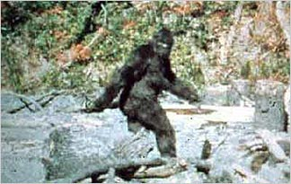
Animal Planet’s: Finding Bigfoot
“It’s A Squatch!”
Notes:
Belief in Bigfoot interprets every thing that happens on the show.
RETICUALR ACTIVATING SYSTEM:
Take in 2 billion bits of info
Process 1.2 million bits
RAS: Tells you what to focus on. Ever wanted to buy a HONDA Accord and then all you see are Honda Accords.
A. RAS/You find evidence to support what you BELIEVE.
B. This can help you find evidence for a great day.
C. Can keep you stressed out.

Slide 37
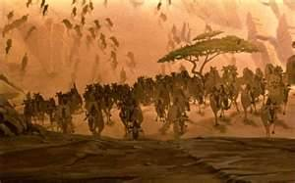
Remember the Stampede Scene from Lion King?
Notes:
When you watched “Lion King” for the first time in an audience filled with kids, what happened when the king is trampled by wildebeests?
Did not every kid in the audience start crying because Simba lost his Daddy?
This story is complete fantasy but our kids experienced it as real at some level. They expressed real emotions.

Slide 38
What story will he tell himself as he grows up?
Notes:
Speaking at College Fair. Added to panel at last minute.
First guy: At MIT…Going to feed the 3rd world with non-essential amino acids for 17 cents a day per person. Groundbreaking research.
Second Guy: Undergrad at Princeton in Chemistry; Graduate School at Brown, Awarded World’s Greatest Bio-Chemist then later in life got his Law Degree at Harvard.
Gets to me: I drank a lot of beer at UGA…I mena a lot of beer. Standing ovation.

Slide 39
“In Common” Patterns of Impoverishing Stories
I’m not good enough.
There’s not enough time.
That’s unfair.
I should be different.
I don’t deserve a great life.
Why bother? I never make it anyway.
I have to control everything to make it work out.
Notes:
Invite room to make “sucking “ noise. If we spend much time here it will suck the life out of the room.
NOT GOOD IDEA: You will recall this as the speaker who sucked.

Slide 40
More SELF-LIMITING Stories
Nothing can go wrong on my watch.
If I am super responsible, things will be OK.
I can’t ask for help.
It’s every man for himself.
I can never relax.
We never have enough.
Nothing ever works out for me.
LIFE IS HARD.
Notes:
Common self-limiting stories in Realty?
What is “hard” by the way?
Insecurity is a story: Speaking at college fair in Boston. 1st: Undergrad in Bio-Chem Brown/Lae Degree at Harvard/Post doc at Harvard/Multiple awards
2nd: Solving world hunger feeding the world with non-essential amino acids for 9 cents a day. Awards/Grants/Published
ME: Drank a lot of beer at UGA.

Slide 41
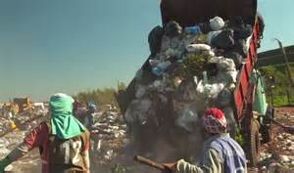
Cateura, Paraguay…Built on Trash Dump
Notes:
Self-Limiting Beleifs:

Slide 42
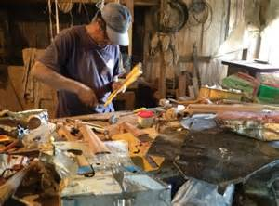
Decided to Make Musical Instruments from Trash

Slide 43
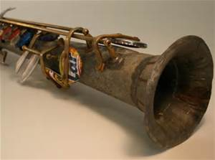
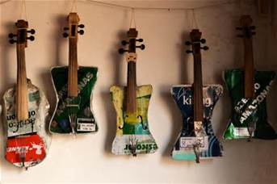
Violins from Baking Sheets, Flutes from Plumbing pipe

Slide 44
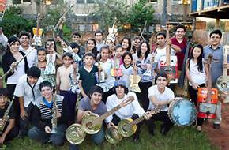
Started An Orchestra for the School Kids

Slide 45

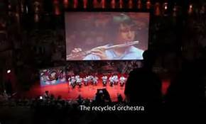
Now Touring Worldwide… the LandFillharmonic
Notes:
We all have a story to tell that limits us. What is the story you want to tell?

Slide 46
10 Minutes A Day for 21 Days
Pythagorean Breathing
Go on vacation every morning for 1 minute.
  Think about your most relaxing and/or fun vacation.
  Is it a beach? Then watch & listen to a You Tube video of a peaceful beach scene for 1 minute.
Find a picture of yourself smiling from when you were “little” and look at it.
Write 3 things for which you are grateful
Write and send an encouraging email to a friend, colleague, family… (NGO)
Notes:
Jeremy Brown/Visalia Oaks…Home run and didn’t know it.

Slide 47
Kevin McDaniel CPC, CPL
M: 678-608-5416
kevin@windriverstrategies.net
www.windriverstrategies.net

