Slide 1
Medicare Updates and What’s Trending for 2018
NJ AAHAM
November 8, 2018

Slide 2
Disclaimer
All Current Procedural Terminology (CPT) only are copyright 2017 American Medical Association (AMA). All rights reserved. CPT is a registered trademark of the American Medical Association. Applicable Federal Acquisition Regulation/ Defense Federal Acquisition Regulation (FARS/DFARS) Restrictions Apply to Government Use. Fee schedules, relative value units, conversion factors and/or related components are not assigned by the AMA, are not part of CPT, and the AMA is not recommending their use. The AMA does not directly or indirectly practice medicine or dispense medical services. The AMA assumes no liability for data contained or not contained herein.
The information enclosed was current at the time it was presented. Medicare policy changes frequently; links to the source documents have been provided within the document for your reference. This presentation was prepared as a tool to assist providers and is not intended to grant rights or impose obligations.
Although every reasonable effort has been made to assure the accuracy of the information within these pages, the ultimate responsibility for the correct submission of claims and response to any remittance advice lies with the provider of services.
Novitas Solutions employees, agents, and staff make no representation, warranty, or guarantee that this compilation of Medicare information is error-free and will bear no responsibility or liability for the results or consequences of the use of this guide.
This presentation is a general summary that explains certain aspects of the Medicare program, but is not a legal document. The official Medicare program provisions are contained in the relevant laws, regulations, and rulings.
Novitas Solutions does not permit videotaping or audio recording of training events.

Slide 3
Novitas eNews – Subscribe Now!
Receive current updates directly from Novitas Solutions:
  JH and JL
  Part A and Part B News
  Issued every Tuesday and Friday
  CMS MLN Connects issued Thursdays
Choose the line of business and topics YOU NEED:
  Novitasphere
  Part A News
  Part B News
  Electronic Billing (EDI)
  Veterans Affairs
  ABILITY | PC-ACE
  Medicare Remit Easy Print (MREP)
  Indian Health Services (IHS)

Slide 4
Acronym List
Acronym | Definition
ACH | Acute Care Hospital
CAH | Critical Access Hospital
CMS | Centers for Medicare & Medicaid Services
EDI | Electronic Data Interchange
FISS | Fiscal Intermediary Shared System
HIC | Health Insurance Claim
IPF | Inpatient Psychiatric Facility
IRF | Inpatient Rehab Facility
LTCH | Long Term Care Hospital
MBI | Medicare Beneficiary Identifier
MID | Medicare Identification Number
OIG | Office of Inspector General
OPPS | Outpatient Prospective Payment System

Slide 5
Today’s Presentation
Agenda:
  Medicare Updates and Reminders
  New Medicare Card
  Outpatient Services Provided to Inpatients of Other Facilities
Objectives:
  Identify and understand the current Medicare updates and reminders
  Identify and utilize the educational resources and information
  Explore the Medicare guidelines regarding outpatient services provided to an inpatient at another facility

Slide 6
  Medicare Updates and Reminders

Slide 7
Medicare Deductible, Coinsurance and Premium Rates for 2019
2019 Part A – Hospital Insurance:
  Deductible: $1,364.00
  Coinsurance:
    $341.00 a day for 61st-90th day
    $682.00 a day for 91st-150th day (lifetime reserve days)
    $170.50 a day for 21st-100th day (Skilled Nursing Facility coinsurance)
2019 Part B –Medical Insurance:
  Deductible: $185.00 a year
  Coinsurance: 20 percent
Reference:
  2019 Medicare Parts A & B Premiums and Deductibles Fact Sheet

Slide 8
Local Coverage Determinations (LCDs)
MM10901:
  Effective: October 3, 2018
  Implementation: January 8, 2019
Key Points:
  New LCD Process:
    Informal meetings
    Interested parties can request a new LCD
    Contractor Advisory Committee (CAC)
    Open Meeting, Publication of the Final Determination, Response to Public Comments and Notice Period
  LCD Reconsideration Process:
    Will consider all LCD requests on published final LCDs
    Will go through a comment and notice period
  Other Important Changes:
    No longer appropriate to include CPT or ICD-10 codes in LCDs instead they will be placed in billing and coding articles linked to the LCD (process could take up to 1 year to complete)

Slide 9
Updating Language to Clarify for Providers Chapter 3, Section 20 and Chapter 5, Section 70 of the Medicare Secondary Payer Manual
MM10863:
  Effective: November 20, 2018
  Implementation: November 20, 2018
Key Points:
  Clarification regarding when and where to obtain information from Medicare beneficiaries, or authorized representatives, for inpatient admissions or outpatient encounters
  Medicare Secondary Payer (MSP) Manual, Pub. 100-05, Chapter 3 - MSP Provider, Physician, and Other Supplier Billing Requirements, Section 20.2.1 “Model Admission Questions to Ask Medicare Beneficiaries” provides a model questionnaire listing the type of questions hospitals may use to determine the correct primary payer
  Providers may access CWF or HETS 270-271 transaction to verify if any insurance information it contains has changed:
    No changes, no need to ask MSP questions, but notate for auditing purposes:
      CWF or 270/271 screen print
    Insurance information changed, must ask the MSP questions
  Affiliated hospital-based service provider, such as a transfer ambulance service, does not need to ask MSP questions if already verified by hospital admissions staff:
    Admissions staff bills for the service
    Non-affiliated providers are responsible for verifying correct information prior to billing services

Slide 10
National Correct Coding Initiative (NCCI) Edits Apply to OPPS and Non-OPPS Claims
Based on the implementation of the IOCE specifications from Change Request (CR) 10699, for claims received on or after July 1, 2018, regardless of the date of service, the following provider types that previously were not subject to NCCI edits '20' (W7020) and '40' (W7040) are now subject to these edits:
  Community Mental Health Centers (CMHCs)
  Critical Access Hospitals (CAHs)
  Indian Health Service hospitals
  End Stage Renal Disease (ESRD) facilities
  Maryland (MD) Waiver hospitals
Description of the edits:
  W7020- Code 2 of a pair that is not allowed by NCCI even if appropriate modifier is present
  W7040- Code 2 of a code pair that would be allowed by NCCI if appropriate modifier is present
CMS released a Special Edition Article SE18012 on September 4, 2018, which provides a reminder on billing requirements implemented for non-OPPS providers
National Correct Coding Initiative (NCCI) Edits Apply to OPPS and Non-OPPS Claims

Slide 11
End Stage Renal Disease (ESRD) Billing Reminders
ESRD services are subject to the monthly billing requirements for repetitive services:
  Include the beginning and ending service dates of the period on one bill:
    Two claims must be filed if two dialysis settings are used during the month:
      Submit each claim for the full range of DOS that are applicable to each type of dialysis through each last day of dialysis that was performed in the billing month
ESRD sessions exceeding the limit:
End Stage Renal Disease (ESRD) Billing Reminders
Reason Code and Description | Resolution
Reason Code 36362: The services on this ESRD claim during the same month as a previously processed or in-process ESRD claim exceeded the limit routinely allowed for these dates of service. | Refer to the Medicare Claims Processing Manual, Pub. 100-04, Chapter 8 - Outpatient ESRD Hospital, Independent Facility, and Physician/Supplier Claims, Section 60.4.2 "Facility Billing Requirements for ESAs" under Maximum Allowable Administrations: The maximum number of administrations of EPO for a billing cycle is 13 times in 30 days and 14 times in 31 days. The maximum number of administrations of Aranesp for a billing cycle is 5 times in 30/ 31days.
Reason Code 36375: The dialysis services on this ESRD claim during the same month as a previously processed or in-process ESRD claim, exceeded the limit routinely allowed for these dates of service. | Refer to Local Coverage Determination (LCD) Frequency of Dialysis L35014 for dialysis services that are able to be exceeded with diagnosis related justification.

Slide 12
Proper Billing for Intensity-Modulated Radiation Therapy (IMRT) Planning Services
Definition:
  IMRT is a procedure that uses advanced computer programs to plan and deliver radiation to treat difficult to reach tumors
Purpose:
  IMRT is provided in two treatment phases:
    Planning phase - a multistep process in which imaging, calculations, and simulations are performed to develop an IMRT treatment plan
    Delivery phase- radiation is delivered to a beneficiary's treatment site (example, a tumor) at the various levels prescribed in the IMRT treatment plan
Billing and payment:
  Payment for services identified with CPT codes 77014, 77280, 77285, 77290, 77295, 77306-77321, 77331, and 77370 are included in the bundled payment when they are performed as part of developing an IMRT plan reported with CPT code 77301:
    These codes should not be billed in addition to CPT code 77301
  Novitas Solutions will begin adjusting claims for outpatient IMRT that did not comply with Medicare billing requirements and were overpaid as a result of a recent audit by the OIG
For more information:
  Proper Billing for Intensity-Modulated Radiation Therapy (IMRT) Planning Services
  MLN Matters Special Edition Article SE18013 - Intensity-Modulated Radiation Therapy (IMRT) Planning Services Editing
Current Procedural Terminology (CPT) only copyright 2017 American Medical Association. All rights reserved.

Slide 13
Hospital Price Transparency
Effective in 2019 CMS updated its guidelines to specifically require hospitals to make public a list of their standard charges
Encourage price transparency by improving public accessibility of charge information:
  Post via the Internet in a machine readable format
  Update this information at least annually, or more often as appropriate
References:
  CMS Finalizes Changes to Empower Patients and Reduce Administrative Burden
  Fiscal Year (FY) 2019 Medicare Hospital Inpatient Prospective Payment System (IPPS) and Long-Term Acute Care Hospital (LTCH) Prospective Payment System Final Rule (CMS-1694-F)
  Frequently Asked Questions Regarding Requirements for Hospitals To Make Public a List of Their Standard Charges via the Internet

Slide 14
MCReF - CMS New Cost Reporting Portal
Effective July 2, 2018, you must use MCReF if you choose electronic submission of your cost report
CMS goals:
  Standardize, automate, and streamline the Medicare Cost Report processes related to provider submission and MAC receipt, acceptance, and subsequent handling
  Increase CMS access to data
System Login:
  https://mcref.cms.gov
References:
  CMS Announcement New Option for Submission of Cost Reports
  Medicare Cost Report e-Filing system (MCReF) Presentation
  Medicare Cost Report e-Filing (MCReF) System Video

Slide 15
Claims for Beneficiaries Eligible as a Qualified Medicare Beneficiary (QMB)
Based on MM10433, the QMB information was reintroduced on the Medicare remittance with revised coding from what was implemented with CR9911:
  Claim Adjustment Group Code “Patient Responsibility” (PR)
  Remittance Advice Remark Codes (RARC):
    N781 - Alert: Patient is a Medicaid/ Qualified Medicare Beneficiary. Review your records for any wrongfully collected deductible. This amount may be billed to a subsequent payer.
    N782 – Alert: Patient is a Medicaid/ Qualified Medicare Beneficiary. Review your records for any wrongfully collected coinsurance. This amount may be billed to a subsequent payer.
Claims that processed with the QMB information between October 2, 2017, and December 8, 2017, are being reprocessed per instruction from MM10494

Slide 16
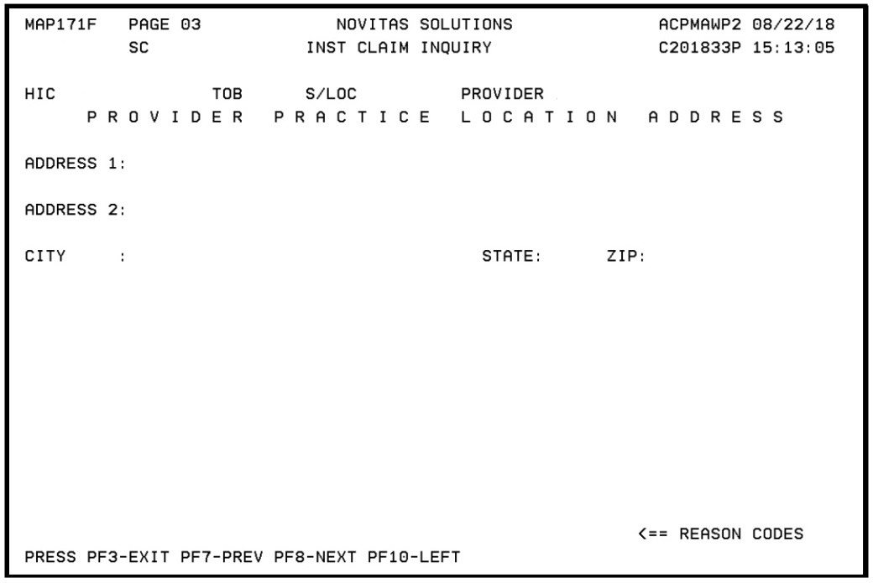
FISS Provider Practice Location Address
FISS Claim Page 3 Provider Practice Location:
  New claim page must include your practice location address when services billed are rendered in an off-campus, outpatient, or provider-based department of a hospital facility
  Refer to MLN Special Edition Article SE18002 Billing Requirements for OPPS Providers with Multiple Service Locations

Slide 17
Annual FISS Recertification
CMS requires annual recertification of every user who has access to FISS
Users must be recertified by the authorized official (AO) or delegated official (DO) on file within 30 days of the date of the letter:
  Letter mailed to the AO/DO listed on the provider’s CMS-855A
  User’s access will be removed if letter is:
    Incomplete
    Inaccurate
    Not returned by the due date
  Completed recertification letters must be return to EDI via fax at 1-877-439-5479
For more information:
  Novitas Solutions Annual Recertification of Part A FISS Users

Slide 18
Helpful Electronic Remittance Advice (ERA) Tips
If you are enrolled to receive your remittances via 835 ERA, review these helpful tips for successfully managing your remittance files:
  ERA is generated 14 days from the date the file was submitted:
    File is available to retrieve for 60 days
  When you retrieve your ERA, save it to location on your system where you can easily locate it in the future if necessary
  Those saved ERA files can be translated by your claim software, or by one of our free software products: PC Print or ABILITY | PC-ACE:
    These software products have the ability to print one or more patients as needed to send to a secondary insurance
  Get into the habit of retrieving ERAs each day so you don’t miss any important information
  ABILITY | PC-ACE Training Module Using Novitasphere

Slide 19
What is Novitasphere?
Novitasphere is a FREE, secure internet portal for the provider community to use to easily connect directly to Novitas Solutions
Novitasphere User Guides and Instructions
Live Chat feature
Dedicated Help Desk: 1-855-880-8424
  Available from 8:00AM-5:00 PM ET

Slide 20
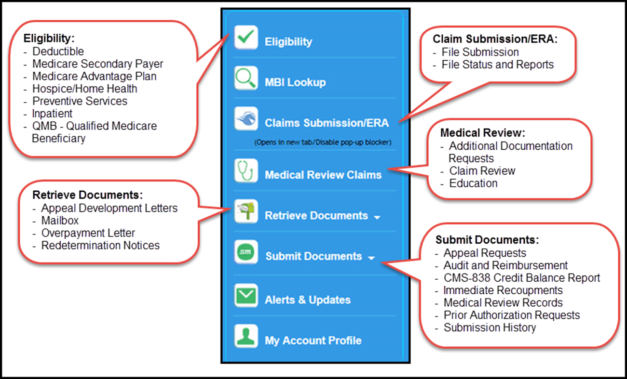
Part A Navigation Bar

Slide 21

Important: Novitasphere Log In Requirement Changes
CMS will be implementing a system security change that affects the Novitasphere log in requirements for maintaining access.
Effective September 1, 2018, registered Novitasphere users must log into Novitasphere at https://www.novitasphere.com at least once every 30 days to be considered active.
Upcoming Changes to Novitasphere Log In Requirements – Action Required

Slide 22
Medicare Credit Balance Reporting Requirement Reminders
Credit balance documentation:
  Identify whether the patient is an eligible Medicare beneficiary
  Identify other liable insurers and the primary payer
  Adhere to applicable Medicare payment rules
  Ensure that a credit balance is due to Medicare and the credit is refundable to the Medicare program
The CMS-838 Certification and Detail page must be submitted:
  Failure to submit a complete and/or accurate detail page will result in the return of the credit balance report:
    Rejected reports, those deemed invalid, are not considered received until they are submitted without errors
    Failure to file a quarterly report by the due date may result in the suspension of all Medicare payments
If your credit balance amount is ZERO at the end of the quarter:
  Required to sign, date and return the Medicare Credit Balance Report Certification Page

Slide 23
Important Medicare Credit Balance Report Dates
Due each quarter ending
Medicare Credit Balance Report must be submitted within 30 days after the close of each calendar quarter
Quarter End | Medicare Credit Balance Report Due | Warning Letter Mailed | Placed on 100% Payment Withhold
March 31 | April 30 | May 15 | June 03
June 30 | July 30 | August 15 | September 03
September 30 | October 30 | November 15 | December 03
December 31 | January 30 | February 15 | March 03

Slide 24
Credit Balance Tips
Credit balance tips:
  Providers must first attempt to make their own adjustments:
    Submit adjustments as soon as you identify the credit balance once that particular quarter begins
  Do not forget to include your UB-04 with your report
  Submit the correct version of the CMS-838 form
  Providers must complete the entire CMS-838 detail page when reporting credit balances
  Ensure that your provider number on the certification page matches the detail page
  Do not include claims you have indicated on a prior quarter
  No need to mail hard copy once a certification has been faxed
  Three attempts are made to contact the provider regarding questions:
    If the provider does not return the telephone call then Novitas will offset the amount reported on the credit balance report
    Claim will not show an adjustment in the Fiscal Intermediary Shared Systems
Visit our website for more details on Credit Balance Reporting

Slide 25
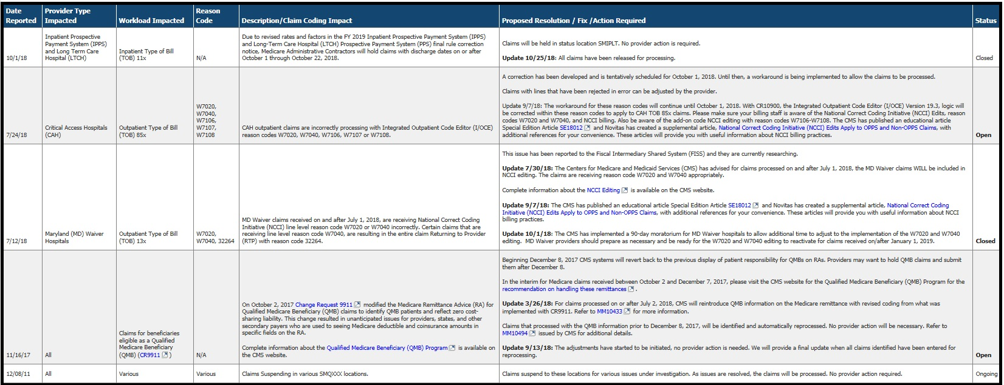
Part A Open Claim Issues
Open Claim Issues for Medicare Part A

Slide 26
New Medicare Card

Slide 27
Important Dates For The New Medicare Card
CMS to remove Social Security Numbers (SSNs) from all Medicare cards by April 2019
The transition period will run from April 2018 through December 31, 2019
October 2018 through the end of the transition period, when a valid and active Medicare Number is submitted on Medicare fee-for-service claims both the Medicare Number and the MBI will be returned on the remittance advice:
  Medicare Remit Easy Print (MREP)
  PC Print
  Standard Paper Remits:
    FISS Standard Paper Remittance
    MCS (Medicare Part B/Professionals)
Find more information on the New Medicare Card on the CMS website on the New Medicare Card home page and the Providers page

Slide 28
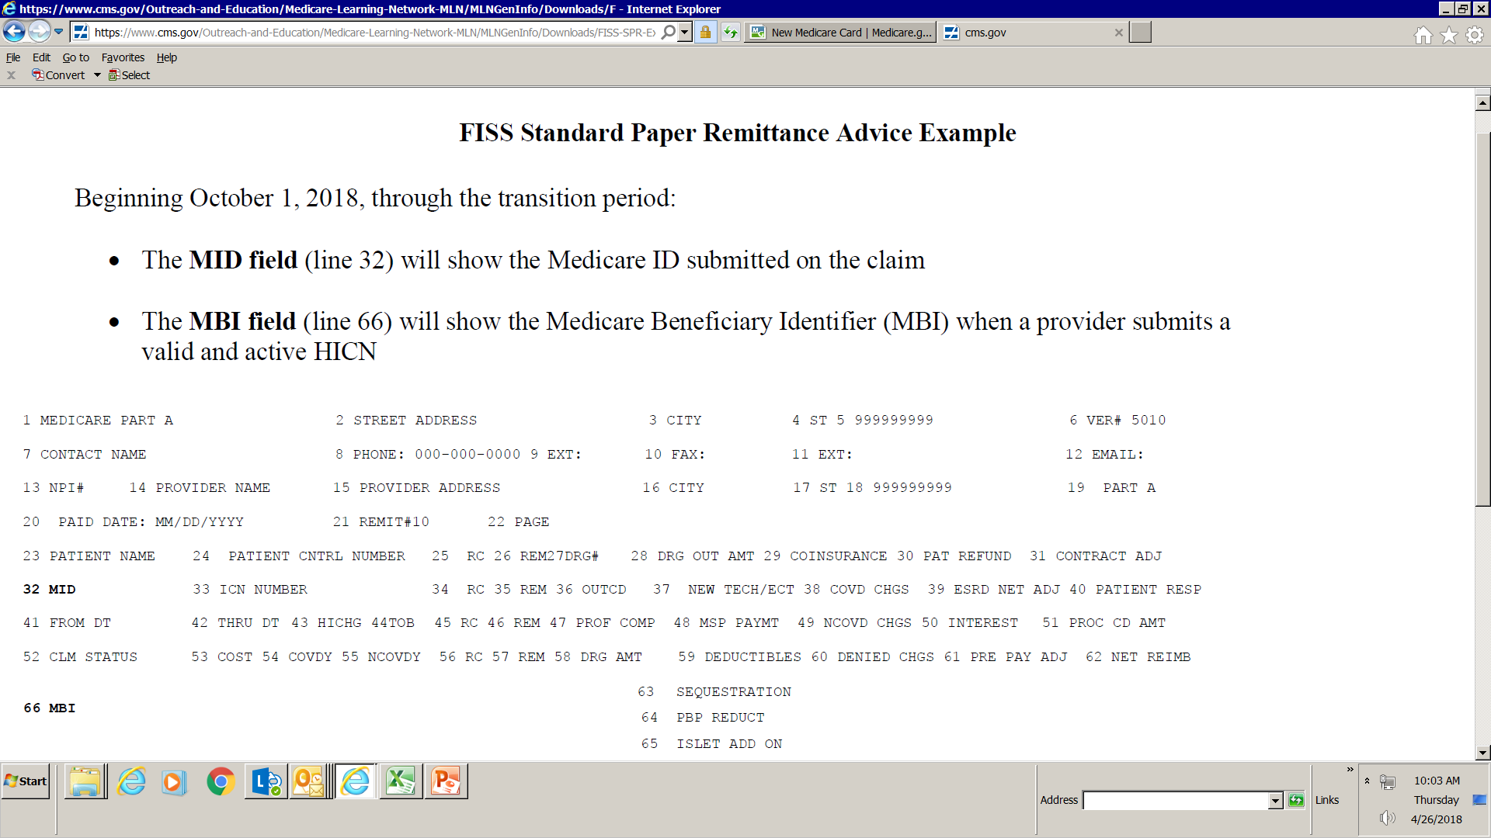
FISS Standard Paper Remittance Advice Example with MBI
Beginning October 1, 2018 through transition period:
  MID field will reflect the Medicare identification submitted
  MBI field will reflect the MBI when a valid and active Medicare number is submitted

Slide 29
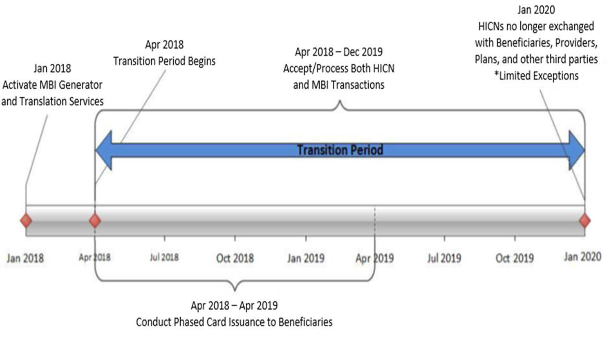
Transition Period

Slide 30
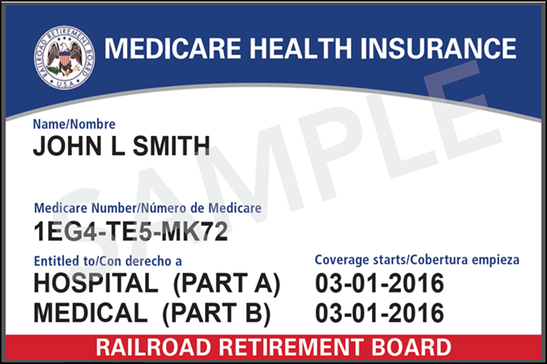
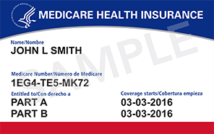
New Medicare Card
New Medicare card:
  Health and Human Services (HHS) logo
  Gender and signature line removed
Railroad Retirement MBI card:
  Railroad Retirement Board logo will be the key identifier
  Mailing will began June 2018

Slide 31
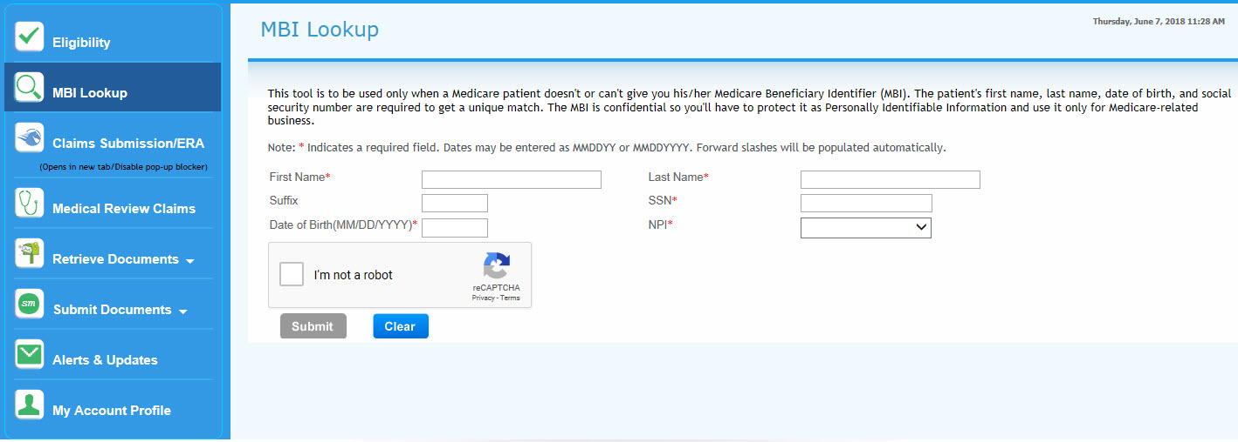
Novitasphere MBI Lookup
MBI crosswalk tool in Novitasphere now available

Slide 32
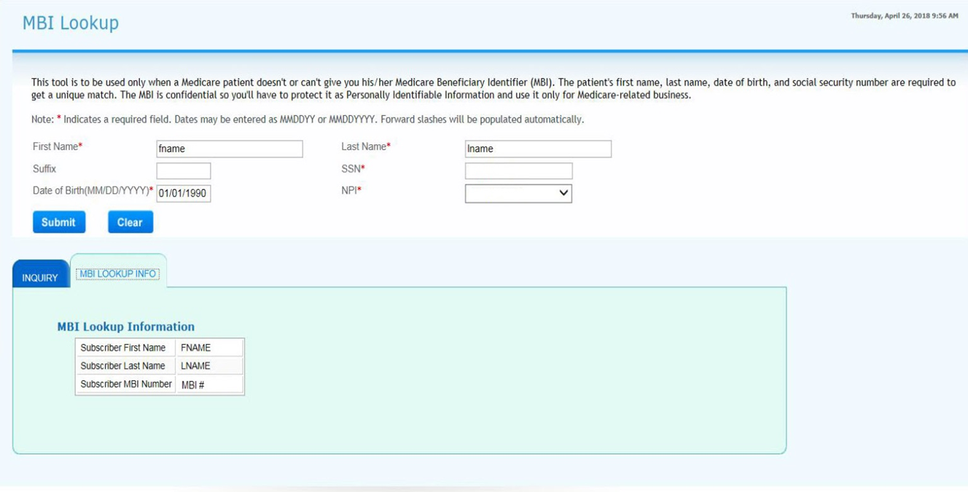
MBI Lookup Results
MBI lookup results

Slide 33
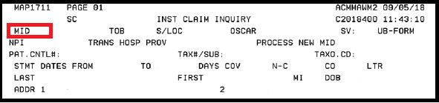
FISS Health Insurance Claim (HIC) Field Changed to MID
FISS Manual updated to reflect Direct Data Entry (DDE) screen changes as part of the Social Security Initiative
Effective October 1, 2018, all fields currently named ‘HIC’ in FISS to be renamed to ‘MID’ (Medicare Identification Number)

Slide 34
Trending Inquiries Received in the Customer Contact Center
Trouble using IVR to obtain beneficiary eligibility or claim status using an MBI ?
  When speaking an MBI in the IVR be sure to speak naturally, including normal pauses ever few characters
  Convert a MBI to a number that can be keyed into the IVR using the IVR Alphanumeric Conversion Tool (JH) (JL):
    Example:
      MBI number EG-4TE-5MK-72 converted 1*32*414*81*325*61*5272
Consider using the Novitasphere (JH) (JL) for most self service inquiries

Slide 35
Outpatient Services Provided to Inpatients of Other Facilities

Slide 36
Outpatient Services Payment: Beneficiaries Who Are Inpatients of Other Facilities - Reminder
Recent OIG report determined that Medicare inappropriately paid ACHs for outpatient services provided to beneficiaries who were inpatients of other facilities, including LTCH, IRF, IPF, and CAH:
  As a result, beneficiaries were unnecessarily charged outpatient deductibles and coinsurance payments
All items and non-physician services provided during a Medicare Part A inpatient stay must be provided directly by the inpatient hospital or under arrangements with the inpatient hospital and another provider
References:
  Medicare Inappropriately Paid Acute-Care Hospitals for Outpatient Services They Provided To Beneficiaries Who Were Inpatients of Other Facilities OIG Report, September 2017.
  MLN Matters Special Edition Article SE170133 Medicare Does Not Pay Acute-Care Hospitals for Outpatient Services They Provide to Beneficiaries in a Covered Part A Inpatient Stay at Other Facilities
  Provider Compliance Tips for Ordering Hospital Outpatient Services Fact Sheet
  Acute Care Hospital Inpatient Prospective Payment System Fact Sheet Page 3
  Items and Services Not Covered Under Medicare Booklet Page 12
  Medicare Claims Processing Manual, Pub. 100-04, Chapter 3 – Inpatient Hospital Billing , Section 10.4 “ Payment of Nonphysician Services for Inpatients”

Slide 37
Background
Section 1812 of the Social Security Act indicates inpatient hospital services provided to Medicare beneficiaries are reimbursed under Medicare Part A:
  Includes inpatient stays at LTCHs, IPFs, IRFs and CAHs
All hospitals are reimbursed by a prospective payment system or reasonable cost:
  ACHs are paid through the IPPS
  Facilities excluded from IPPS but paid under their respective PPS:
    IRFs and units
    LTCH
    IPFs and units
    Children’s hospitals
    Cancer hospitals
    Skilled Nursing Facilities
  CAHs are not subject to the IPPS and are, instead, paid on a reasonable cost basis
Provider Specialties/Services

Slide 38
Under Arrangement Policy – Billing Guidelines
Inpatient claim should include:
  All services rendered to the beneficiary directly, or
  All services provided under arrangement, on an outpatient basis, at another hospital
Inpatient hospital will reimburse the other hospital and transportation provided the amount that was determined and agreed upon by all parties involved
Outpatient services may not be separately billed by the other hospital or the transportation provider:
  If outpatient services are paid separately this could result in increased cost-sharing for the beneficiary
Medicare Learning Network (MLN) Matters Special Edition Article: SE17033 - Medicare Does Not Pay Acute-Care Hospitals for Outpatient Services They Provide to Beneficiaries in a Covered Part A Inpatient Stay at Other Facilities

Slide 39
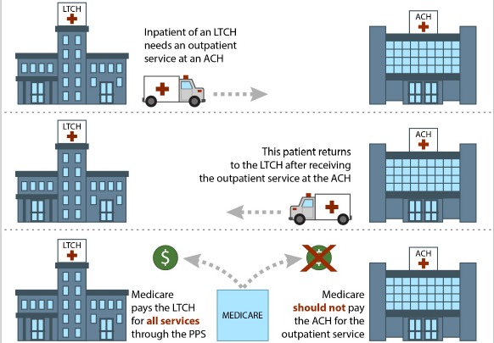
Beneficiary Receives an Outpatient Service at an ACH While Still an Inpatient of a LTCH

Slide 40
Part B Services Covered under Part A When Furnished to Inpatients
The following medical items, supplies, and services furnished to inpatients are covered under Part A:
  They are covered by prospective payment rate or reimbursed as reasonable costs under Part A to hospitals excluded from PPS:
    Laboratory services (excluding anatomic pathology services and certain clinical pathology services)
    Pacemakers and other prosthetic devices including lenses, and artificial limbs, knees, and hips
    Radiology services including CT scans furnished to inpatients by a physician’s office, other hospital, or radiology clinic
    Total Parenteral Nutrition (TPN) services
    Transportation, including transportation by ambulance, to and from another hospital or freestanding facility to receive specialized diagnostic or therapeutic services not available at the facility where the patient is an inpatient

Slide 41
Part B Services Covered under Part A When Furnished to Inpatients - Exceptions
Pneumococcal vaccine, influenza virus vaccine and hepatitis B vaccine and their administration are reimbursed under Part B only:
  Regardless of the setting furnished
Ambulance service:
  When the patient is transferred from one hospital to another, and is admitted as an inpatient to the second, the ambulance service is payable under Part B:
    Hospital owned and operated ambulance:
      Hospital bills separately
    Hospital arranges for the ambulance transportation with an ambulance operator:
      Hospital bills separately
Part B inpatient services, where Part A benefits are not payable, payment may be made to the hospital under Part B

Slide 42
OIG Findings
OIG released a report titled, “Medicare Inappropriately Paid Acute-Care Hospitals for Outpatient Services They Provided to Beneficiaries Who Were Inpatients of Other Facilities”
The OIG reviewed a total of 129,790 claims with dates of service from January 1, 2013, through August 31, 2016:
  Medicare inappropriately paid ACHs $51.6 million for outpatient services, while the beneficiary was an inpatient at another facility
  Beneficiaries were held responsible for $14.4 million paid to the ACH for unnecessary deductibles and coinsurance
  Medicare paid the ACH’s outpatient claim before the inpatient facility’s inpatient claim in 94 percent of the cases
  Medicare paid the inpatient facility’s inpatient claim before the ACH’s outpatient claim in 6 percent of the cases

Slide 43
OIG Recommendations
MACs were instructed to identify and recover any improper payments to ACHs
ACHs were to refund to beneficiaries any deductibles and coinsurance amounts that were incorrectly collected from the beneficiary or from someone on their behalf

Slide 44
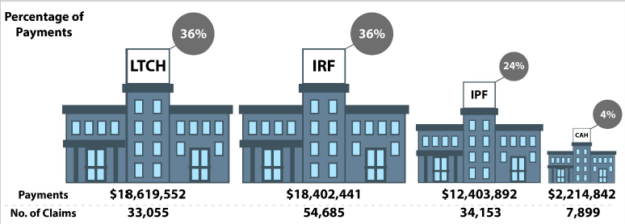
Percentage of Total Payments by Type of Inpatient Facility

Slide 45
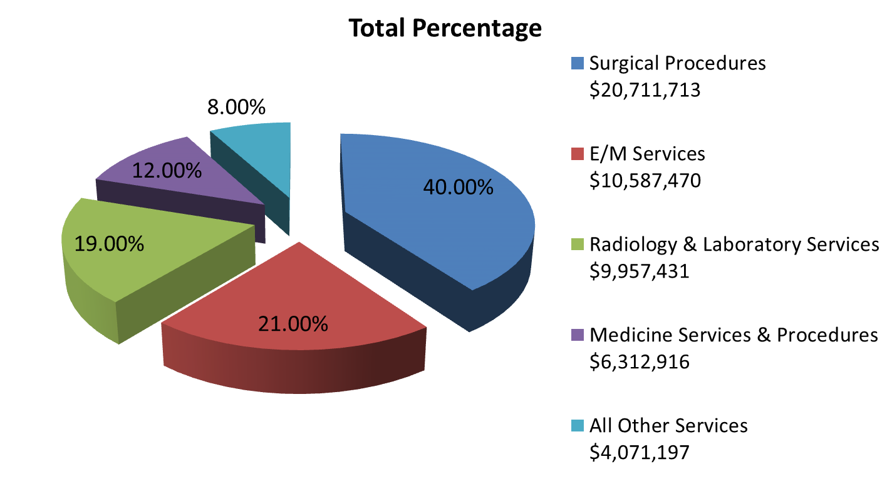
Percentages of Total Payments by Type of Outpatient Service

Slide 46
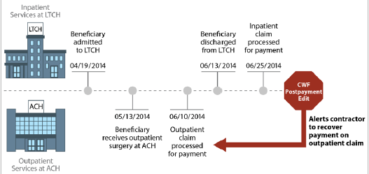
Outpatient Claim Processed Before Inpatient Claim: Postpayment Edit
ACH submitted a Part B claim before the LTCH discharged the beneficiary and was paid
LTCH discharged and submitted an inpatient claim and was paid
CWF’s postpayment edit generated an alert that a previously paid outpatient claim overlapped with a paid inpatient claim:
  MAC should have recovered the outpatient payment to the ACH
    This was the missing step which resulted in an overpayment to the ACH

Slide 47
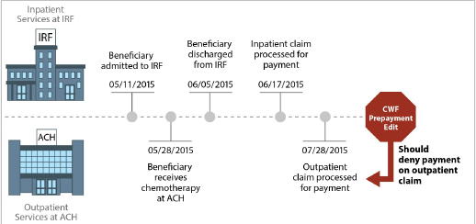
Inpatient Claim Processed Before Outpatient Claim: Prepayment Edit
IRF discharged and submitted an inpatient claim and was paid
ACH submitted a Part B claim after the IRF discharged the beneficiary and was paid
The CWF’s prepayment edit should have denied the payment for the outpatient claim but did not do so, which resulted in an improper payment to the ACH:
  ACH should have received payment from the IRF under arrangement

Slide 48
Education and Training Events

Slide 49
Part A Upcoming Events
Novitas Medicare Part A Educational Event Calendar
Date | Time | Title
November 15 | 1:00 PM | The Path to Skilled Nursing Facility (SNF) Basics, Billing, and More
November 20 | 2:00 PM | Credit Balance Overview
November 27 | 11:00 AM | Novitasphere Hot Topics
November 29 and November 30 | 8:00 AM to 4:45 PM | Virtual Symposiums
December 4 | 2:00 PM | Novitasphere Overview
December 6 | 10:00 | NCCI Edits W7020 and W7040

Slide 50
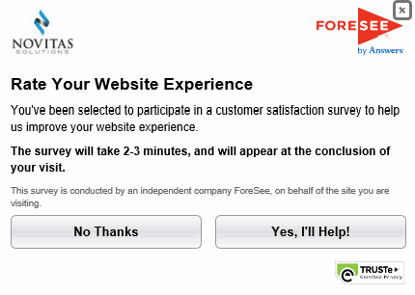
Website Satisfaction Surveys

Slide 51
Summary
Identified the current Medicare updates and reminders
Provided educational resources and information
Explored the Medicare guidelines regarding outpatient services provided to an inpatient at another facility

Slide 52
Thank You for Attending
Contact Information:
  Diane Hess
    Education Specialist
    Diane.Hess@novitas-solutions.com
    Phone: (717) 526-6520
  Stephanie Portzline
    Manager, Provider Engagement
    Stephanie.Portzline@novitas-solutions.com
    Phone: (717) 526-6317
  Janice Mumma
    Supervisor Provider Outreach and Education
    janice.mumma@novitas-solutions.com
    717-526-6406

