Slide 1
Medicare Updates and What’s Trending
NJ AAHAM
November 20, 2019

Slide 2
Disclaimer
All Current Procedural Terminology (CPT) only are copyright 2018 American Medical Association (AMA). All rights reserved. CPT is a registered trademark of the American Medical Association. Applicable Federal Acquisition Regulation/ Defense Federal Acquisition Regulation (FARS/DFARS) Restrictions Apply to Government Use. Fee schedules, relative value units, conversion factors and/or related components are not assigned by the AMA, are not part of CPT, and the AMA is not recommending their use. The AMA does not directly or indirectly practice medicine or dispense medical services. The AMA assumes no liability for data contained or not contained herein.
The information enclosed was current at the time it was presented. Medicare policy changes frequently; links to the source documents have been provided within the document for your reference. This presentation was prepared as a tool to assist providers and is not intended to grant rights or impose obligations.
Although every reasonable effort has been made to assure the accuracy of the information within these pages, the ultimate responsibility for the correct submission of claims and response to any remittance advice lies with the provider of services.
Novitas Solutions’ employees, agents, and staff make no representation, warranty, or guarantee that this compilation of Medicare information is error-free and will bear no responsibility or liability for the results or consequences of the use of this guide.
This presentation is a general summary that explains certain aspects of the Medicare program, but is not a legal document. The official Medicare program provisions are contained in the relevant laws, regulations, and rulings.
Novitas Solutions does not permit videotaping or audio recording of training events.

Slide 3
Subscribe to Novitas eNews!
Receive current updates via email directly from Novitas Solutions:
  Part A and Part B News
  Issued every Tuesday and Friday
  CMS MLN Connects issued Thursdays
Subscribing is quick and easy:
  Click the Join E-Mail List from our website tool bar

Slide 4
Acronym List
Acronym | Definition
ACH | Acute Care Hospital
CAH | Critical Access Hospital
CMS | Centers for Medicare & Medicaid Services
EDI | Electronic Data Interchange
FISS | Fiscal Intermediary Shared System
HIC | Health Insurance Claim
IPF | Inpatient Psychiatric Facility
IRF | Inpatient Rehab Facility
LTCH | Long Term Care Hospital
MBI | Medicare Beneficiary Identifier
MID | Medicare Identification Number
OIG | Office of Inspector General
OPPS | Outpatient Prospective Payment System

Slide 5
Today’s Presentation
Agenda:
  Medicare Updates and Reminders
  Overview of Hospital Off-Campus Outpatient Department Reporting Requirements
  Part A East (PAE) QIC Demonstration
  Credit Balance Reporting
  Education and Training Events
Objectives:
  Identify and understand the current Medicare updates and reminders
  Identify and utilize the educational resources and information
  Explore the Medicare guidelines regarding outpatient services provided to an inpatient at another facility

Slide 6
  Medicare Updates and Reminders

Slide 7
Update to Medicare Deductible, Coinsurance and Premium Rates for 2020
2020 Part A – Hospital Insurance:
  Deductible: $1408.00
  Coinsurance:
    $352.00 a day for 61st-90th day
    $704.00 a day for 91st-150th day (lifetime reserve days)
    176.00 a day for 21st-100th day (Skilled Nursing Facility coinsurance)
2020 Part B –Medical Insurance:
  Deductible: $198.00 a year
  Coinsurance: 20 percent
Reference:
  2020 Medicare Parts A & B Premiums and Deductibles Fact Sheet

Slide 8
ICD-10 and Other Coding Revisions to NCDs
MM11392:
  Effective: January 1, 2020
  Implementation: January 6, 2020
Key Point:
  Maintenance update of ICD-10 and other coding updates to NCDs due to newly available codes:
    NCD20.7 Percutaneous Transluminal Angioplasty
    NCD110.18 Aprepitant
    NCD110.23 Stem Cell Transplantation
    NCD150.3 Bone Mineral Density Studies
    NCD220.4 Mammography
    NCD220.13 Percutaneous Image-Guided Breast Biopsy
    NCD270.3 Blood Derived-Products for Chronic, Non-Healing Wounds

Slide 9
W7092 Device to Procedure Edits Bypass
W7092 Device to Procedure Edits Bypass:
  Effective with claims received on or after 10/07/19 for dates of service 1/1/19 and after, certain procedures rendered without the use of a device can bypass edit W7092 when the CG modifier is applied to the procedure
  For the list of procedures that can be reported with the CG modifier, refer to the edit 92 bypass list in CR11412 - October 2019 Integrated Outpatient Code Editor (I/OCE) Specifications Version 20.3

Slide 10
Medicare Plans to Modernize Payment Grouping and Code Editor Software
SE19013
  CMS modernizing its grouping and code editor software:
    Converting all Assembler-based grouping and code editor software to Java versions
  Planned conversion schedule of the three sub-systems within FISS:
    Medicare Code Editor (MCE):
      Test software available March 2021
      Full conversion October 1, 2021
    Inpatient Grouper (MS-DRG):
      Test software available March 2021
      Full conversion October 1, 2021
    Integrated Outpatient code Editor (IOCE):
      Test software available July 2022
      Full conversion January 2, 2023
  Protect CMS from future quality and integration risks

Slide 11
Opioid Treatment Programs: Get Ready to Participate in the New Benefit
Starting January 1, 2020, under the CY 2020 Physician Fee Schedule proposed rule, CMS plans to pay Opioid Treatment Programs (OTPs) through bundled payments for opioid use disorder treatment services for people with Medicare Part B, including medication-assisted treatment medications, toxicology testing, and counseling
Get ready to participate in the new benefit:
  Obtain full OTP certification from the Substance Abuse and Mental Health Services Administration (SAMHSA)
  Enroll in Medicare starting in early November
  Subscribe to MLN Connects for the latest news and updates
For More Information:
  Fact Sheet
  OTP webpage

Slide 12
Medicare Coverable Services for Integrative and Non-pharmacological Chronic Pain Management
SE19008 Non-pharmacologic treatment options for pain:
  National Coverage Determinations (NCDs):
    Electrical nerve stimulation Electrical nerve stimulation (NCD 160.7)
    Induced lesions of nerve tracts (NCD 160.1
    Inpatient hospital pain rehabilitation (NCD 10.3)
    Outpatient hospital pain rehabilitation (NCD 10.4)
    Supervised exercise therapy for symptomatic peripheral artery disease (NCD 20.35)
    Screening for depression (NCD 210.9)
  Local Coverage Determinations (LCDs):
    Epidural injections
    Spinal cord stimulation
    Peripheral nerve stimulation
    Facet joint interventions
    Therapy and rehabilitation services (PT, OT)
  Additional National Policies:
    Chronic care management
    Behavioral health integration services
  Preventive Services:
    Initial Preventive Physical Exam (IPPE)
    Annual Wellness Visits (AWV)

Slide 13
Influenza Vaccine Payment Allowances Annual Update for 2019-2020 Season
MM11428:
  Effective August 1, 2019
  Implementation no later than October 1, 2019
Key Points:
  Updated payment allowances for influenza vaccines
  2019-2020 season
Influenza resources:
  SE19022 - 2019-2020 Influenza (Flu) Resources for Health Care Professionals

Slide 14
October 2019 Quarterly and Fiscal Year 2020 Updates
MM11451 - October 2019 Hospital Outpatient Perspective Payment System Updates:
  Reflects the HCPCS, Ambulatory Payment Classification (APC), HCPCS Modifier, and Revenue Code additions, changes, and deletions identified in CR 11451
MM11412 - October 2019 Integrated Outpatient Code Editor (I/OCE) Specifications Version 20.3:
  Summarizes the modifications of the I/OCE for the October 2019 V20.3 release
  Providers should review the entire CR 11412 document and note the highlighted sections, which also indicate changes from the prior release of the software
MM11343 - October 2019 - Quarterly Average Sales Price (ASP):
  Refers providers to review CR 11343 for new and revised Average Sales Price (ASP) and ASP Not Otherwise Classified (NOC) drug pricing files for Medicare Part B drugs
MM11361 - Fiscal Year (FY) 2020 Inpatient Prospective Payment System (IPPS) and Long Term Care Hospital (LTCH) PPS Changes
  Policy changes for FY 2020 were displayed in the Federal Register on August 2, 2019, with a publication date of August 16, 2019, and the corresponding correction document published on October 8, 2019 in the Federal Register
  All items covered in this CR are effective for hospital discharges occurring on or after October 1, 2019, through September 30, 2020, unless otherwise noted

Slide 15
Inpatient Rehabilitation Facility (IRF) Services: Billing Requirements
In a recent report, the OIG determined that payments for IRF services did not comply with Medicare billing requirements:
  Medical record documentation did not support that IRF care was reasonable and necessary
  CMS revised the Inpatient Rehabilitation Facilities (IRFs): Improving Documentation Positively Impacts CERT Web-Based Training (WBT) course and the IRF Prospective Payment System Booklet
Additional resources:
  MM11345 - Inpatient Rehabilitation Facility (IRF) Annual Update: Prospective Payment System (PPS) Pricer Changes for FY 2020
  Many IRF Stays Did Not Meet Medicare Coverage and Documentation Requirements OIG Report
  FY 2019 IRF PPS Final Rule
  IRF Quality Reporting Program website
  Medicare Benefit Policy Manual Chapter 1, Section 110

Slide 16
IRF Coverage Requirements
A pre-admission screening, reviewed and approved by a rehabilitation physician before an IRF admission
A post-admission physician evaluation verifying the patient’s pre-admission screening information remains unchanged or documenting any changes
  NOTE: Beginning October 1, 2018, the post-admission physician evaluation counts as one of the three required face-to-face rehabilitation physician visits in the first week of the IRF stay
An individualized patient plan of care
An interdisciplinary approach to IRF care with interdisciplinary team meetings held at least once per week throughout the IRF stay
  NOTE: Beginning October 1, 2018, the rehabilitation physician may lead the interdisciplinary team meetings remotely without any additional documentation requirements
Clarifies the IRF admission requirements by specifying a patient must:
  Need the active and ongoing therapeutic intervention of multiple therapy disciplines (physical therapy, occupational therapy, speech-language pathology, or prosthetics/orthotics therapy):
    One of the therapies must be physical therapy or occupational therapy
  Generally, need an intensive rehabilitation therapy program uniquely provided in IRFs
  Be reasonably expected to actively participate in and benefit from intensive IRF services
  Need close medical supervision by a physician for managing medical conditions to support participation in an intensive rehabilitation therapy program
  Need an intensive, coordinated interdisciplinary care approach

Slide 17
Billing Instructions for Beneficiaries Enrolled in Medicare Advantage (MA) Plans for Services Covered by Decision Memo CAG-00451N
SE19024:
  Provides information on the NCD requiring coverage of Chimeric Antigen Receptor (CAR) T-cell therapy for cancer
    See the decision memorandum for more information
  Provides information for hospitals providing CAR T-cell therapy to beneficiaries enrolled in MA plans
  Background:
    A person's immune system contains white blood cells most of which are lymphocytes to help fight substances that are foreign to the body, including cancer
    Two main types of lymphocytes:
      B lymphocytes (B-cells) - generate and release antibodies to fight infection, especially bacterial infections
      T lymphocytes (T-cells) - employ several other mechanisms to fight abnormal cells such as cancer
    One type of therapy that leverages the immune system, immunotherapy, is Chimeric Antigen Receptor (CAR) T-cell therapy:
      CAR T-cells have been genetically altered to improve the ability of the T-cells to fight cancer
      Genetic modification creating a CAR can enhance the ability of the T-cell to recognize and attach to a specific protein, called an antigen, on the surface of a cancer cell

Slide 18
Coverage and Noncoverage Indications of CAR T-Cell Therapy
Effective for services performed on or after August 7, 2019, CMS covers autologous treatment for cancer with T-cells expressing at least one Chimeric Antigen Receptor (CAR) when:
  Administered at healthcare facilities enrolled in the FDA Risk Evaluation and Mitigation Strategies (REMS); and
  Used for a medically accepted indication as defined at Social Security Act Section 1861(t)(2)
    Used for either an FDA-approved indication (according to the FDA-approved label for that product); or
    For other uses when the product has been FDA-approved and the use is supported in one or more CMS-approved compendia
The use of non-FDA-approved autologous T-cells expressing at least one CAR is non-covered
Routine costs in clinical trials that use CAR T-cell therapy as an investigational agent that meet the requirements listed in NCD 310.1 will be covered

Slide 19
Coverage for CAR T-Cell Therapy for Beneficiaries Enrolled in Medicare Advantage (MA) Plans
For Calendar Years (CYs) 2019 and 2020 only:
  Original fee-for-service Medicare will pay for CAR T-cell therapy for cancer obtained by beneficiaries enrolled in MA plans when the coverage criteria outlined in the decision memorandum is met
  Policy is effective as of August 7, 2019
  Plans should account for CAR T-cell therapy for cancer items and services in their contract year 2021 bids

Slide 20
Billing Instructions for CAR T-cell Therapy
For claims submitted on or after August 7, 2019 for MA beneficiaries (on or after April 1, 2019 for non-MA beneficiaries):
  Hospitals report the CAR T-cell-related revenue codes 087X (Cell/Gene Therapy) and 089X (Pharmacy) established by the NUBC
  When billing charges separately for tracking these services when furnished in the outpatient setting, providers must submit:
    HCPCS 0537T with revenue code 0871
    HCPCS 0538T with revenue code 0872
    HCPCS 0539T with revenue code 0873
    Note: The above codes will appropriately receive Reason Code W7111
  Reference for non-MA beneficiaries:
    SE19009 - Chimeric Antigen Receptor (CAR) T-Cell Therapy Revenue Code and HCPCS Setup Revisions

Slide 21
CAR T-Cell Therapy Billing and Payment Reminders
Administration of CAR T-cells in the hospital outpatient setting:
  Paid separately under CPT code 0540T with Revenue Code 0874 (Assigned to status indicator “S”)
Payment for the various steps required to collect and prepare CAR-T is included in payment for the biological:
  May choose to include the charges for these various steps in the charge submitted for the biological or report these charges separately for tracking purposes
  Do not report the same charge(s) twice:
    Providers should choose one option listed above
    Must not include charges for pre-infusion steps in both the drug revenue code (0891) and separately listed for the pre-infusion revenue codes (0871, 0872, and 0873)

Slide 22
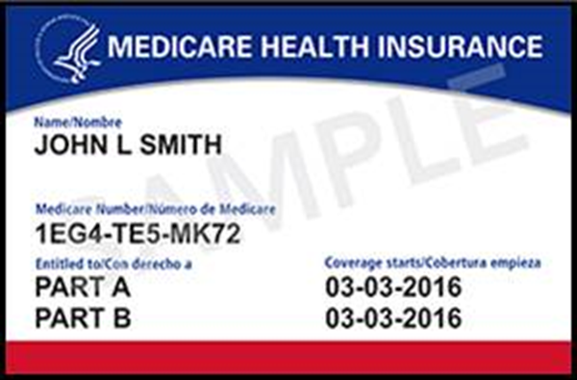
MBI is Here!
Effective January 1, 2020, claims submitted to Medicare will require the beneficiary’s MBI number
Is your office or facility prepared for the MBI transition?
Use MBI now for all Medicare transactions
3 ways to get the MBI:
  Ask your patient for their card
  Use your Medicare Administrative Contractor’s look up tool:
    Sign up for the Portal to use the tool
  Check the remittance advice:
    MBI is returned on the remittance advice if a valid and active Health Insurance Claim Number is submitted
Get Your New Medicare Card
Beneficiaries who did not receive their card can:
  Sign into MyMedicare.gov:
  Call 1-800-MEDICARE (1-800-633-4227)
  TTY users can call 1-877-486-2048

Slide 23
Is Your Vendor/Clearinghouse Submitting Your Claims With the MBI?
If you send the MBI to your vendor/clearinghouse on your Medicare claim for payment, but you see both the Health Insurance Claim Number and the MBI on your remittance advice:
  Your vendor/clearinghouse is not using the MBI to submit your claims
  Contact your vendor/clearinghouse today and ask about their process to submit Medicare claims
Starting January 1, 2020, Medicare will reject claims with the Health insurance Claim Number, with a few exceptions
For more information, see the MLN Matters Article

Slide 24
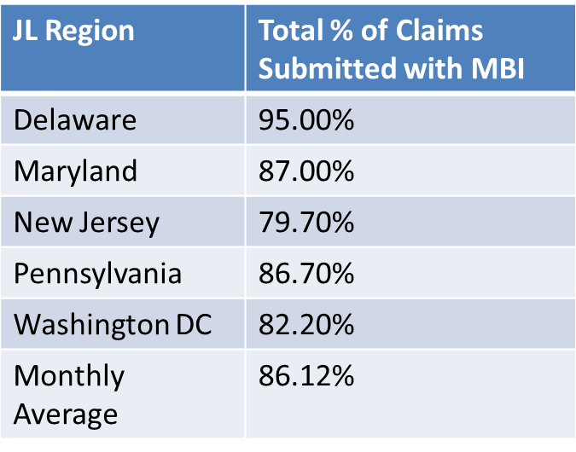
JL Claims Submitted With MBI October 2019
Part A
Part B
JL Region | Total % of Claims Submitted with MBI
Delaware | 89.40%
Maryland | 86.10%
New Jersey | 80.10%
Pennsylvania | 86.10%
Washington DC | 81.40%
Monthly Average | 84.62%

Slide 25
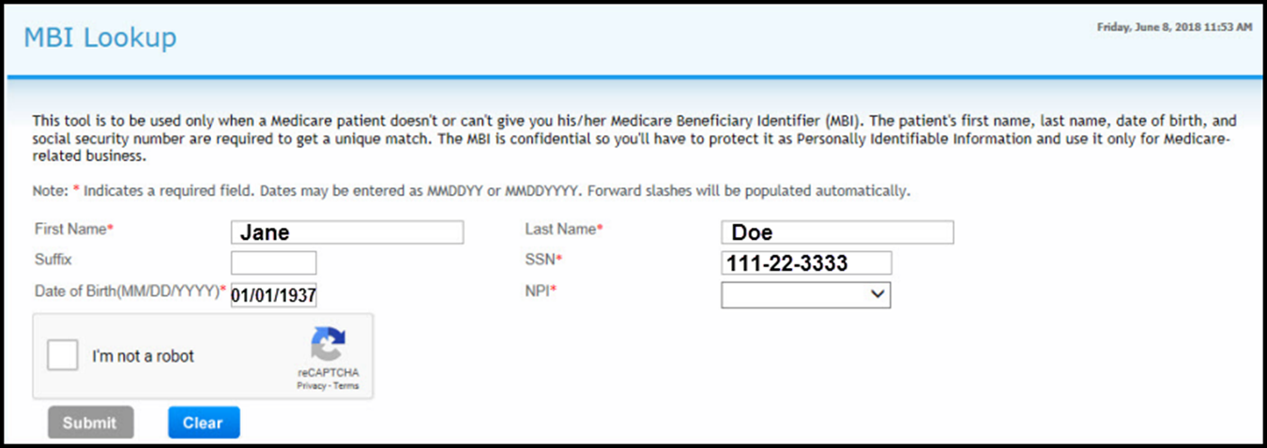
Novitasphere MBI Lookup
Select the MBI Lookup from the left navigation bar

Slide 26
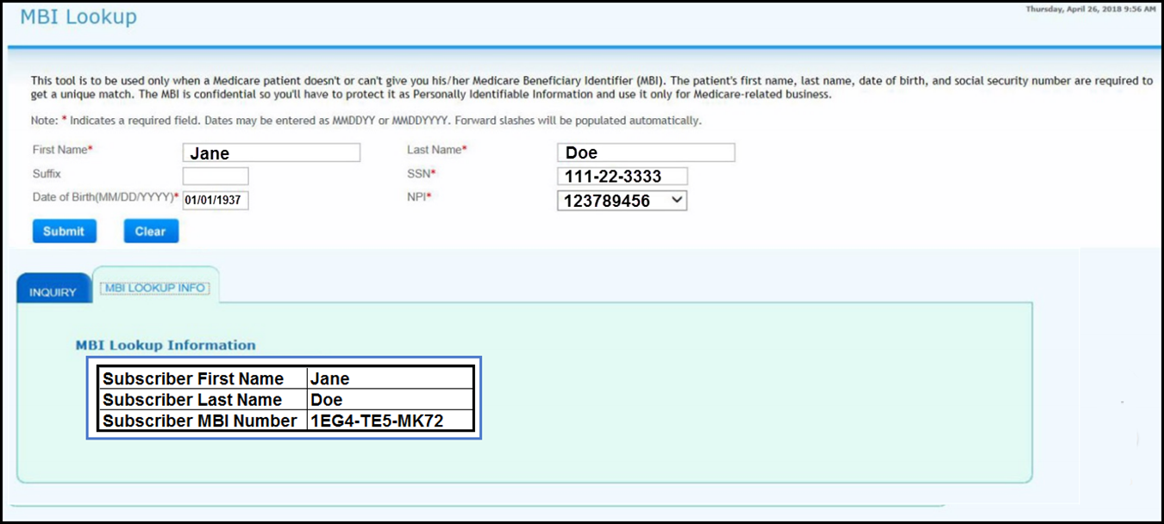
MBI Lookup Results

Slide 27
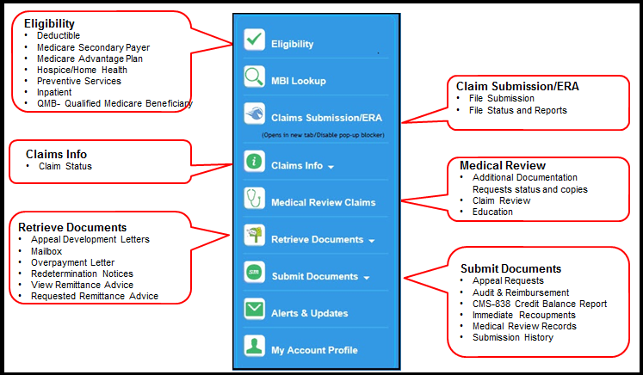
Part A Novitasphere
New enhancements to Novitasphere for Part A
  Appeal Status information
  Remittance Advice copies
    Copies similar to the Standard Paper Remittance (SPR)
Novitasphere Portal Center
  Enrollment information and reference materials
Current features list:

Slide 28
New in Novitasphere: Part A Claim Status
Part A Claim Status is now available in Novitasphere, our free, secure internet portal:
  Status of claims going back over 2 years
  Details such as:
    Billed and paid amounts
    Check number
    Claim status and finalized date
    Patient claim information
    Line item details

Slide 29
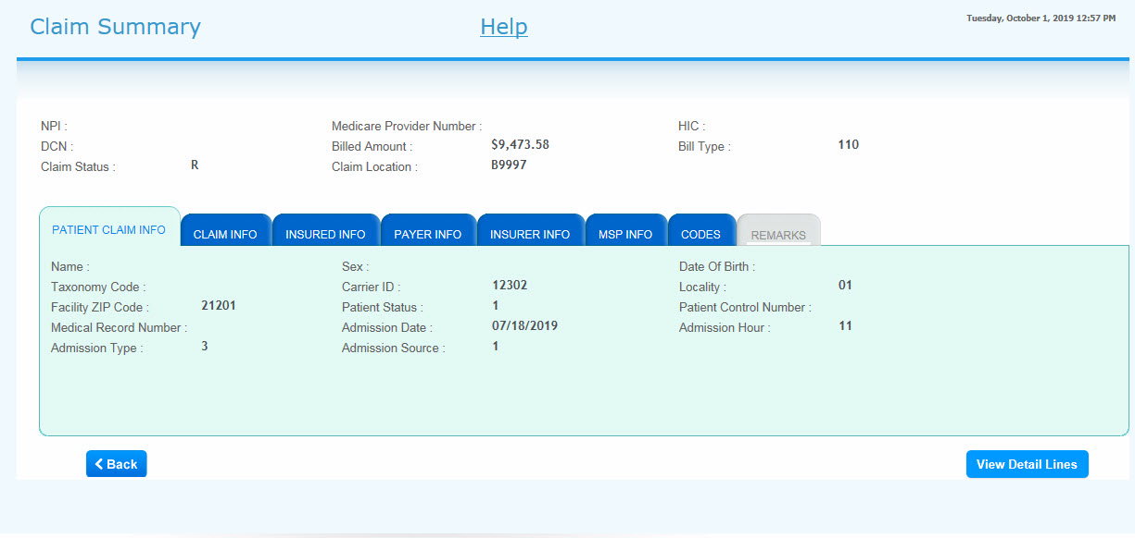
Claim Status – Header Level

Slide 30
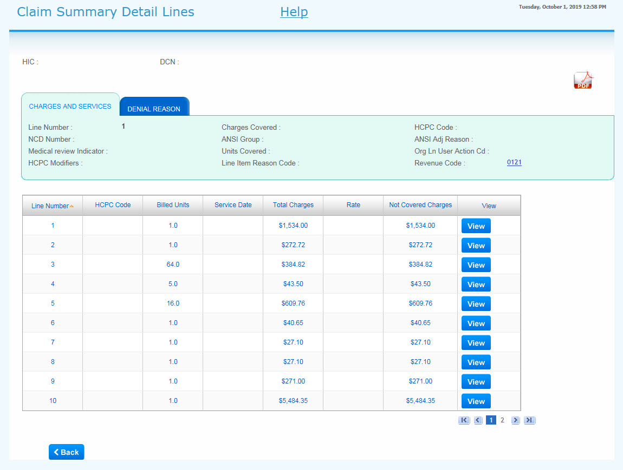
Claim Status – Detail Lines

Slide 31
Submitting a Redetermination in Novitasphere
Enter the following data elements to locate a claim:
  DCN
  File to upload:
    Use browse button
    Documents must be in PDF or TIF format and less than 1500 pages
    Do not submit a copy of Redetermination and Clerical Error Reopening Form with records:
      Will cause duplication and will impact submission
    Note: Add More Documentation creates another line entry

Slide 32
CMS HETS Production: Returns Wrong MSP Info
Recent change resulted in HETS not receiving new and updated MSP data:
  Could cause incorrect MSP information to be returned by the system
  Issue is only impacting a limited number of beneficiaries’ records
  Resolution has been identified and CMS expects this issue to be resolved by late November

Slide 33
Conditional Payment Claim Reminder
Definition:
  A conditional payment is a payment made by Medicare when there is evidence that payment has not been made or cannot reasonably be expected to be made promptly
Purpose:
  For auto/no-fault, liability, or WC:
    When the primary insurer does not pay promptly (within 120 days) or the case is in litigation payment is made “on condition” that Medicare will be refunded if primary insurer pays
    When the primary insurer denies/rejects a claim because benefits exhausted or there is personal liability, or a policy exclusion bill a conditional claim
  For WA, disability, and ESRD:
    Although it is not a conditional payment, you must follow the conditional payment billing guidelines in order for the claim to process correctly when the primary insurance denied the claim in full or applied the full amount to either deductible or coinsurance.
Conditional Payment

Slide 34
Conditional Billing
The following requirements must be met in order to consider processing as a conditional payment:
  Occurrence codes 01, 02, 03, 04 or 33 (whichever is applicable) with corresponding date;
  Occurrence code 24 with the date primary insurance denied/date billed to primary insurer (120 day elapsed date);
  Medicare Secondary Payer (MSP) value code 12, 13, 14, 15, 16, 41, 42, 43, or 47 must be present;
  Associated MSP value code amount must contain all zeros;
  Payer Name, "C" along with primary insurer name
  Remarks must state why the primary payer has not paid on this claim.
    The information for Remarks can be pulled directly from the primary payer Explanation of Benefits
Increase of claim being RTP’d with Reason Code 31102 and 31361

Slide 35
Hardcopy Claim Submissions Including Adjustments and Cancels
There are certain instances in which hardcopy claim submissions (including adjustments and cancels) may be necessary, for example:
  935 adjustments or cancels
  MSP tertiary claims (JH) (JL)
  MSP claims that providers are trying to cancel (XX8 TOB and primary payer is not Medicare)
  Tribal-self funded adjustments
  ASCA provider (JH) (JL):
    Must have submitted documentation to either EDI or claims
  Disaster related: Must provide explanation (i.e. national disaster declared by CMS, Fire or Flood in building and cannot submit claims for multiple days, switching billers and will not be able to submit claims for multiple days, etc.)
Effective with requests received on or after June 1, 2019, hardcopy claims will be returned to provider, via mail, if one of the exceptions listed is not met
For a hardcopy adjustment or cancel claim:
  Complete and attach the Hardcopy Adjustment and Cancel Request Form (JH) (JL)
  Include detailed remarks indicating the reason
Electronic adjustment and cancel requests are preferred when appropriate
Hardcopy Claim Submissions Including Adjustments and Cancels (JH) (JL)

Slide 36
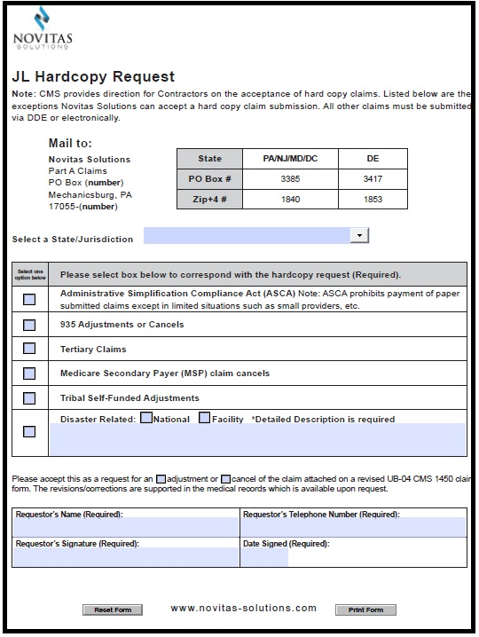
Revised Hardcopy Request Form

Slide 37
Electronic Submission of Medically Denied Cancel Claims
Novitas Solutions will allow electronic submission of cancel claims with denied items or services:
  Remarks must be specific:
    Overlapping an inpatient claim
  Appeal process should be followed if claim cancellation is not allowable
Reference:
  Allowing Electronic Submission of Medically Denied Cancel Claims, Reason Code 30941
  Knowing How and When to Cancel a Claim

Slide 38
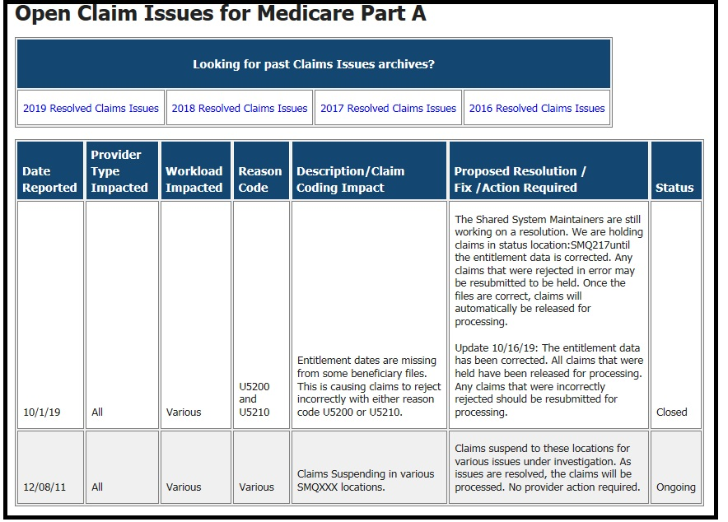
Open Claim Issues
The “Open Claim Issues for Medicare Part A” JL is a list of known errors that Novitas has implemented actions for correction
Providers are encouraged to review this listing to confirm their issue is not already being researched/addressed before contacting the Customer Contact Center for assistance

Slide 39
Overview of Hospital Off-Campus Outpatient Department Reporting Requirements

Slide 40
Hospital Off-Campus Outpatient Department Reporting
Changes to editing for appropriate reporting of off-campus outpatient department locations will impact all providers:
  To ensure correct payment for services provided at a hospital off-campus provider-based departments, CMS will be enacting changes for OPPS providers that have multiple practice locations
  Payment impacts only applies to those providers paid under OPPS
System related editing set to activated with the April 2020 Quarterly Release:
  Requirements for correct provider practice location reporting was effective back in 2017, however, systematic edits were not put in place at that time
Prepare by verifying that enrollment information is up to date and any claim submissions reflect the practice locations EXACTLY as it appears from the practice location address screen which is received from the PECOS
Ensure that the practice locations are linked to the NPI that is being reported on the claim submission
References:
  Hospital Off-Campus Outpatient Department Reporting Requirements
  SE190007 - Activation of Systematic Validation Edits for OPPS Providers with Multiple Service Locations

Slide 41
Validating Provider Practice Location
Medicare systems will validate the service facility location to ensure services are provided in a Medicare enrolled location:
  Validation will be exact matching based on the information on the CMS-855A form submitted by the provider and entered into PECOS:
    Must match, word for word, including abbreviations and punctuation
  Ensure claims data matches provider enrollment information
Claims will RTP with reason code 34977 if:
  Hospital claim is submitted with a service facility location that was not included in PECOS or on the CMS-855A enrollment form; or
  Location reported does not exactly match the information from the CMS-855A
  Note: FISS system will automatically capitalize all letters, so capitalization is not something that will cause a claim to receive reason code 34977
Providers who need to add a new or correct an existing practice location address will need to submit a new CMS-855A enrollment application in PECOS

Slide 42
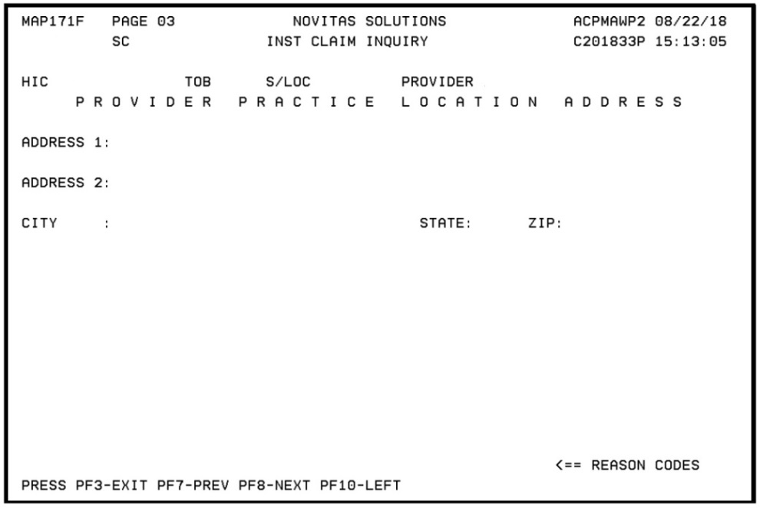
FISS Claim Page 3 Provider Practice Location Address
To access Claim Page 03 MAP171F press F11 from Claim Page 03 MAP1719
Enter the provider practice location address in the fields provided on this page

Slide 43
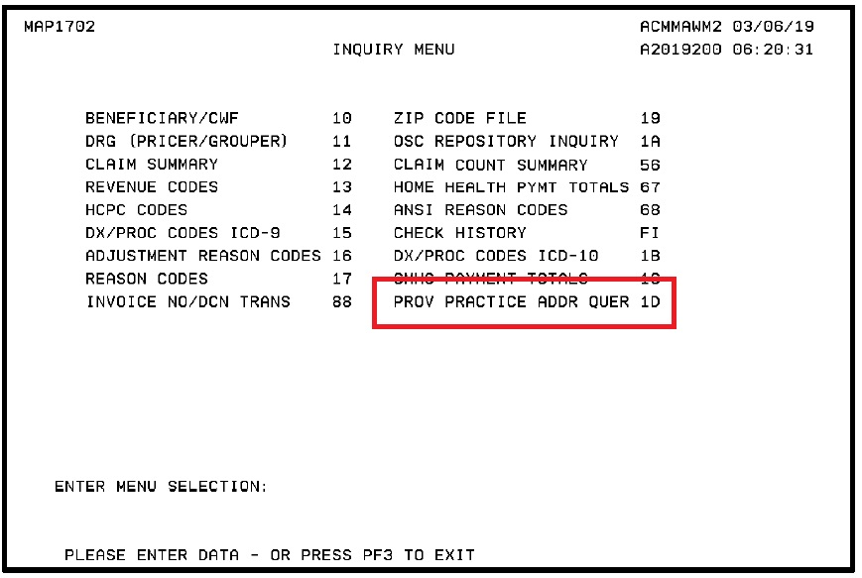
Provider Practice Address Query Screen
Practice location screen received from the PECOS is available in DDE:
  Compare this file to ensure claims submitted for the practice location is an exact match
  Select the Provider Practice Address Query menu selection 1D from the Inquiry Menu

Slide 44
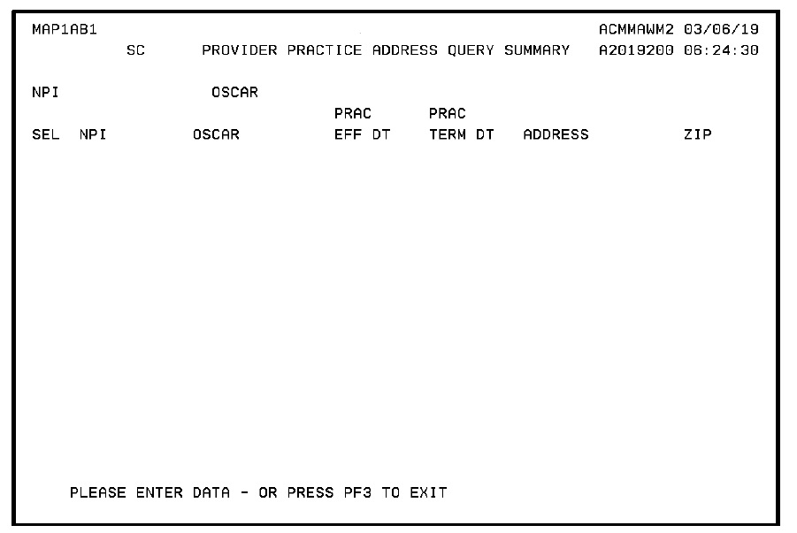
Provider Practice Address Query Summary
Provider Practice Address Query Summary MAP1AB1:
  Type ‘S’ in the SEL field and press enter to go to the Provider Practice Address Query Inquiry Screen

Slide 45
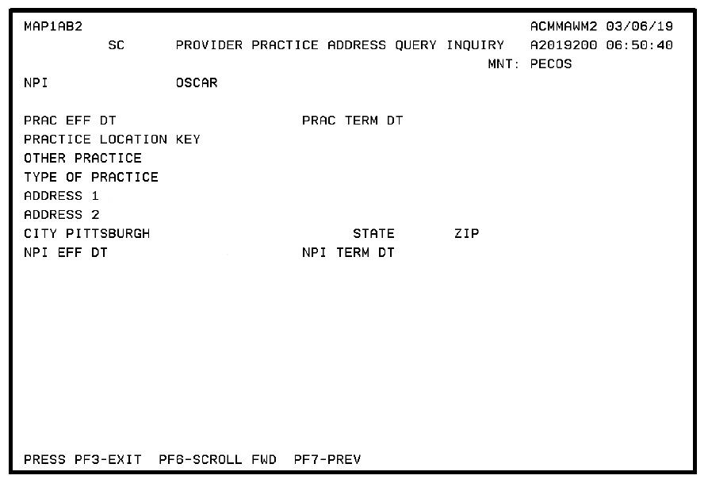
Provider Practice Address Query Inquiry
Provider Practice Address Query Inquiry MAP1AB2

Slide 46
Address Example 1
An address in the practice address query screen is listed as:
  ADDRESS 1: 123 Apple St. #34
  ADDRESS 2:
  CITY: Nowheretown STATE: JD ZIP: 12345-1234
In order to not receive reason code 34977 for invalid location on the claim submission:
  Word “street” must be abbreviated as it appears on the screen as “St.” with the appropriate punctuation
  The “#34” must also appear in the address 1 field:
    It cannot be moved to the address 2 line
  Address 2 line must remain blank
  Zip code must be reported with the full five digits plus the additional four exactly as they appear
If any element does not exactly match, the system will not be able to match the exact address and the claim will RTP for reason code 34977

Slide 47
Address Example 2
An address in the practice address query screen is listed:
  ADDRESS 1: Going Rd Suite 2C
  ADDRESS 2: Clinic of Clinics
  CITY: Townstown STATE: JD ZIP:98765-5432
In order to not receive reason code 34977 for invalid location on the claim submission, the practice location information must be filled in with ALL elements of this address
  Address 1 line must be abbreviated as it appears with no punctuation in this example
  Address 2 line must include the name listed under the Address 2 line:
    “Clinic of Clinics”

Slide 48
Reporting Line Level Information: Off-Campus Practice Location Modifiers
OPPS providers are required to report one of the appropriate modifiers when reporting an off-campus practice location:
  PO - Services, procedures and/or surgeries provided at off-campus provider-based outpatient departments:
    For all excepted items for services reported with a HCPCS furnished
  PN -Non-excepted service provided at an off-campus, outpatient, provider-based department of a hospital:
    For all non-excepted items and services
    Triggers a payment rate under the Medicare Physician Fee Schedule (MPFS)
  ER - Items and services furnished by a provider-based off-campus emergency department.
Claim will RTP with reason code 34978 if:
  An inappropriate modifier is reported;
  A practice location is reported and no modifier is reported

Slide 49
Affect on Non-OPPS Providers
Non-OPPS providers include Maryland (MD) waiver and Indian Health Service (IHS) providers
Hospital providers are required to include all practice locations in PECOS or on the CMS-855A enrollment form
  Claim will RTP with reason code 34977 if:
    Hospital claim is submitted with a service facility location that was not included in PECOS or on the CMS-855A enrollment form; or
    Location reported does not exactly match the information from the CMS -855A
  Applies to TOBs 13x and 14x
Non-OPPS providers are exempt from reporting the modifiers PN, PO, or ER as payments will not change due to off-campus practice locations
Non-OPPS providers only have to ensure the off-campus location is reported correctly

Slide 50
Part A East (PAE) QIC Demonstration

Slide 51
Demonstration Background
In 2015, CMS authorized the QIC (C2C) to conduct the Telephone Discussion Demonstration:
  Selected DME suppliers had the opportunity to participate in a formal recorded telephone discussion to offer verbal testimony
In 2019, CMS authorized C2C to conduct the Telephone Discussion Demonstration for Part A East:
  The Phone Discussion and Reopening Process will be conducted the same as DME
  Providers will receive a letter requesting phone discussion with C2C:
    Phone discussions are voluntary
    Reviews can take 120 days instead of traditional 60 day time frame
Participation in demonstration will not impact subsequent appeal rights

Slide 52
Benefits of Demonstration
Selected provider who elect to participate in the demonstration will have the opportunity for direct interaction with the reconsideration decision maker to:
  Provide verbal testimony
  Submit any missing/critical documentation needed to further support a favorable decision
  Receive feedback/education on CMS policies and requirements
  Improve proper claim submission
C2C will conduct an analysis on completed unfavorable claims currently pending a decision at the ALJ:
    For potential claim reopening
References:
  Part A East Appeals Demonstration (JH) (JL)
  C2C Website for PAE Appeals Demonstration

Slide 53
Provider Discussion Request
Indicate in writing at the top of reconsideration form requesting a phone discussion
If reconsideration request has already been submitted contact via fax or email:
  ADemoFeedback@c2cinc.com
  Fax: 904-224-2732
Not all requests can be granted a phone discussion:
  C2C will determine eligibility
  Notification will be sent if appeal criteria is not met

Slide 54
Credit Balance Reporting

Slide 55
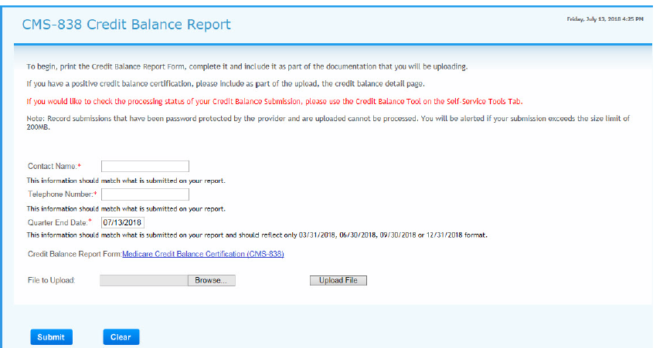
CMS-838 Credit Balance Report

Slide 56
Important Medicare Credit Balance Report Dates
Due each quarter ending
Medicare Credit Balance Report must be submitted within 30 days after the close of each calendar quarter
Quarter End | Medicare Credit Balance Report Due | Warning Letter Mailed | Placed on 100% Payment Withhold
March 31 | April 30 | May 15 | June 03
June 30 | July 30 | August 15 | September 03
September 30 | October 30 | November 15 | December 03
December 31 | January 30 | February 15 | March 03

Slide 57
Helpful Hints for Successful Credit Balance Reporting
Providers must first attempt to make their own claim adjustments:
  Submit adjustments as soon as you identify the credit balance once that particular quarter begins
Submit the correct version of the CMS-838 form:
  Use of the electronic version is preferred, however paper copies are still acceptable
Complete the entire CMS-838 detail page when reporting credit balances
Ensure the provider number (PTAN) on the certification page matches the detail page
One refund check per Credit Balance Report
Review your Credit Balance Report to verify all data is correct and matching before you submit it
Visit our website for more details on Credit Balance Reporting

Slide 58
Contact Person
Contact person should be a person who has knowledge of Credit Balance Report and should also know how to process claims:
  Listed at the top of the Detail Page
Ensure the telephone number is correct
Only one attempt will be made to contact the provider regarding questions on the submitted report:
  If the provider does not return the telephone call then Novitas will offset the amount reported on the credit balance report
  The claim will not show an adjustment in FISS

Slide 59
Education and Training Events

Slide 60

Novitas Learning Center
New Novitas Learning Center (NLC)!
  Improved look and feel and streamlined navigation
  More sophisticated design:
    Intuitive dashboard provides quick view of learning customized for the learner
    Learn anywhere, anytime on any device
    Improved content library
  Take the lead in your own professional development when seeking and accessing Medicare training opportunities

Slide 61

2019 Novitas Symposiums
2019 Novitas Explore Medicare Education Symposiums
Date | Location | Venue Information
12/4/2019- 12/5/2019 | Virtual | Virtual Symposium

Slide 62
Summary
Identified the current Medicare updates and reminders
Provided educational resources and information
Explored the Medicare guidelines regarding outpatient services provided to an inpatient at another facility

Slide 63
Thank You for Attending
Contact Information:
  Diane Hess
    Education Specialist
    Diane.Hess@novitas-solutions.com
    Phone: (717) 526-6520
  Stephanie Portzline
    Manager, Provider Engagement
    Stephanie.Portzline@novitas-solutions.com
    Phone: (717) 526-6317
  Janice Mumma
    Supervisor Provider Outreach and Education
    janice.mumma@novitas-solutions.com
    717-526-6406

