Slide 1
Medicare Updates and What’s Trending for 2019
NJ AAHAM
March 6, 2019

Slide 2
Disclaimer
All Current Procedural Terminology (CPT) only are copyright 2019 American Medical Association (AMA). All rights reserved. CPT is a registered trademark of the American Medical Association. Applicable Federal Acquisition Regulation/ Defense Federal Acquisition Regulation (FARS/DFARS) Restrictions Apply to Government Use. Fee schedules, relative value units, conversion factors and/or related components are not assigned by the AMA, are not part of CPT, and the AMA is not recommending their use. The AMA does not directly or indirectly practice medicine or dispense medical services. The AMA assumes no liability for data contained or not contained herein.
The information enclosed was current at the time it was presented. Medicare policy changes frequently; links to the source documents have been provided within the document for your reference. This presentation was prepared as a tool to assist providers and is not intended to grant rights or impose obligations.
Although every reasonable effort has been made to assure the accuracy of the information within these pages, the ultimate responsibility for the correct submission of claims and response to any remittance advice lies with the provider of services.
Novitas Solutions’ employees, agents, and staff make no representation, warranty, or guarantee that this compilation of Medicare information is error-free and will bear no responsibility or liability for the results or consequences of the use of this guide.
This presentation is a general summary that explains certain aspects of the Medicare program, but is not a legal document. The official Medicare program provisions are contained in the relevant laws, regulations, and rulings.
Novitas Solutions does not permit videotaping or audio recording of training events.

Slide 3
Subscribe to Novitas eNews!
Receive current updates via email directly from Novitas Solutions:
  Part A and Part B News
  Issued every Tuesday and Friday
  CMS MLN Connects issued Thursdays
Subscribing is quick and easy:
  Click the Join E-Mail List from our website tool bar

Slide 4
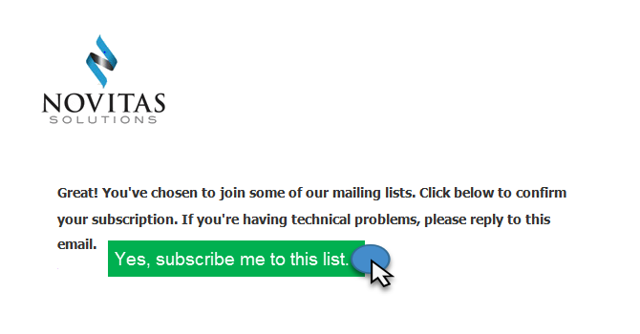

Remain Enrolled
A verification e-mail will be sent to you minutes after subscribing:
  Click “Yes, subscribe me to the list”
Didn’t receive the verification or you stopped receiving eNews:
  Your network firewall or spam filter is blocking us
  Please alert your network IT personnel
  Follow these simple steps to allow eNews:
    https://mailchimp.com/about/ips/

Slide 5
Acronym List
Acronym | Definition
ACH | Acute Care Hospital
CAH | Critical Access Hospital
CMS | Centers for Medicare & Medicaid Services
EDI | Electronic Data Interchange
FISS | Fiscal Intermediary Shared System
HIC | Health Insurance Claim
IPF | Inpatient Psychiatric Facility
IRF | Inpatient Rehab Facility
LTCH | Long Term Care Hospital
MBI | Medicare Beneficiary Identifier
MID | Medicare Identification Number
OIG | Office of Inspector General
OPPS | Outpatient Prospective Payment System

Slide 6
Today’s Presentation
Agenda:
  Medicare Updates and Reminders
  Keeping Your Patients Healthy
  Novitas Initiatives
Objectives:
  Identify and understand the current Medicare updates and reminders
  Identify and utilize the educational resources and information
  Explore the Medicare guidelines regarding outpatient services provided to an inpatient at another facility

Slide 7
  Medicare Updates and Reminders

Slide 8
Update to Medicare Deductible, Coinsurance and Premium Rates for 2019
MM11025:
  Effective Date: January 1, 2019
  Implementation Date: January 7, 2019
Key Points:
  2019 Part A – Hospital Insurance:
    Deductible: $1,364.00
    Coinsurance:
      $341.00 a day for 61st-90th day
      $682.00 a day for 91st-150th day (lifetime reserve days)
      $170.50 a day for 21st-100th day (Skilled Nursing Facility coinsurance)
  2019 Part B –Medical Insurance:
    Deductible: $185.00 a year
    Coinsurance: 20 percent
Additional Reference:
  2019 Medicare Parts A & B Premiums and Deductibles Fact Sheet

Slide 9
Therapy Cap Values for Calendar Year (CY) 2019
MM11055:
  Effective: January 1, 2019
  Implementation: January 7, 2019
Key Points:
  Outpatient therapy limits (KX modifier threshold) for:
    Physical Therapy (PT) and Speech-Language Pathology (SLP) combined is $2,040
    Occupational Therapy (OT) is $2,040
  Medical Review (MR) threshold amount :
    PT and SLP services combined is $3,000
    OT services is $3,000
Provider Specialty: Therapy (JL)

Slide 10
Removal of Functional Reporting Requirements for Therapy
MM11120:
  Effective: January 1, 2019
  Implementation: February 26, 2019
Key Points:
  HCPCS G-codes and severity modifiers for functional reporting are no longer required on claims for therapy services
  The retention of the therapy cap amounts as thresholds of incurred expenses above which claims must include a modifier to confirm services are medically necessary as shown by medical record documentation
Functional reporting requirements were effective for dates of service, January 1, 2013 through December 31, 2018
  Functional Reporting

Slide 11
Total Knee Arthroplasty (TKA) Removal fro the Medicare Inpatient-Only (IPO) List and Application of the 2- Midnight Rule
SE19002:
  Effective January 1, 2018, TKA procedures have been removed from the IPO list
  TKA procedures can be performed on an inpatient or an outpatient basis assuming all other criteria is met
  CMS contracted the Beneficiary and Family-Centered Care Quality Improvement Organizations (BFCC-QIOs) to review a sample of Medicare fee-for-service (FFS) short-stay inpatient for compliance with the 2-Midnight Rule looking at documentation in the medical record to support:
    The admitting physician/practitioner’s reasonable expectation that the beneficiary will require medically necessary hospital services spanning 2 midnights or longer and admits the patient to the hospital based on that expectation; or
    The admitting physician/practitioner’s judgment that the beneficiary required hospital care on an inpatient basis despite lack of a 2-midnight expectation based on complex medical factors including but not limited to:
      Patient’s history, co-morbidities and current medical needs
      Severity of signs and/or symptoms
      Risk of adverse events

Slide 12
Revision of Definition of the Physician Supervision of Diagnostic Procedures, Clarification of DSMT Telehealth Services, and Establishing a Modifier for Expanding the Use of Telehealth for Individuals with Stroke
MM11043 :
  Effective: January 1, 2019
  Implementation: January 2, 2019
Key Points:
  Revises the definition of "Personal Supervision" of the Physician Supervision of Diagnostic Procedures indicator to specify that procedures performed by a Registered Radiologist Assistant (RRA) or a Radiology Practitioner Assistant (RPA) may be performed under direct supervision
  Adds instructions to use modifier G0 (G zero) to identify Telehealth services furnished for purposes of diagnosis, evaluation, or treatment of symptoms of an acute stroke
  Clarifies requirements for when Diabetes Self-Management Training (DSMT) services may be paid as a telehealth service

Slide 13
New Modifier for Expanding the Use of Telehealth for Individuals with Stroke
MM10883:
  Effective: January 1, 2019
  Implementation: January 7, 2019
Key Points:
  New HCPCS informational Modifier G0 (G zero)
  For telehealth services that are furnished on or after January 1, 2019, for purposes of diagnosis, evaluation, or treatment of symptoms of an acute stroke:
    Telehealth distant site codes billed with Place of Service (POS) code 02 or Critical Access Hospitals, CAH method II (revenue codes 096X, 097X, or 098X); or
    Telehealth originating site facility fee, billed with HCPCS code Q3014
Telehealth Service Modifiers (JH)
Current Procedural Terminology (CPT) only copyright 2018 American Medical Association. All rights reserved.

Slide 14
Update to Intensive Cardiac Rehabilitation (ICR) Programs
MM11117:
  Effective: February 9, 2018
  Implementation: March 19, 2019
Key Points:
  The CR expands coverage in an Intensive Cardiac Rehabilitation (ICR) Programs for approved additional conditions:
    Stable, chronic heart failure defined as patients with left ventricular ejection fraction of 35% or less and New York Heart Association (NYHA) class II to IV symptoms despite being on optimal heart failure therapy for at least 6 weeks; or
    Any additional condition for which the Secretary has determined that a cardiac rehabilitation program shall be covered, unless the Secretary determines, using the same process used to determine that the condition is covered for a cardiac rehabilitation program, that such coverage is not supported by the clinical evidence

Slide 15
Supervised Exercise Therapy (SET) for Symptomatic Peripheral Artery Disease (PAD) – Clarification of Payment Rules
MM11022:
  Effective: May 25, 2017
  Implementation: March 19, 2019
Key Points:
  On May 25, 2017 CMS issued NCD providing SET coverage criteria for beneficiaries with Intermittent Claudication (IC) for treatment of symptomatic Peripheral Artery Disease (PAD)
    ICD-10 codes are provided in MM11022
  Medicare will cover PAD rehabilitation CPT 93668 up to 36 sessions over a 12 week period if all components of a SET program are met:
    Sessions lasting 30-60 minutes of therapeutic exercise-training
    Performed In hospital outpatient setting (TOB 13X, 85X), or a physician’s office (place of service 11)
    Delivered by qualified auxiliary personnel
    Under direct physician supervision
    Face-to-face with physician responsible for PAD treatment to obtain referral
Current Procedural Terminology (CPT) only copyright 2018 American Medical Association. All rights reserved.

Slide 16
NCD 20.4 Implantable Cardiac Defibrillators (ICDs)
MM10865:
  Effective: February 15, 2018
  Implementation: March 26, 2019
Key Points:
  Claims no longer require any trial-related coding
  CMS will cover ICDs for the following patient indications:
    Personal history of sustained VT or cardiac arrest due to VF
    Prior MI and a measured LVEF ≤ 0.30
    Have severe ischemic dilated cardiomyopathy but no personal history of sustained VT or cardiac arrest due to VF, and have NYHA Class II or III heart failure, LVEF < 35%
    Have severe non-ischemic dilated cardiomyopathy but no personal history of cardiac arrest or sustained VT, NYHA Class II or III heart failure, LVEF < 35%, and been on optimal medical therapy for at least 3 months
    Documented familial, or genetic disorders with a high risk of life-threatening tachyarrhythmias (sustained VT or VF), to include, but not limited to, long QT syndrome or hypertrophic cardiomyopathy
    Patients with an existing ICD may receive an ICD replacement if it is required due to the end of battery life, ERI, or device/lead malfunction

Slide 17
Outpatient Services Payment: Beneficiaries Who Are Inpatients of Other Facilities - Reminder
Recent OIG report determined that Medicare inappropriately paid ACHs for outpatient services provided to beneficiaries who were inpatients of other facilities, including LTCH, IRF, IPF, and CAH:
  As a result, beneficiaries were unnecessarily charged outpatient deductibles and coinsurance payments
All items and non-physician services provided during a Medicare Part A inpatient stay must be provided directly by the inpatient hospital or under arrangements with the inpatient hospital and another provider
References:
  Medicare Inappropriately Paid Acute-Care Hospitals for Outpatient Services They Provided To Beneficiaries Who Were Inpatients of Other Facilities OIG Report, September 2017.
  MLN Matters Special Edition Article SE170133 Medicare Does Not Pay Acute-Care Hospitals for Outpatient Services They Provide to Beneficiaries in a Covered Part A Inpatient Stay at Other Facilities
  Provider Compliance Tips for Ordering Hospital Outpatient Services Fact Sheet
  Acute Care Hospital Inpatient Prospective Payment System Fact Sheet Page 3
  Items and Services Not Covered Under Medicare Booklet Page 12
  Medicare Claims Processing Manual, Pub. 100-04, Chapter 3 – Inpatient Hospital Billing , Section 10.4 “ Payment of Nonphysician Services for Inpatients”

Slide 18
Hospital Price Transparency
Effective in 2019 CMS updated its guidelines to specifically require hospitals to make public a list of their standard charges
Encourage price transparency by improving public accessibility of charge information:
  Post via the Internet in a machine readable format
  Update this information at least annually, or more often as appropriate
References:
  CMS Finalizes Changes to Empower Patients and Reduce Administrative Burden
  Fiscal Year (FY) 2019 Medicare Hospital Inpatient Prospective Payment System (IPPS) and Long-Term Acute Care Hospital (LTCH) Prospective Payment System Final Rule (CMS-1694-F)
  Frequently Asked Questions Regarding Requirements for Hospitals To Make Public a List of Their Standard Charges via the Internet

Slide 19
2019 Medicare Part D Opioid Policies: Information for Prescribers
CMS implemented new opioid policies for Medicare drug plans on January 1, 2019, that include:
  Improved safety alerts when patients fill opioid prescriptions at the pharmacy
  Drug management programs for patients at-risk for misuse or abuse of opioids or other drugs
  Posted new training materials, including slide decks and tip sheets for:
    Prescribers
    Pharmacists
    Patients
MLN Matters Special Edition Article SE18016 A Prescriber’s Guide to the New Medicare Part D Opioid Overutilization Policies for 2019
Visit the Reducing Opioid Misuse webpage for more information on CMS’ overall strategy:
  Prevention
  Treatment
  Data
Review of opioid use during the IPPE and is helpful in diagnosing and then treating as appropriate opioid disorders:
  MLN Matters Special Edition Article SE18004 - Review of Opioid Use During the IPPE and AWV

Slide 20
FISS Provider Practice Location Address
FISS Claim Page 3 Provider Practice Location:
  New claim page must include your practice location address when services billed are rendered in an off-campus, outpatient, or provider-based department of a hospital facility
    Report the address exactly as it appears in PECOS
    Upon implementation of the April 2019 quarterly release, claims that do not match exactly will RTP
    Ensure that an accurate address for each hospital department practice location is present in PECOS
      Providers who need to add a new or correct an existing practice location address will need to submit a new 855A enrollment application in PECOS
  Refer to MLN Special Edition Article SE18002 Billing Requirements for OPPS Providers with Multiple Service Locations and SE18023 Activation of Systemic Validation Edits for OPPS Providers with Multiple Service Locations

Slide 21
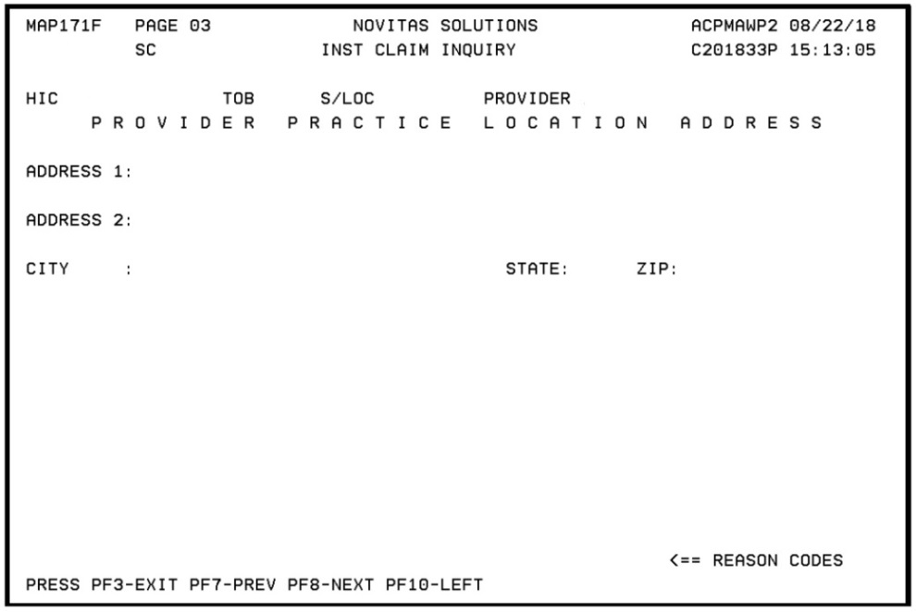
FISS Claim Page 3 Provider Practice Location Address
To access Claim Page 03, (MAP171F), from Claim Page 03 (MAP1719) press F11
Enter the provider practice location address in the fields provided on this page

Slide 22
Reporting the Service Facility Location for an Off-Campus, Provider-Based Department of a Hospital
Claim level information:
  When all the services rendered on the claim are from the billing provider address:
    Report the billing provider address only in the billing provider loop 2010AA and not to report any service facility location in loop 2310E (or in DDE MAP 171F screen for DDE submitters)
  When all the services rendered on the claim are from one campus of a multi-campus provider that report a billing provider address:
    Report the campus address where the services were rendered in the service facility location in loop 2310E if the service facility address is different from the billing provider address loop 2010AA (or in DDE MAP 171F screen for DDE submitters)
  When all the services rendered on the claim are from the same off-campus, outpatient, provider-based department of a hospital:
    Report the off-campus, outpatient, provider-based department service facility address in the service facility provider loop 2310E (or in DDE MAP 171F screen for DDE submitters)
  When there are services rendered on the claim from multiple locations:
    If any services on the claim were rendered at the billing provider address:
      Report the billing provider address only in the billing provider loop 2010AA and do not report the service facility location in loop 2310E (or in DDE MAP 171F screen for DDE submitters)
    If no services on the claim were rendered at the billing provider address:
      Report the service facility address in loop 2310E (or in DDE MAP 171F screen for DDE submitters) from the first registered encounter of the “From” date on the claim
Line level information:
  Report modifier PO (Services, procedures and/or surgeries provided at off-campus provider-based outpatient departments) for all excepted items for services reported with a HCPCS furnished
  Report modifier PN (Non-excepted service provided at an off-campus, outpatient, provider-based department of a hospital) for all non-excepted items and services
    Triggers payment under the MPFS

Slide 23
User CR: FISS to Add Additional Search Features to Provider Direct Data Entry (DDE) Screen
MM10542:
  Effective: January 1, 2019
  Implementation: January 7, 2019
Key Points:
  New feature will allow providers to find the claim associated with the AR and reconcile it back to their patient accounts:
    Use the invoice number on the AR to find the DCN
    Use the DCN to look up the claims
    New screen will be “Invoice Number/DCN Translator"

Slide 24
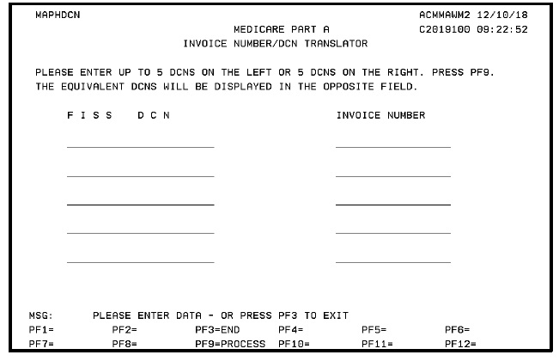
FISS Invoice Number/DCN Translator
Menu option 88 on the Inquiry Menu in FISS
Enter up to 5 DCNs on the left or 5 DCNs on the right

Slide 25
Annual FISS Recertification
CMS requires annual recertification of every user who has access to FISS
Users must be recertified by the authorized official (AO) or delegated official (DO) on file within 30 days of the date of the letter:
  Letter mailed to the AO/DO listed on the provider’s CMS-855A
  User’s access will be removed if letter is:
    Incomplete
    Inaccurate
    Not returned by the due date
  Completed recertification letters must be return to EDI via fax at 1-877-439-5479
For more information:
  Novitas Solutions Annual Recertification of Part A FISS Users

Slide 26
Important Dates For The New Medicare Card
CMS to remove Social Security Numbers (SSNs) from all Medicare cards by April 2019
The transition period will run from April 2018 through December 31, 2019
October 2018 through the end of the transition period, when a valid and active Medicare Number is submitted on Medicare fee-for-service claims both the Medicare Number and the MBI will be returned on the remittance advice
Find more information on the New Medicare Card on the CMS website on the New Medicare Card home page and the Providers page

Slide 27
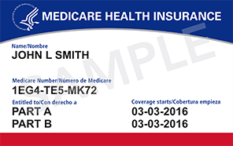
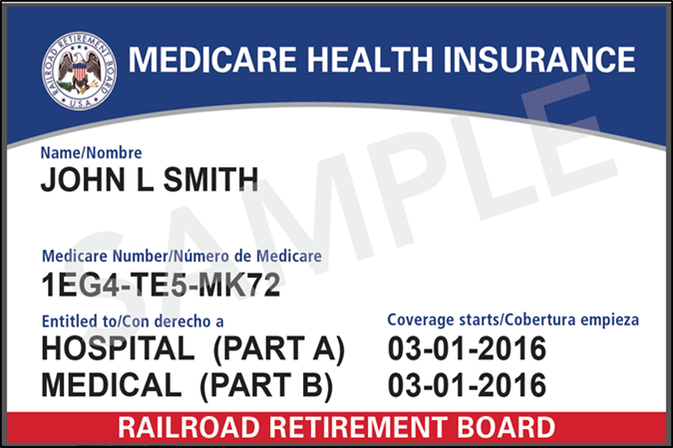
New Medicare Card
New Medicare card:
  Health and Human Services (HHS) logo
  Gender and signature line removed
Railroad Retirement MBI card:
  Railroad Retirement Board logo will be the key identifier
  Mailing will began June 2018

Slide 28
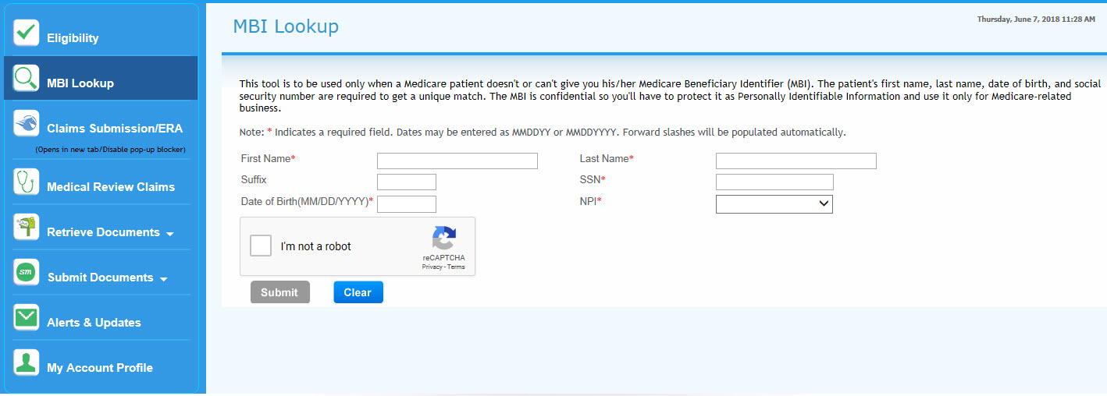
Novitasphere MBI Lookup
MBI crosswalk tool in Novitasphere now available

Slide 29
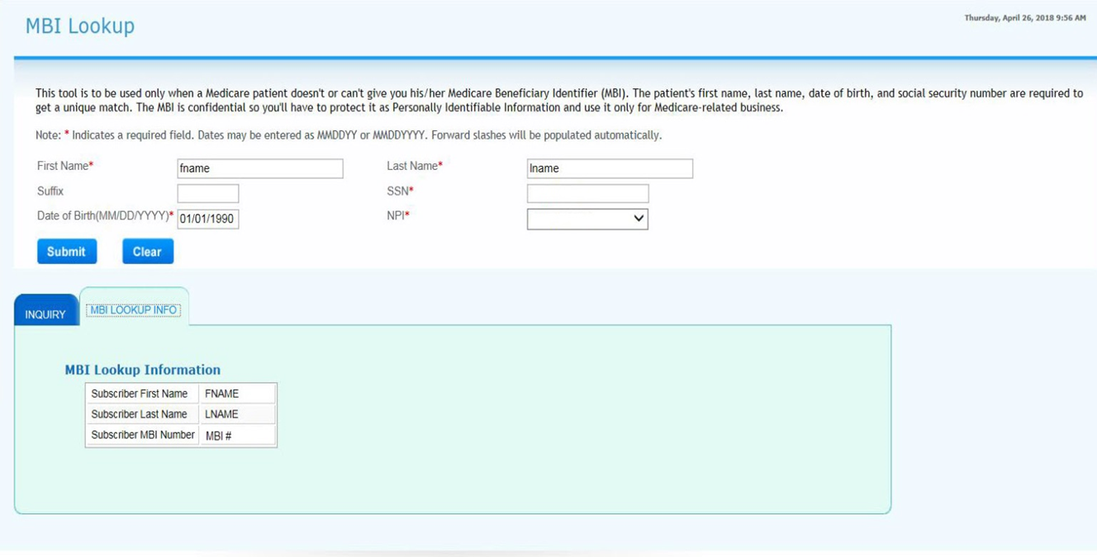
MBI Lookup Results
MBI lookup results

Slide 30
MSP Diagnosis Codes Available in HETS and Novitasphere
HETS and Novitasphere will return MSP diagnosis codes when applicable:
  MSP diagnosis codes primarily relate to treatment from an injury or illness resulting from and auto or other accident which:
    Liability or no-fault insurance may pay
    Another party is responsible for payment
    Workers’ compensation benefits for a given condition
  Helps you determine primary and secondary billing for patient services
  These are ICD-10 diagnosis codes that are listed on the beneficiaries’ MSP file:
    If the MSP file was set up with ICD-9 codes, these will not populate
References:
  MLN Connects December 6, 2018
  Novitasphere Portal Part A User Manual

Slide 31
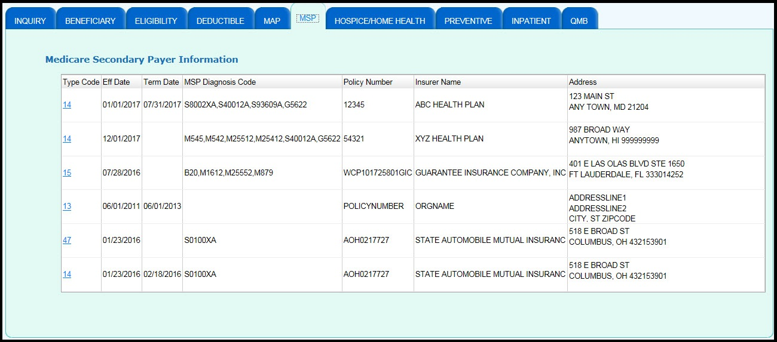
Novitasphere MSP Information

Slide 32
HETS and Novitasphere Include Medicare Diabetes Prevention Program Information
Effective December 8, HETS will return Medicare Diabetes Prevention Program (MDPP):
  Use this information to determine the next available (MDPP) services for you patients
  HETS will not return MDPP if the Medicare Beneficiary is ineligible for MDPP
Reference:
  MLN Connects December 13
  Provider Specialty: Preventive Services Part A

Slide 33
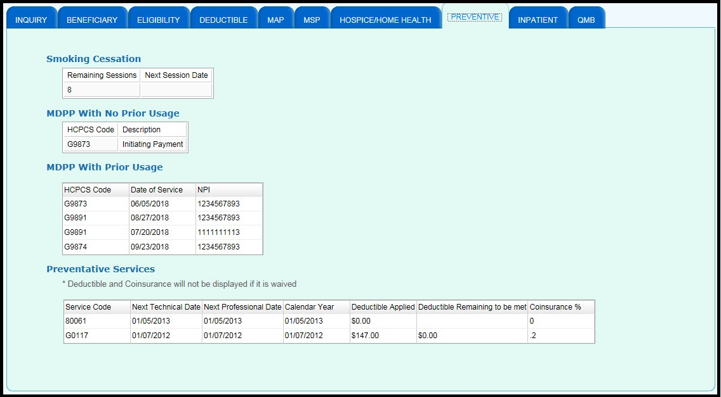
Novitasphere – Preventive Services

Slide 34
Preventative Services:
Keeping Your Patients Healthy

Slide 35
Discuss Preventive Services With Your Patient
Definition:
  Preventive services can be defined as patient counseling and screenings to prevent illness, disease, and other health-related problems
Purpose:
  Providers play a crucial role in promoting, providing, and educating Medicare patients about potentially life-saving preventive services and screenings
  Encourage Medicare patients to take advantage of covered preventive services
  Medicare covers many preventive services at little or no cost to patients
References:
  CMS Preventive Services Page
  CMS Preventive Services Video
  Medicare Claim Processing Manual, Pub. 100-04, Chapter 18 – Preventive and Screening Services
  Provider Resources on Preventive Services
  Your Guide to Medicare’s Preventive Services:
    A guide for beneficiaries

Slide 36
Preventive Services and Screenings Covered by Medicare
Alcohol Misuse Screening & Counseling
Annual Wellness Visit
Bone Mass Measurements
Cardiovascular Disease Screening Tests
Colorectal Cancer Screening
Counseling to Prevent Tobacco Use
Depression Screening
Diabetes Screening
Diabetes Self-Management Training
Glaucoma Screening
Hepatitis B Vaccine & Administration
Hepatitis C Virus Screening
HIV Screening
Influenza Virus Vaccine & Administration
Initial Preventive Physical Examination
Intensive Behavioral Therapy (IBT) for Cardiovascular Disease
Intensive Behavioral Therapy (IBT) for Obesity
Lung Cancer Screening
Medical Nutrition Therapy
Pneumococcal Vaccine & Administration
Prostate Cancer Screening
Screening for Cervical Cancer
Screening for STIs and HIBC to Prevent STIs
Screening Mammography
Screening Pap Tests
Screening Pelvic Examinations
Ultrasound Screening for Abdominal Aortic Aneurysm (AAA)

Slide 37
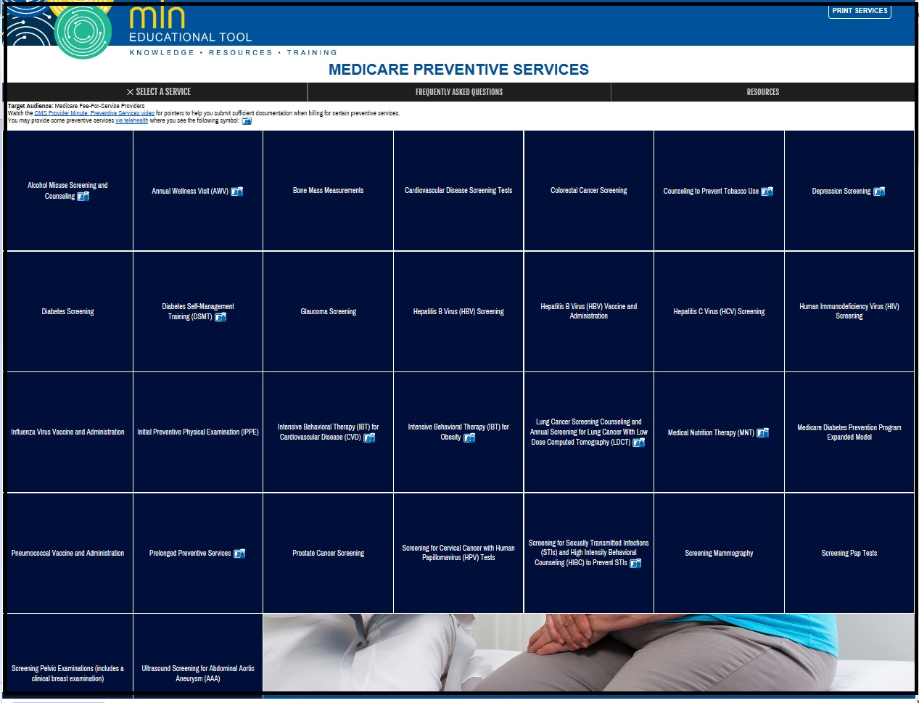
Interactive Preventive Services Tool
Preventive Services Tool

Slide 38
Novitasphere Preventive Services Tab

Slide 39
Medicare Diabetes Prevention Program (MDPP)
Definition:
  The MDPP is defined as an expanded model which includes an evidence-based set of services aimed to help prevent the onset of type 2 diabetes among Medicare beneficiaries with an indication of prediabetes
Purpose:
  The primary goal of the expanded model is to help Medicare beneficiaries achieve at least five percent (5%) weight loss
  Coverage of structured sessions with a coach, using a CDC-approved curriculum to provide training in dietary changes, increased physical activities, and weight loss strategies

Slide 40
Payment for MDPP Services
Organizations who enroll as an MDPP supplier are paid performance-based payments through the CMS claims systems:
  Medicare payments to suppliers will vary
  Payments can be up to $670 per beneficiary over a two year-period, depending on the beneficiary’s attendance and weight loss
In order to submit claims for MDPP services, organizations must:
  Meet all MDPP supplier requirements and standards, including preliminary or full CDC recognition
  Have a separate Medicare enrollment as an MDPP supplier
For the payment structure, HCPCS G-codes, and billing information:
  Billing and Claims Fact Sheet
  Billing and Payment Quick Reference Guide
  MLN Matters Article MM10970 - Updating Calendar Year (CY) 2019 Medicare Diabetes Prevention Program (MDPP) Payment Rates

Slide 41

Eligible Beneficiaries
Eligible beneficiaries are those who:
  Are enrolled in Medicare Part B
  Have a body mass index (BMI) of at least 25, or at least 23 if self-identified as Asian
Meet one of the following three blood test requirements within the 12 months of the first core session:
  A hemoglobin A1c test with a value between 5.7 and 6.4 percent
  A fasting plasma glucose of 110-125 mg/dl
  A 2-hour plasma glucose of 140-199 mg/dl (oral glucose tolerance test)
Have no previous diagnosis of type 1 or type 2 diabetes (other than gestational diabetes)
Do not have end-stage renal disease (ESRD)

Slide 42

Overview of the Benefit
The first year includes six months of weekly core sessions followed by six months of monthly maintenance sessions
The second year is contingent upon beneficiary performance and monthly maintenance sessions
MDPP suppliers must use a CDC-approved curriculum to guide sessions
Copayment is waived
No referral is required

Slide 43
Core Sessions
Months 0 to 6:
  MDPP suppliers must offer a minimum of 16 sessions, offered at least one week apart
  Sessions are available to eligible beneficiaries regardless of weight loss and attendance performance while on the program
  MDPP suppliers must use a CDC-approved curriculum to guide sessions
  Five percent weight loss is not required to receive payment
Months 7-12:
  MDPP suppliers must offer a minimum of six monthly sessions during the second six months
  Sessions are available to eligible beneficiaries regardless of weight loss and attendance performance while on the program
  MDPP suppliers must use a CDC-approved curriculum to guide sessions
  Payments are made in two three-month intervals
Months 13-24:
  MDPP suppliers must offer monthly maintenance sessions
  Eligible beneficiaries who achieve and maintain weight loss and attendance goals have coverage for three-month intervals of monthly maintenance sessions for up to one year
  MDPP suppliers must use topics from a CDC-approved curriculum to guide sessions:
  Payments are made in four three-month intervals and only if the beneficiary attends two ongoing maintenance sessions and achieves five percent weight loss

Slide 44
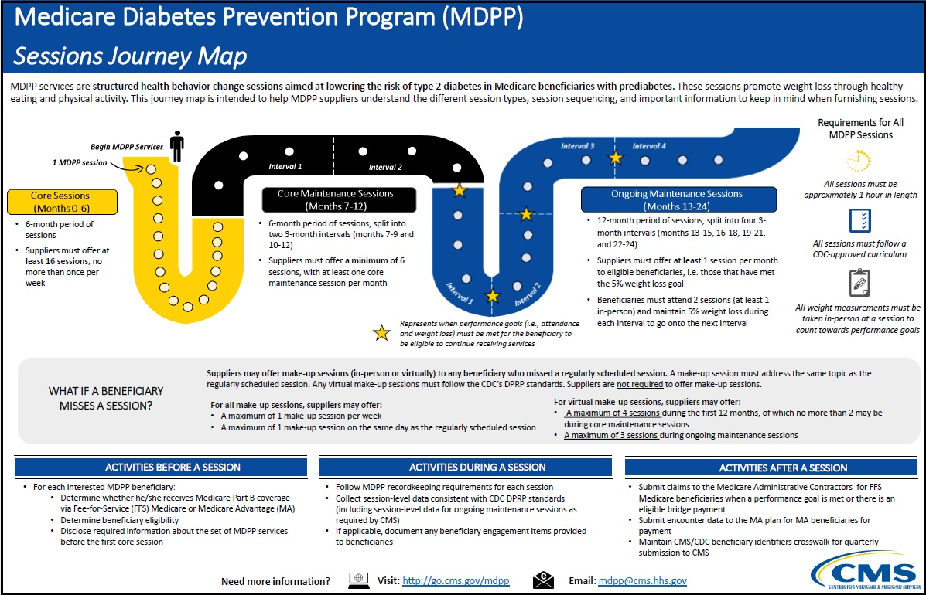
MDPP Sessions Journey Map
MDPP Sessions Journey Map

Slide 45
Medicare Diabetes Prevention Program (MDPP) Enrollment
To enroll as an MDPP supplier, organizations must:
  Have MDPP preliminary recognition or full CDC DPRP recognition
  Have an active and valid tax-identification number (TIN) or national provider identifier (NPI)
  Pass enrollment screening at the high categorical risk level
  Submit a list of MDPP coaches on the MDPP enrollment application who will lead sessions, including full name, date of birth, social security number (SSN), and active and valid NPI and coach eligibility end date (if applicable)
  Meet MDPP supplier standards and requirements, and other requirements of existing Medicare providers or suppliers
  Once enrolled, revalidate enrollment every five years
Complete the CMS20134 Application
MDPP Enrollment and Recognition Information:
  Preparing to Enroll as an MDPP Supplier
  Enrollment Checklist

Slide 46
MDPP References
Overview of the MDPP Expanded Model Fact Sheet
CMS MDPP Web Page
MLN Medicare Diabetes Prevention Program Calls:
  Find links to the presentations, audio recordings, and transcripts
Frequently Asked Questions
Listserv Signup
Email questions to: mdpp@cms.hhs.gov

Slide 47

March is National Colorectal Cancer Awareness Month
Of cancers that affect both men and women, colorectal cancer is the second leading cause of cancer-related deaths
Recommend screening to help protect your patients
Screening can help find this cancer at an early stage, when treatment often leads to a cure
Colorectal cancer screening coverage:
  Multitarget Stool (sDNA) test (81528):
    Aged 50 to 85 years
    Asymptomatic
    At average risk of developing colorectal cancer
  Screening colonoscopies (G0105, G0121), fecal occult blood tests (82270, G0328), flexible sigmoidoscopies (G0104), and barium enemas (G0106, G0120):
    Aged 50 and older who are at normal risk of developing colorectal cancer
    At high risk of developing colorectal cancer
  Deductible/coinsurance waived:
    Exception: barium enema - coinsurance applies; deductible waived
  NCD for Colorectal Cancer Screening Tests (210.3)

Slide 48
Frequency Guidelines – Not High Risk
Beneficiaries not meeting criteria for high risk:
  Multitarget sDNA test: once every three years
  Screening FOBT: once every 12 months
  Screening flexible sigmoidoscopy: once every 48 months (unless the beneficiary does not meet the criteria for high risk of developing colorectal cancer and the beneficiary has had a screening colonoscopy within the preceding 10 years, in which case Medicare may cover a screening flexible sigmoidoscopy only after at least 119 months have passed following the month that the beneficiary received the screening colonoscopy)
  Screening colonoscopy: once every 120 months (10 years), or 48 months after a previous sigmoidoscopy
  Screening barium enema (when used instead of a flexible sigmoidoscopy or colonoscopy): once every 48 months

Slide 49

Frequency Guidelines –High Risk
Beneficiaries at high risk:
  Screening FOBT: once every 12 months
  Screening flexible sigmoidoscopy: once every 48 months
  Screening colonoscopy: once every 24 months (unless a screening flexible sigmoidoscopy has been performed and then Medicare may cover a screening colonoscopy only after at least 47 months)
  Screening barium enema (when used instead of a flexible sigmoidoscopy or colonoscopy): once every 24 months

Slide 50

Protect Your Patients from Influenza this Season
Serious health threat to people 65 and older, who are at high risk for hospitalization, complications, and even death from flu
CDC recommends everyone six months of age and older receive a flu vaccine each year
Typical flu season is late fall through early spring
Medicare coverage:
  One flu vaccine and its administration each flu season:
    Additional flu vaccines if medically necessary
  Coinsurance and deductible waived
  Assignment must be accepted
  ICD-10 code – Z23
References:
  2019 Flu Reimbursement
  Centers for Disease Control and Prevention (CDC): Influenza (Flu)
  CMS Influenza Virus Vaccine and Administration Quick Reference
  MLN Matters Article MM10871 – “Quarterly Influenza Virus Vaccine Code Update – January 2019”

Slide 51
Novitas Initiatives

Slide 52
What is Novitasphere?
Definition:
  Free, secured web-based Portal which allows enrolled users access to time-saving features
Purpose:
  Allows enrolled users access to Eligibility, MBI Lookup, Remittance Advice, Appeal Requests, Medical Review Records and more
  Available to JH and JL Part A/B providers, billing services and clearinghouses
  Live Chat feature
    Dedicated Help Desk: 1-855-880-8424
    Available from 8:00AM-5:00 PM ET
Novitasphere User Guides and Instructions
For demonstrations and more information visit our Novitasphere webpage

Slide 53
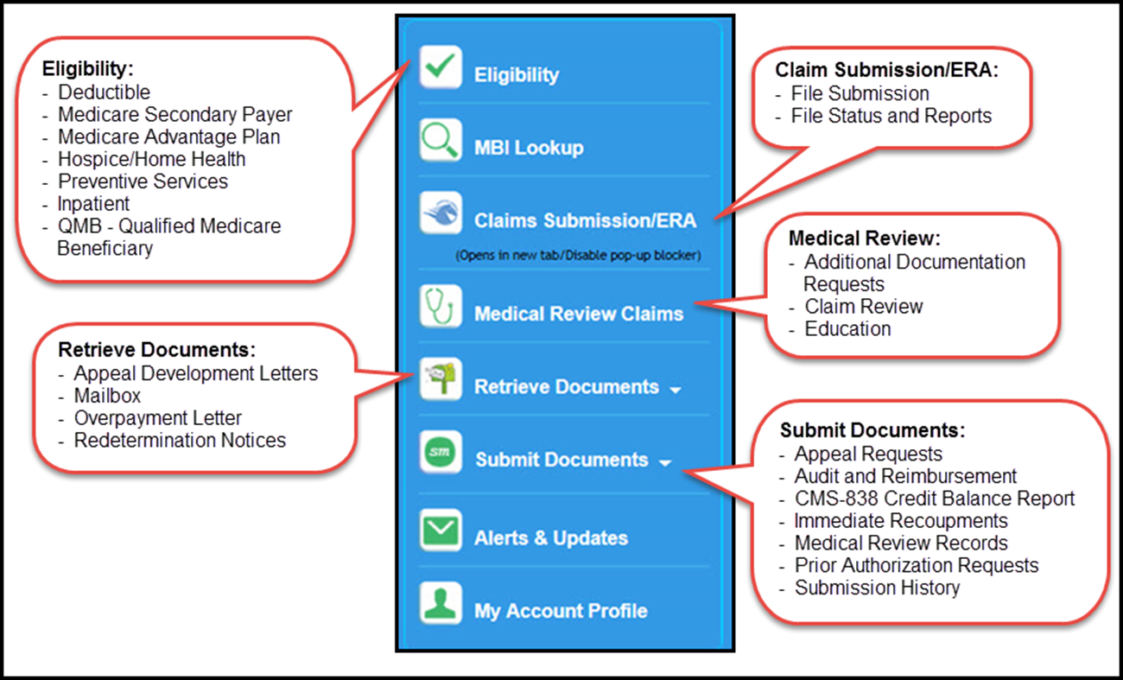
Part A Navigation Bar

Slide 54

Important: Novitasphere Log In Requirement Changes
CMS will be implementing a system security change that affects the Novitasphere log in requirements for maintaining access.
Effective September 1, 2018, registered Novitasphere users must log into Novitasphere at https://www.novitasphere.com at least once every 30 days to be considered active.
Upcoming Changes to Novitasphere Log In Requirements – Action Required

Slide 55
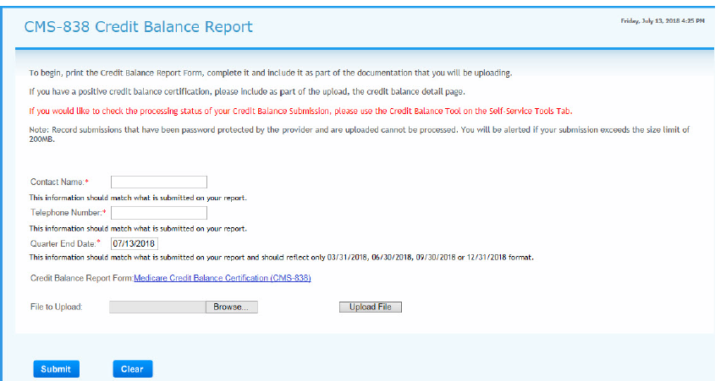
CMS-838 Credit Balance Report

Slide 56
Important Medicare Credit Balance Report Dates
Due each quarter ending
Medicare Credit Balance Report must be submitted within 30 days after the close of each calendar quarter
Quarter End | Medicare Credit Balance Report Due | Warning Letter Mailed | Placed on 100% Payment Withhold
March 31 | April 30 | May 15 | June 03
June 30 | July 30 | August 15 | September 03
September 30 | October 30 | November 15 | December 03
December 31 | January 30 | February 15 | March 03

Slide 57
Helpful Hints for Successful Credit Balance Reporting
Providers must first attempt to make their own claim adjustments:
  Submit adjustments as soon as you identify the credit balance once that particular quarter begins
Submit the correct version of the CMS-838 form:
  Use of the electronic version is preferred, however paper copies are still acceptable
Complete the entire CMS-838 detail page when reporting credit balances
Ensure the provider number (PTAN) on the certification page matches the detail page
One refund check per Credit Balance Report
Review your Credit Balance Report to verify all data is correct and matching before you submit it
Visit our website for more details on Credit Balance Reporting

Slide 58
Contact Person
Contact person should be a person who has knowledge of Credit Balance Report and should also know how to process claims:
  Listed at the top of the Detail Page
Ensure the telephone number is correct
Only one attempt will be made to contact the provider regarding questions on the submitted report:
  If the provider does not return the telephone call then Novitas will offset the amount reported on the credit balance report
  The claim will not show an adjustment in FISS

Slide 59
Trending Inquiries Received in the Customer Contact Center
Trouble using IVR to obtain beneficiary eligibility or claim status using an MBI ?
  When speaking an MBI in the IVR be sure to speak naturally, including normal pauses ever few characters
  Convert a MBI to a number that can be keyed into the IVR using the IVR Alphanumeric Conversion Tool:
    Example:
      MBI number EG-4TE-5MK-72 converted 1*32*414*81*325*61*5272
Consider using Novitasphere for most self service inquiries

Slide 60

New Novitas Learning Center (NLC)
New Novitas Learning Center (NLC):
  Improved look and feel and streamlined navigation
  More sophisticated design:
    Intuitive dashboard provides quick view of learning customized for the learner
    Learn anywhere, anytime on any device
    Improved content library
  Take the lead in your own professional development when seeking and accessing Medicare training opportunities

Slide 61
New Novitas Learning Center
Novitas strives to continually improve the services and resources provided to our customers. Our most recent innovation is the redesign of the Novitas Learning Center. Effective January 1, 2019, Novitas Learning Center users will observe a few changes:
  The username previously established to access a Novitas Learning Center account will be replaced by the user’s email address.
  Existing users will log into their account using the email address associated with the user account in the Novitas Learning Center.
  All users will be prompted to reset their passwords after the January 1, 2019, transition.
    Users will only need to reset their password one time.
  Historical learning information associated with the Novitas Learning Center account will be migrated to the new system for all completed courses.
    If a course is still in progress at the time of the transition, it will not be moved to the new system.

Slide 62
Summary
Identified the current Medicare updates and reminders
Provided educational resources and information
Explored the Medicare guidelines regarding outpatient services provided to an inpatient at another facility

Slide 63
Thank You for Attending
Contact Information:
  Diane Hess
    Education Specialist
    Diane.Hess@novitas-solutions.com
    Phone: (717) 526-6520
  Stephanie Portzline
    Manager, Provider Engagement
    Stephanie.Portzline@novitas-solutions.com
    Phone: (717) 526-6317
  Janice Mumma
    Supervisor Provider Outreach and Education
    janice.mumma@novitas-solutions.com
    717-526-6406

