Slide 1
NJ HealthCAP
NJ Department of Health
Data Intermediary Services
November 7, 2017

Slide 2

Agenda
I. About PCG
II. Program Overview
III. Application Overview
IV. Claims Submission Process
V. Claims Correction Process
VI. Data Reporting and Review
VII. Upcoming Features and Hotfixes

Slide 3
I. About PCG
Public Focus. Proven Results.

Slide 4

PCG Overview - A History of Success
30 Years of Healthcare Expertise
Management consulting firm focused exclusively on public sector solutions
2,000+ employees in 50 offices in U.S., Canada, and Europe
Headquarters in Boston with a large office in Princeton, NJ
State health agency partner for 30 years
Recent: state fiscal agent for early intervention services, Medicaid billing and compliance, third party administrator, claims adjudication and validation
5 company practice areas
    Health, Human Services, Technology, Education, and Public Partnerships
    Health practice area includes 350+ professionals
50+ SMEs specializing in claims processing systems development, consulting, and reporting services, including:
National leader in claims processing and reporting systems
  NY DOH State Fiscal Agent, DC DHCF Claims Billing Process Implementation and Compliance Assessment, MA Commonwealth Care Alliance Third Party Administration Services, AZ AHCCS Claims Processing, Adjudication, and Validation
National leader in claims grouper implementation and analysis
  CO HCPF APR-DRG and EAPG System Implementation, MA EOHHS EAPG System Implementation, TX HHSC EAPG System Implementation, WI DHS EAPG System Implementation and DRG Rate Setting
National leader in state-based exchange implementation and consulting services
  AR AHIM State-Based Marketplace Implementation, HI DHS Health Connector Exchange Consulting and Project Management Services, NM Health Insurance Exchange Consulting and Project Management Services

Slide 5
II. Program Overview

Slide 6
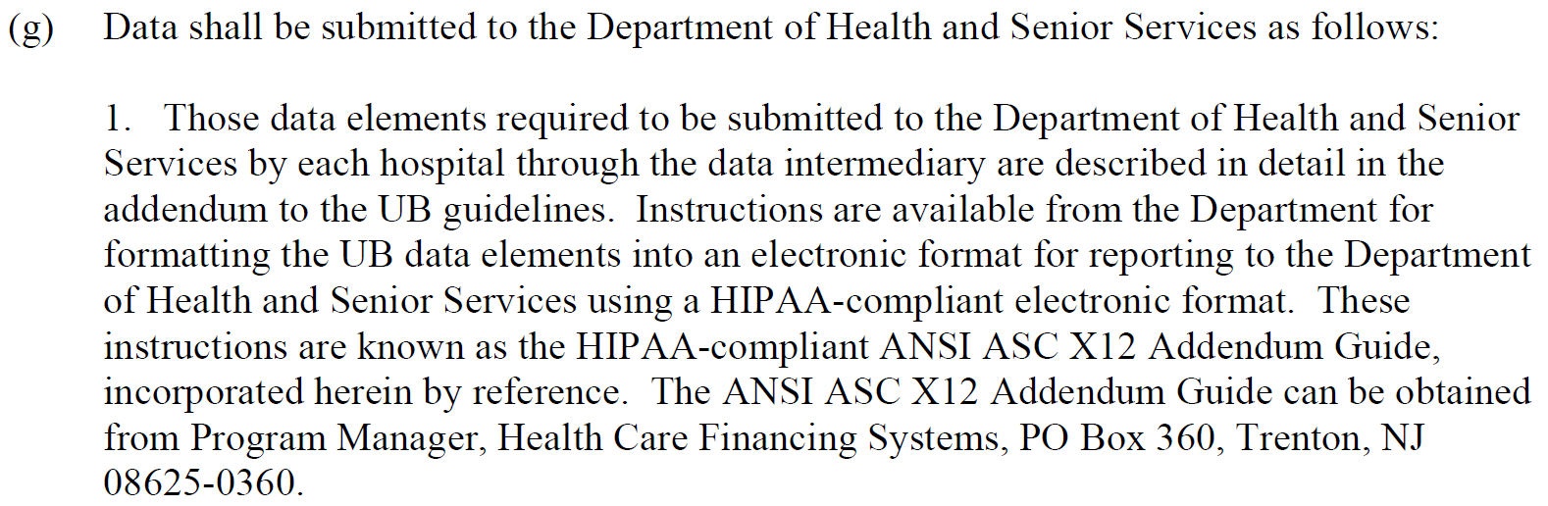
Program Overview
Governed by N.J.A.C Title 8, Chapter 31B (Hospital Financing Rules), Subchapter 2 (Hospital Reporting of Uniform Bill Data)
Submission requirements for hospital UB data are identified in 8:31B-2.5(g)(1):

Slide 7

Program Overview
The ASC X12N / 005010X225 ANSI 837 Health Care Service: Data Reporting (R) file format has been specifically requested by DOH as the required format for hospital UB data submission historically and in the present.
The NJ-specific 837R requirements that deviate from the standard 837R specifications are located in the NJ HealthCAP 837R Addendum Guide.
  Also known as the companion guide across the industry

Slide 8
III. Application Overview

Slide 9
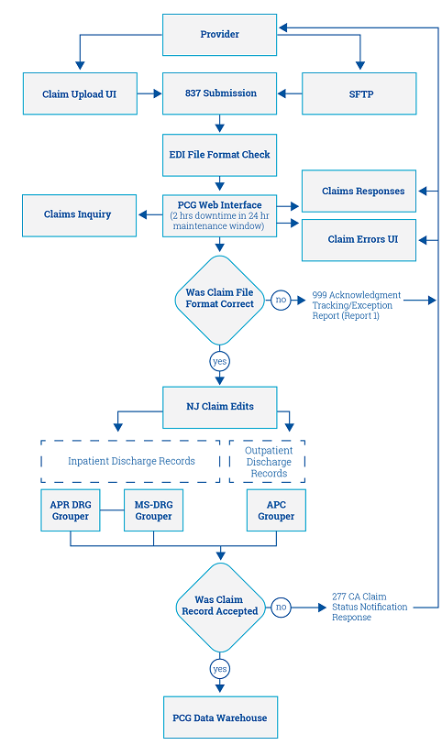
Application Overview
Notes:
Kevin

Slide 10
Application Overview
Notes:
Kevin

Slide 11
IV. Claims Submission Process

Slide 12
Claims Submission Process
837R Submission
SFTP
Web UI
File Format Check (999)
“999”Status”: Accepted/Rejected
Claim Content Check (277)
Track progress in “Claim Response” page
“File Status”: In Process/Completed
Track progress in “Claim Response” page
Rejected files require resubmission
Accepted claims move to data warehouse
Claims w/ errors require revisionsand resubmission through the “Claim Error” page

Slide 13
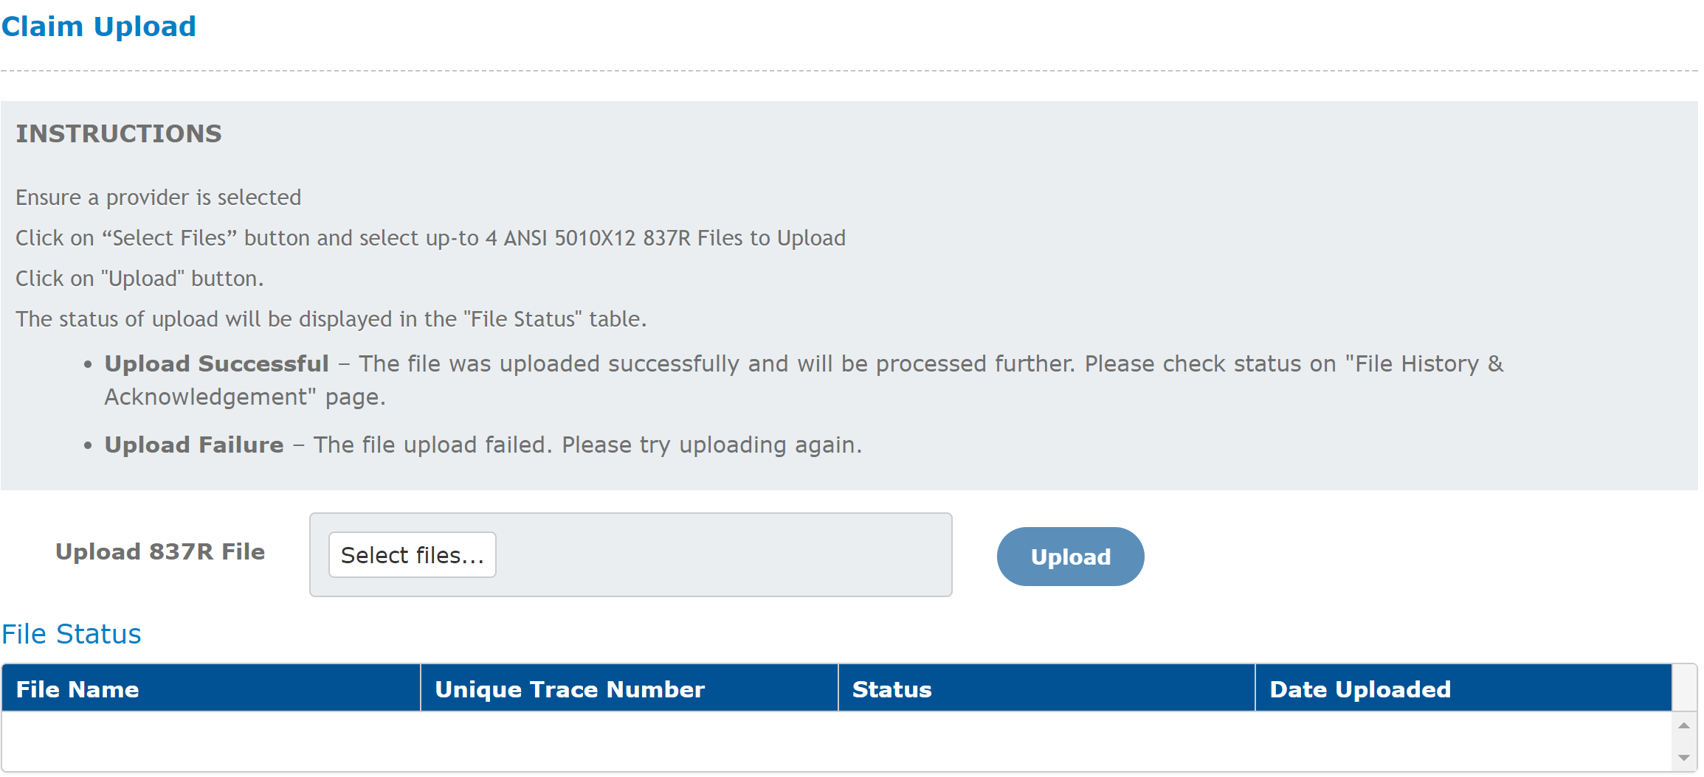
Claims Submission Process

Slide 14
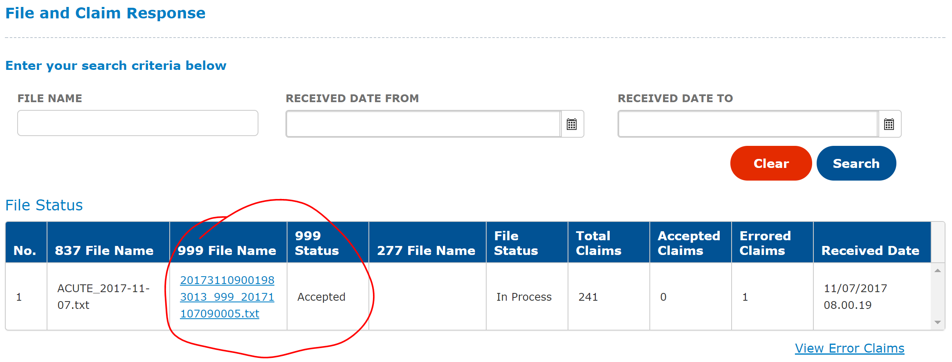
Claims Submission Process
*For rejected files, users can download the list of rejection reasons by clicking the hyperlinked text in the “999 File Name” column.

Slide 15
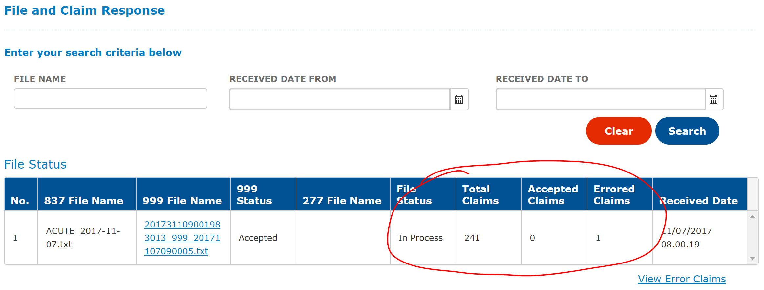
Claims Submission Process
*Errored claims will not populate in the Claim Error page until the “File Status” shows “Complete”.

Slide 16
V. Claims Correction Process

Slide 17
Claims Correction Process
Claims Error Page
Error Identification
Error Revision
Once an 837R file has been completely processed through both file format and clinical content checks, claims with clinical errors will appear in the “Claim Error” page.
Before clicking into a claim, all errors associated with a claim are listed in the “Error List” column
After clicking into a claim, all errors associated with a claim are listed in the “validation errors” table
Error locations are also highlighted red
Revise errors by inputting the correct information into red highlighted fields
For updating claim lines, add new lines by clicking the “Add Line” button, and delete lines by clicking the “X” button next to each line
Some errors could be caused by more than one issue
Notes:
Kevin

Slide 18
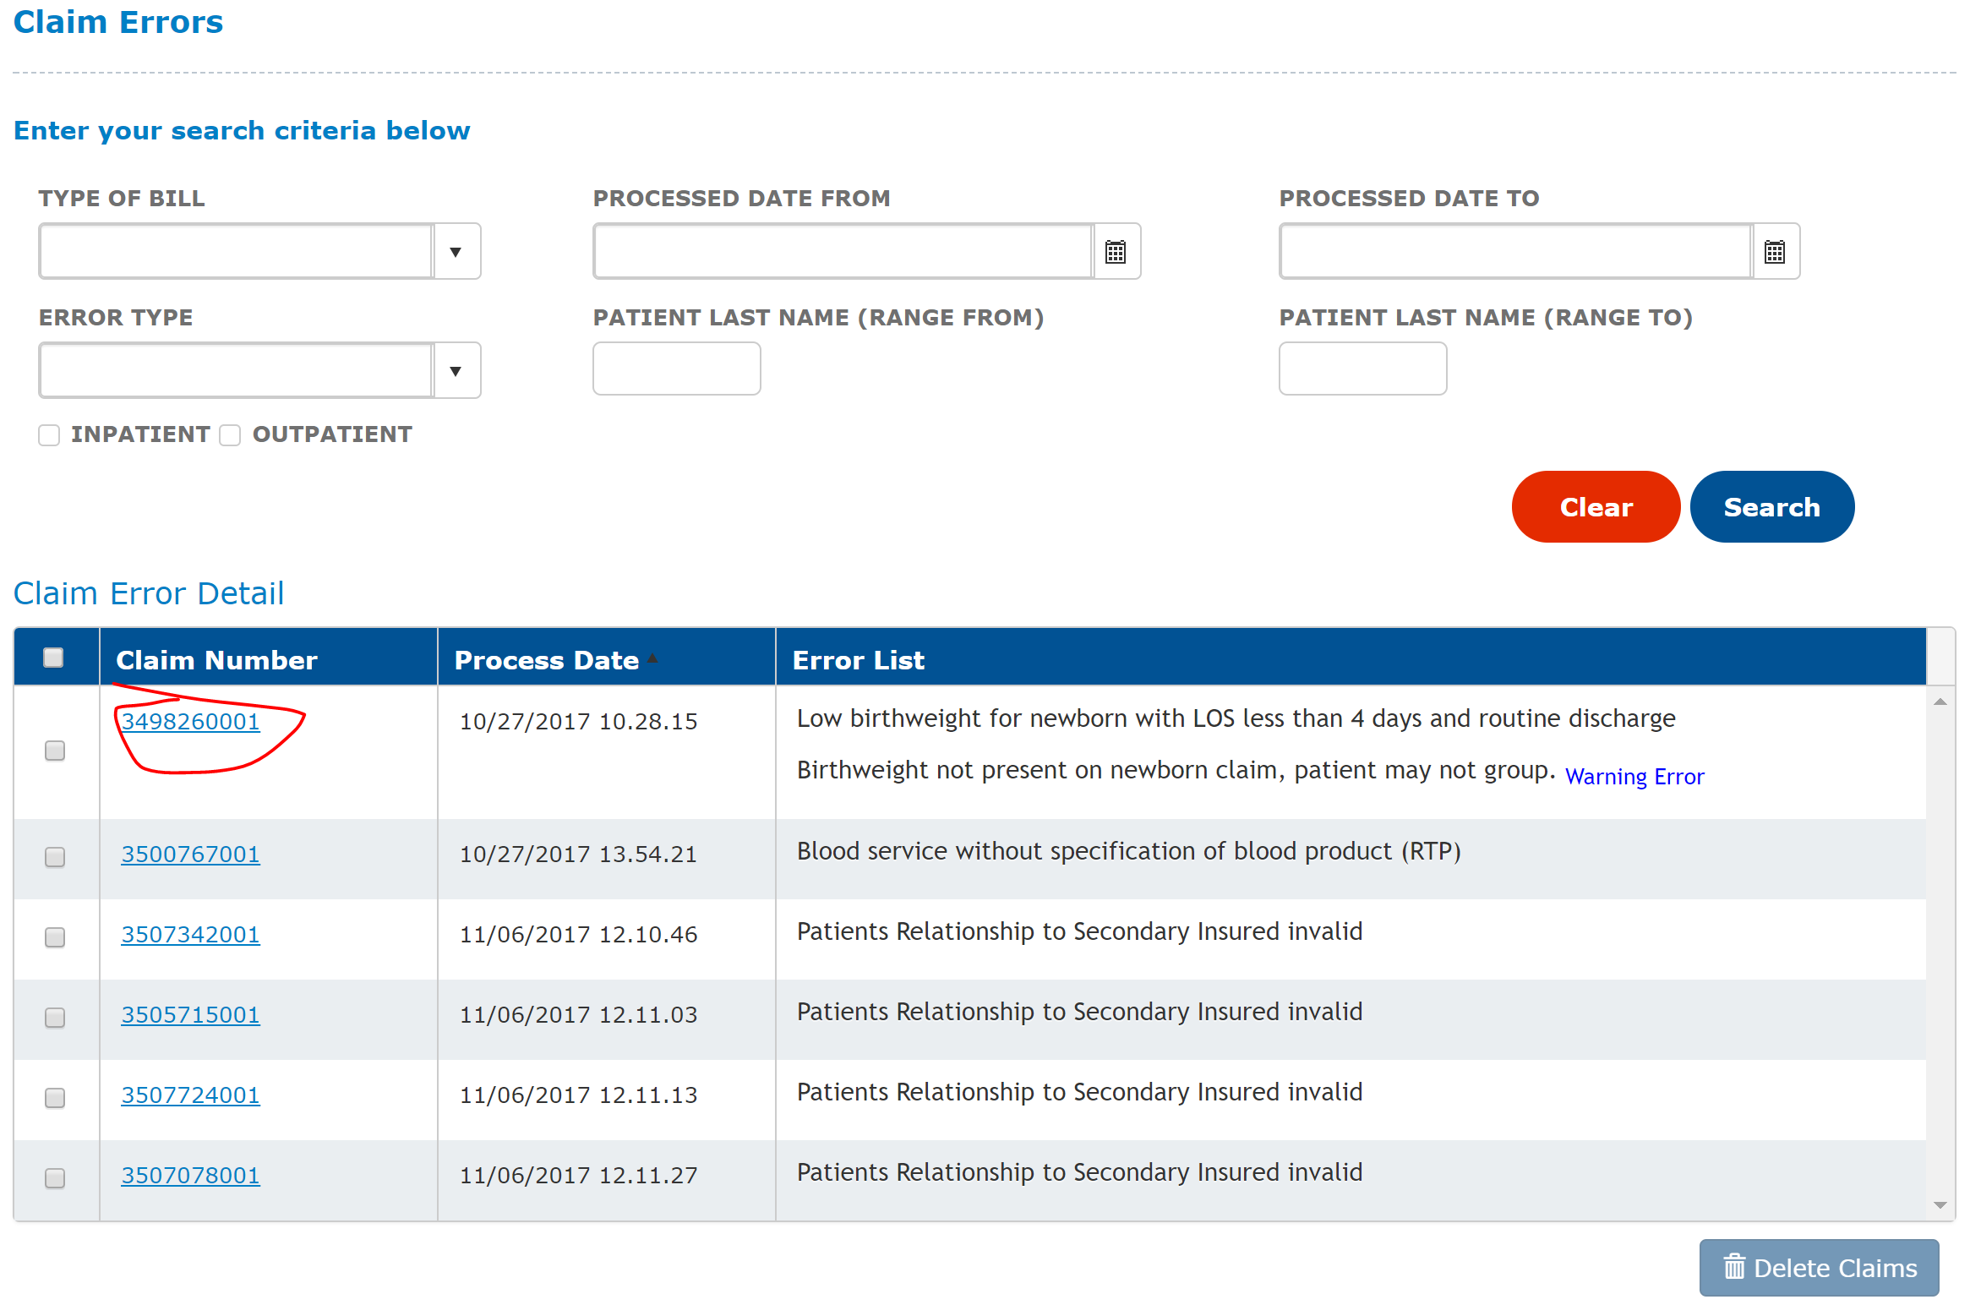
Claims Correction Process
Notes:
Kevin

Slide 19
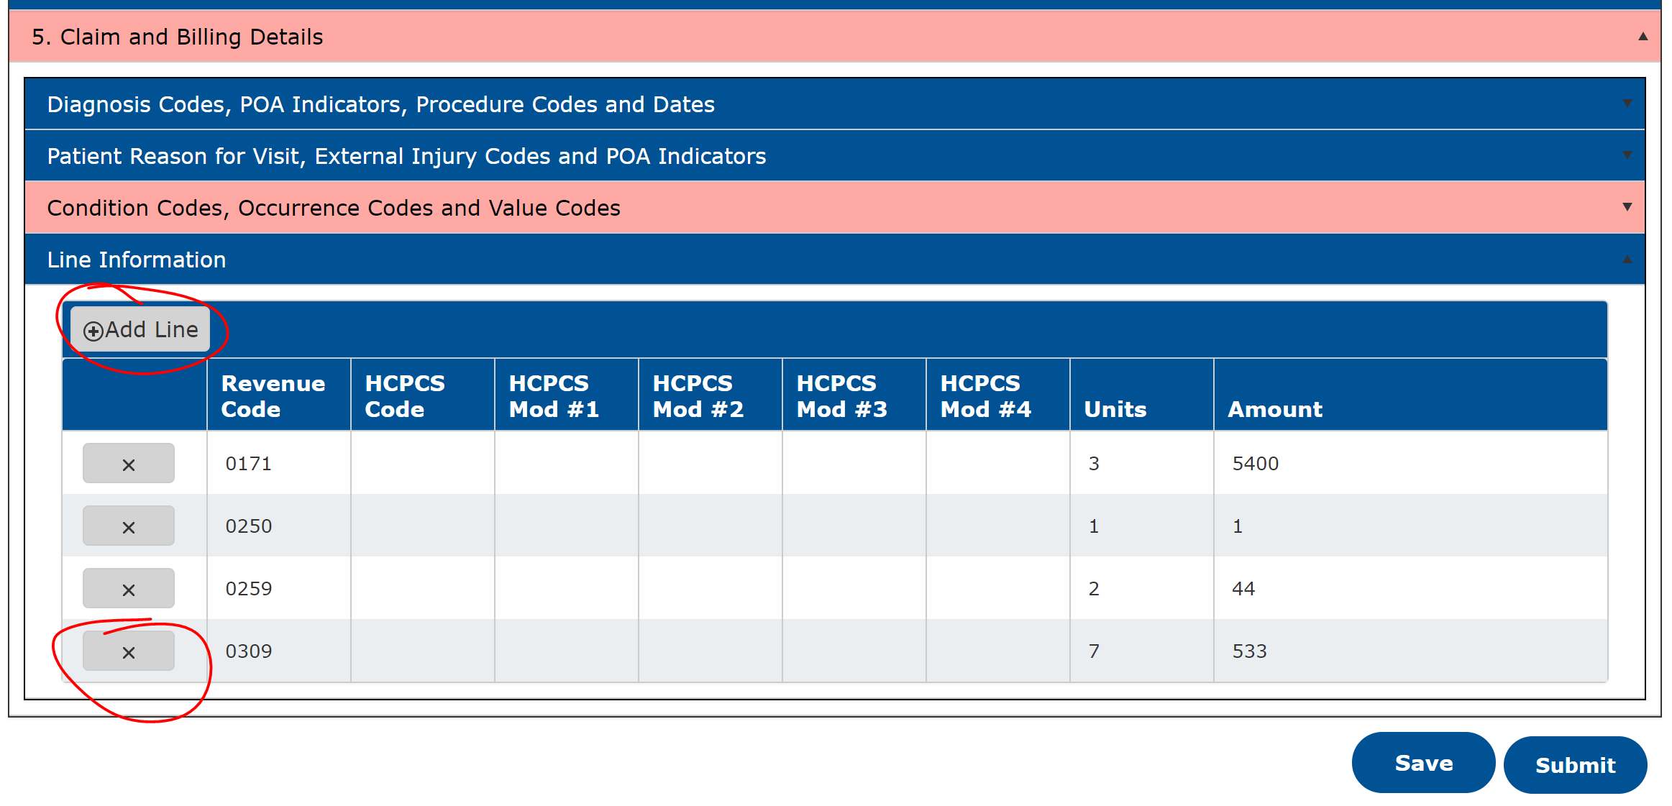
Claims Correction Process
Notes:
Kevin

Slide 20
VI. Data Reporting and Review

Slide 21

Data Reporting and Review
Three (3) claims submission statistic reports within NJ HealthCAP application:
  Load Summary Report
  Load Detail Report
  Claim Errors Report
Two (2) accepted claims data extract features:
  Accepted claims data extract with data warehouse
  837R outbound file for upload to Nuance’s quality management application (Clintegrity) [upcoming]

Slide 22
Data Reporting and Review
Load Summary Report
837R file submission status
Claim count check by batch
Load Detail Report
PCN/claim submission status
Claim count by PCN check
Claim Errors Report
All claims with identified clinical errors
Populated after a batch has been completed
Accepted claims by batch
Rejected claims by batch
Claim charge by PCN check

Slide 23
VII. Upcoming Features and Hotfixes

Slide 24

Upcoming Features
Display “rejected” 837R files in Load Summary Report
Allowability of multiple NPIs in a single 837R file
837R outbound file of accepted claims for upload to Nuance’s quality management system
999 Acknowledgement User Guide

Slide 25

Upcoming Hotfixes
Claim/revenue/charge line removal and deletion
Code set updates for 10/1/2017 DX/PCS/HCPCS/CPT codes
Highlighting all identified errors in Claim Errors page

Slide 26
Contact Information
Programmatic Questions: NJ Department of Health
Abate Mammo
Executive Director
Email: Abate.Mammo@doh.nj.gov
Technical Questions: PCG
Logan Barron
Operations Analyst
Email: NJ_HealthCAP@pcgus.com
Phone: 844-880-8709
Steven Wang
Consultant
Email: NJ_HealthCAP@pcgus.com
Phone: 844-880-8709
Notes:
Kevin

