Slide 1
Tune in to what’s new.

Slide 2
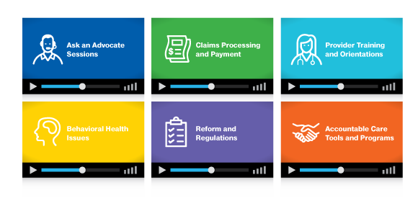

It’s programming just for providers.
UHC ON AIR
Our live and on demand programs include these topics and much more:

Slide 3
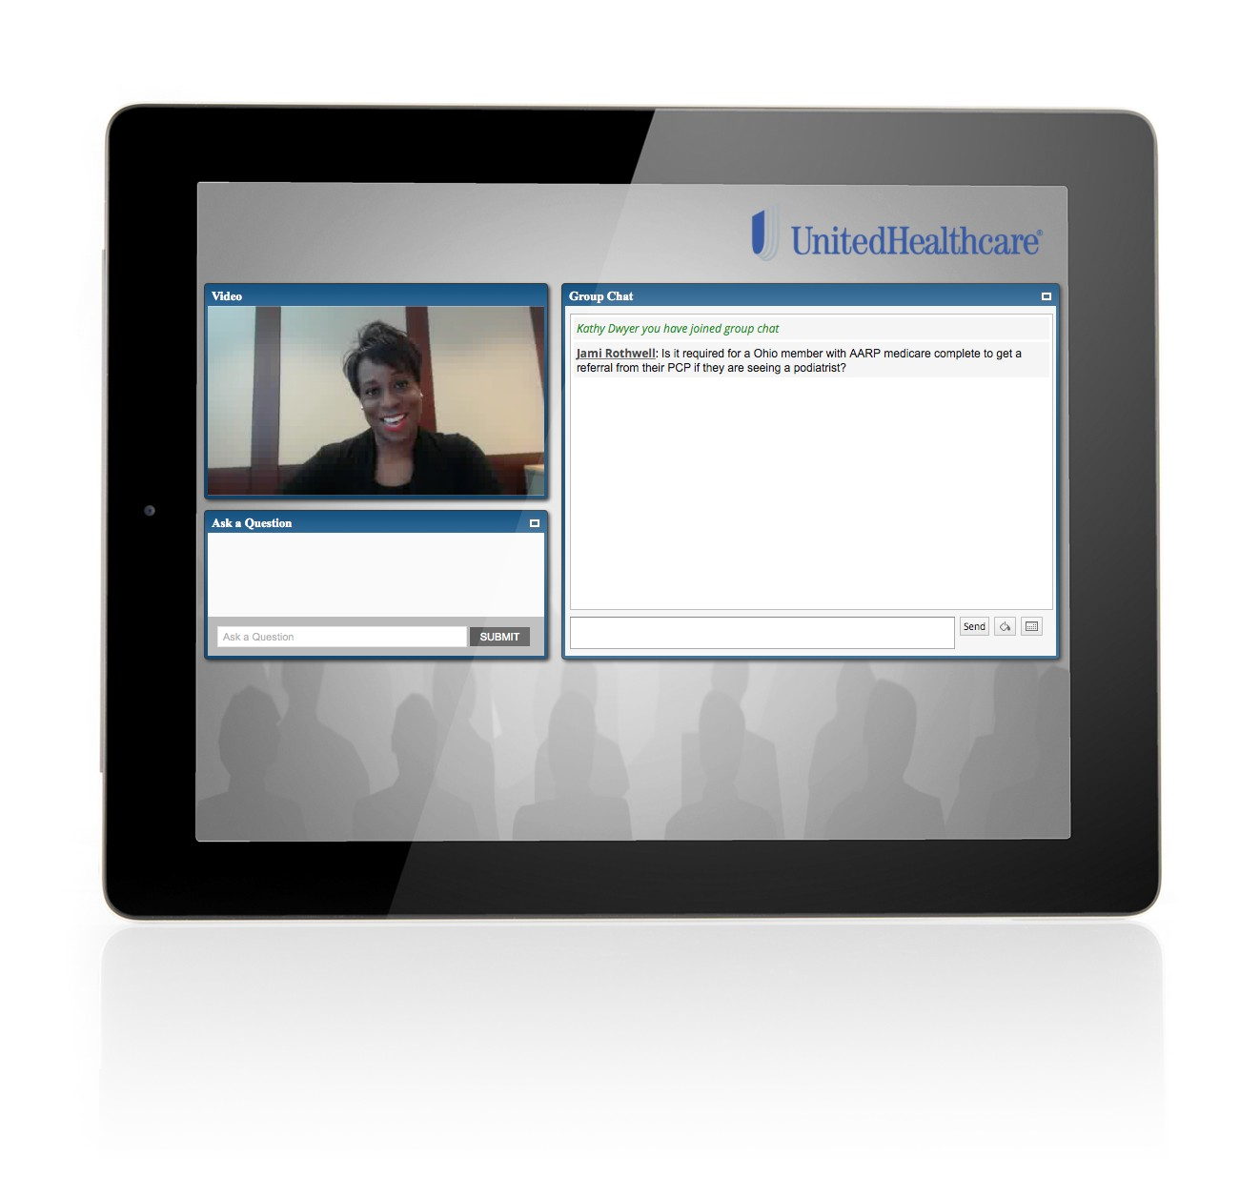

UHC ON AIR
Listen. Ask. Contribute.
Live broadcasts give you the opportunity to simply listen in or interact with speakers by asking questions or oﬀering suggestions.
Live broadcasts

Slide 4
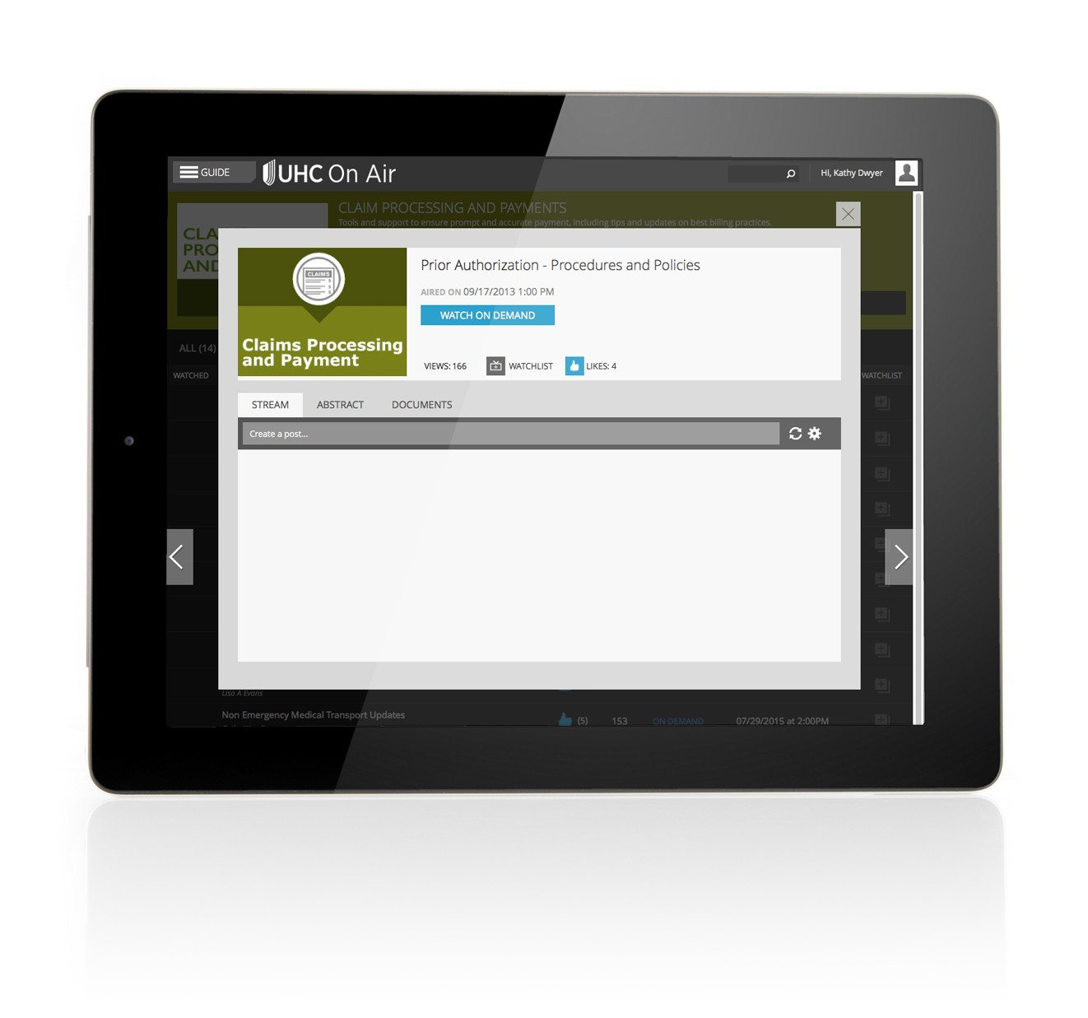

UHC ON AIR
Pick the perfect time.
We’re always creating more on-demand programs that you can choose to watch any time, from any smart device or computer.
On Demand

Slide 5

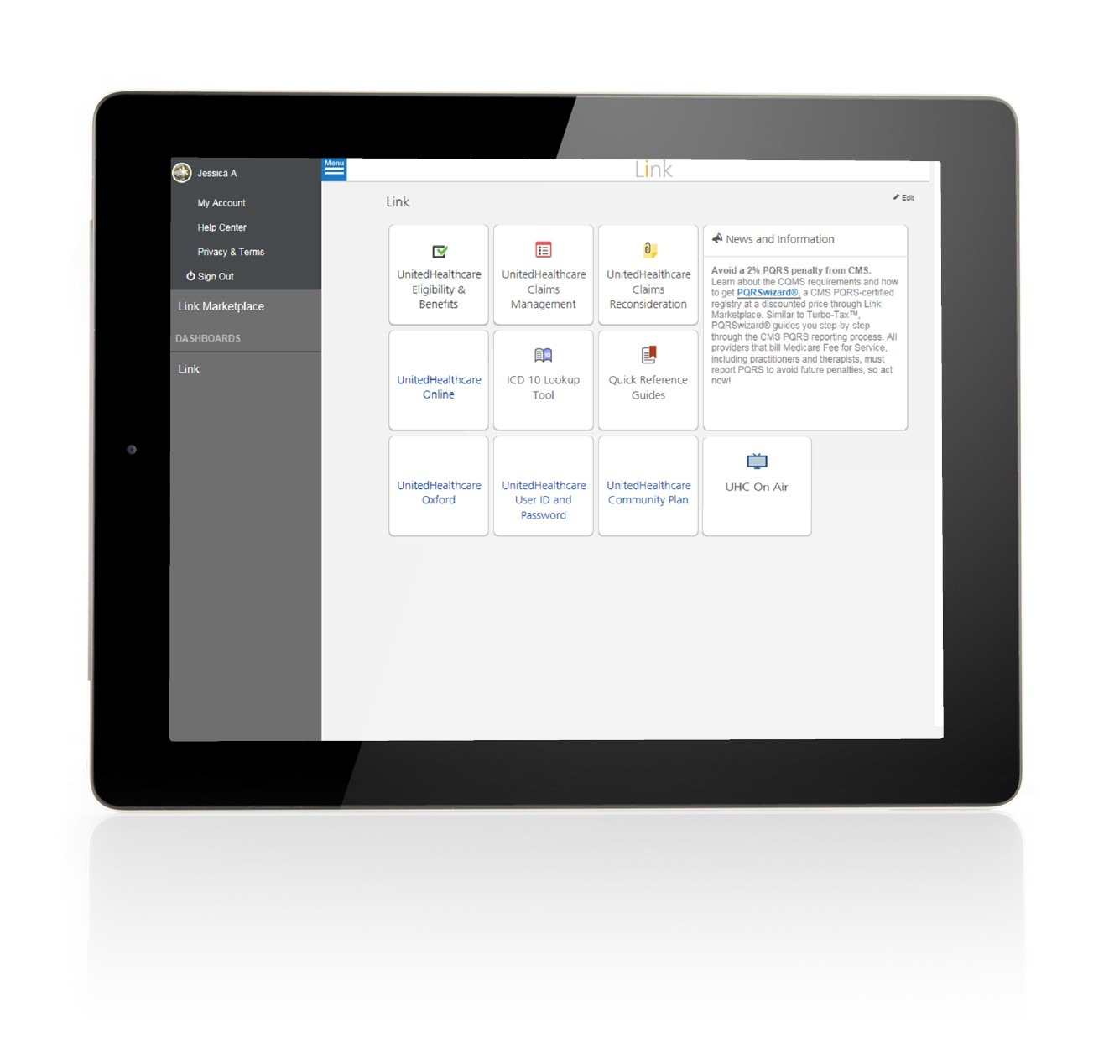
How to get access
UHC ON AIR
1
Log in to Link and select the UHC On Air button.

Slide 6
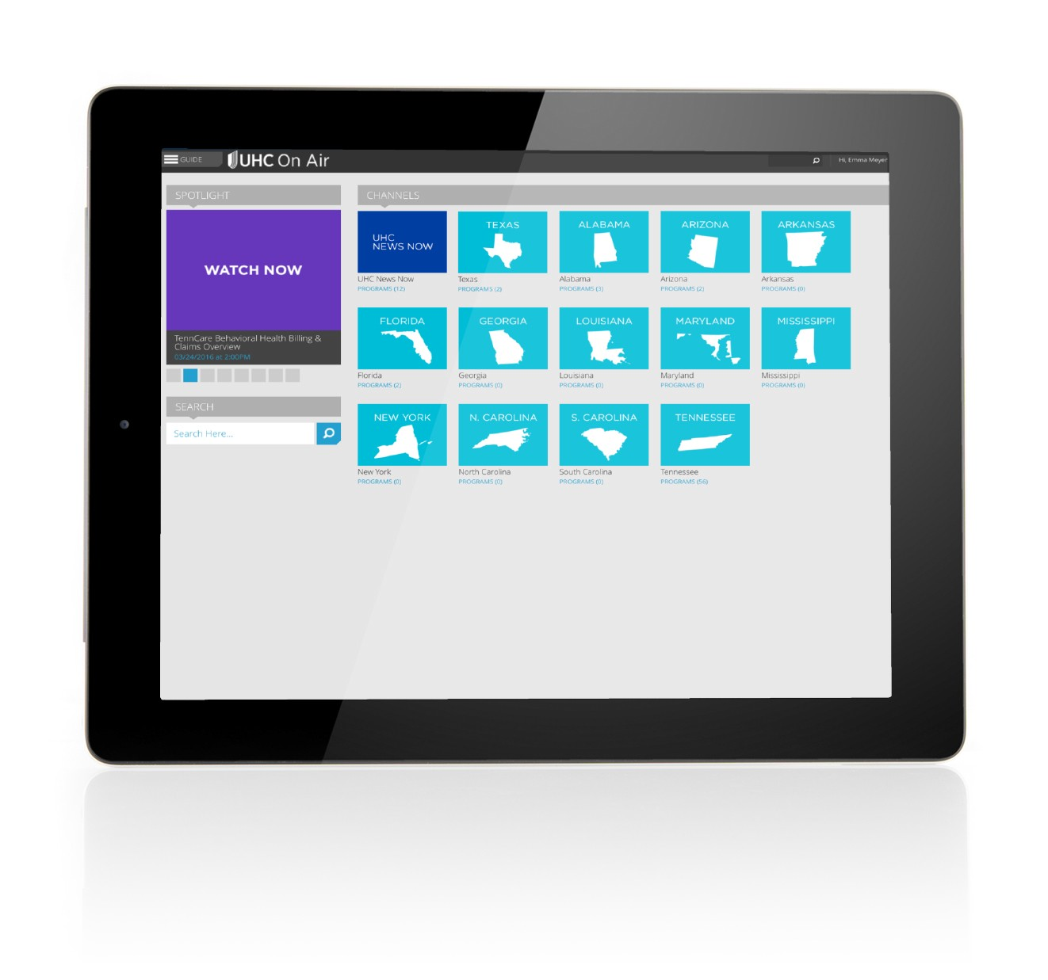
How to get access
UHC ON AIR
2
Select the UHC News Now channel to watch national UnitedHealthcare information, related to Medicare, Medicaid, Military & Veterans and Commercial benefit plans, programs and services.
Select your state-specific channel to see our local programming.

Slide 7
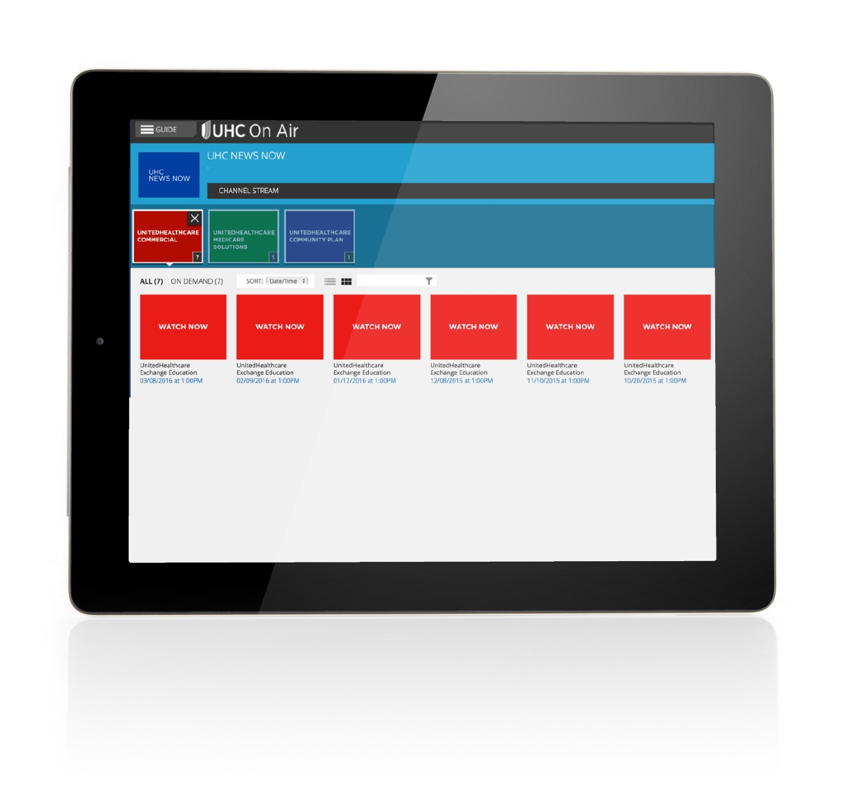
How to get access
UHC ON AIR
3
After selecting your channel, you’ll see videos categorized by plan type.

Slide 8



Questions
UHC ON AIR
Does your oﬃce allow time for training such as what is oﬀered on UHC On Air?
Are there any technical barriers that might prevent your staﬀ from viewing these programs?
When would you prefer to watch a video vs. reading a communication?
What types of content would you like to see on UHC On Air?
What’s the ideal length/time for a video?
Would you like an option to receive notifications when new videos are posted?
UHC On Air has expanded to a number of new markets and has more than 7,000 registered viewers since its 2013 launch in Tennessee.
Elearning! Magazine Learning! 100 award winner for providing live and on-demand education that allows care providers and their staﬀs to learn in a new way, on their own schedule.

Slide 9
UHC ON AIR
Thank you!

