Slide 1
NJAAHAM Spring Payer Conference
March 6, 2019

Slide 2
UHC Customer Service
United Healthcare: 1-877-842-3210
  Website: www.uhcprovider.com
Oxford: 1-800-666-1353
  Website: www.oxfordhealth.com
Community Plan: 1-888-362-3368
  Website: www.uhccommunityplan.com

Slide 3
Important Reminders for Your Patients in
UnitedHealthcare Oxford Commercial Plans
Coming up in 2019…..
If you have patients whose employers are renewing their health coverage with a UnitedHealthcare Oxford commercial plan, you’ll see some differences in their new member ID card that we want to remind you about:
The member’s ID number will change to 11 digits.
The Group Number will change to be numeric-only.
The website listed on the back of the card is www.uhcprovider.com.
The ERA Payer ID number won’t change and will remain 06111.
For more information, please call Provider Services at 800-666-1353. When you call, provide your National Provider Identifier (NPI) number.
Notes:
July 2018 Bulletin page 59
In December 2017, we let care providers know that we would be taking steps to
streamline the administrative experience for UnitedHealthcare Oxford commercial
plans. These steps have begun and will continue over the next 24 to 36 months as
employer groups renew health coverage for their employees.
When your patients see you for care, ask your staff to:
• Check their eligibility each time they visit your office.
• Include their new member ID number on claims or requests for services that require authorization.
• Use the provider website listed on the back of the member’s ID card for secure transactions.

Slide 4

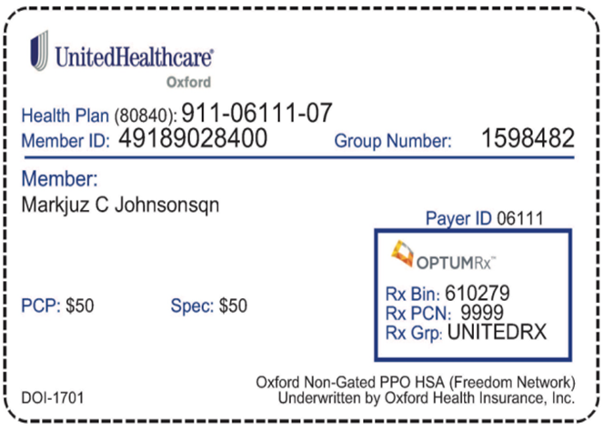
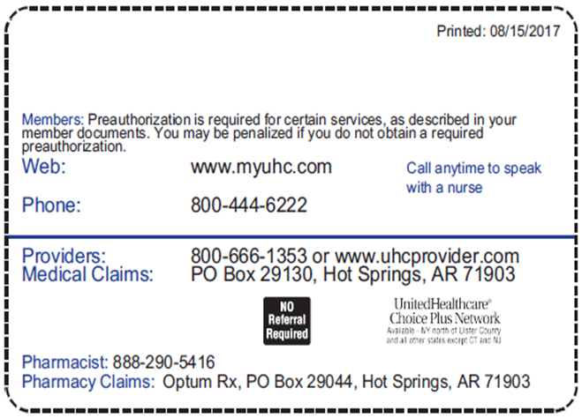
New Member ID Card Sample

Slide 5
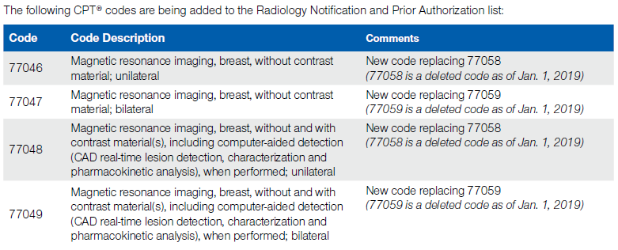
Radiology Program Procedure Code Changes
As of Jan. 1, 2019, UnitedHealthcare is updating the procedure code list for the
Radiology Notification and Prior Authorization Programs based on code changes
made by the American Medical Association (AMA).
Claims with dates of service on or after Jan.1, 2019 are subject to these changes.
Notes:
January 2019, page 8
See next slide.

Slide 6
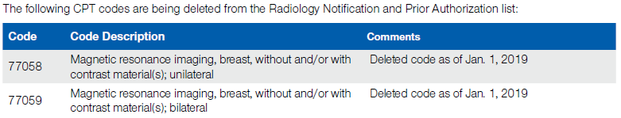
Radiology Program Procedure Code Changes (cont.)
For the most current listing of CPT codes for which notification/prior authorization is required, go to UHCprovider.com/Radiology > Specific Radiology Programs.
These requirements don’t apply to advanced imaging procedures provided in the emergency room, urgent care center, observation unit or during an inpatient stay.
Notes:
January 2019, page 8
For complete details on this radiology protocol, go to the UnitedHealthcare Care Provider Administrative Guide online at UHCprovider.com > Menu > Administrative Guides and Manuals.

Slide 7
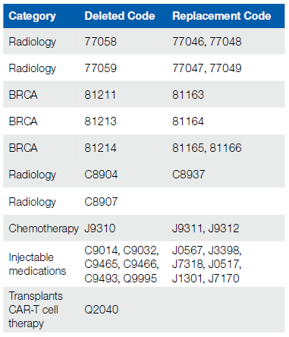
Changes in Advance Notification and Prior
Authorization Requirements – Code Replacements
The 2019 American Medical Association (AMA) national procedure code changes have been announced. For dates of service on or after Jan. 1, 2019, the following
prior authorization codes have been deleted and are replaced with procedure code(s) as noted below. This change affects all UnitedHealthcare entities:
Notes:
January 2019, pages 10 and 11
Ten fax numbers used for medical prior authorization retired on Jan. 1, 2019 and more will be retired throughout the year. The fax numbers are listed at UHCprovider.com/priorauth.
The most up-to-date Advance Notification lists are available online: UnitedHealthcare Medicare, UnitedHealthcare Community plan, and UnitedHealthcare Commercial Plans — UHCprovider.com/priorauth > Advance Notification and Plan Requirement Resources > Plan Requirement Resources.

Slide 8

Changes in Advance Notification and Prior
Authorization Requirements – Code Additions
Effective for dates of service on or after April 1, 2019, we’re adding the following new code to prior authorization for UnitedHealthcare commercial plans (UnitedHealthcare Mid Atlantic Health Plan, Navigate, Neighborhood Health Partnership, UnitedHealthOne, UnitedHealthcare Commercial, UnitedHealthcare of the River Valley and UnitedHealthcare West):
Notes:
January 2019, pages 10 and 11
Ten fax numbers used for medical prior authorization retired on Jan. 1, 2019 and more will be retired throughout the year. The fax numbers are listed at UHCprovider.com/priorauth.
The most up-to-date Advance Notification lists are available online: UnitedHealthcare Medicare, UnitedHealthcare Community plan, and UnitedHealthcare Commercial Plans — UHCprovider.com/priorauth > Advance Notification and Plan Requirement Resources > Plan Requirement Resources.

Slide 9
New Prior Authorization Requirement for
In‑Patient Cerebral Seizure Video EEG Monitoring
Starting April 1, 2019, UnitedHealthcare will require prior authorization for in-patient video electroencephalograph (EEG) for cerebral seizure monitoring.
Applies to UnitedHealthcare commercial and UnitedHealthcare Medicare Advantage members.
We’ve implemented this change as part of our commitment toward the Triple Aim of improving health care services, health outcomes and overall cost of care.
All requests for this procedure (CPTR code 95951) will be subject to medical necessity and level of care review.
Prior authorization isn’t required if these procedures are done in an outpatient hospital setting.
For more information, contact your local network management representative.
Notes:
January 2019, page 12
How to Submit a Prior Authorization Request
You can initiate prior authorization requests for dates of service on or after April 1, 2019, online or by phone:
• Online: Use the Prior Authorization and Notification tool on Link. Sign in to Link by going to UHCprovider. com and clicking on the Link button in the top right corner. Then, select the Prior Authorization and Notification tile on your Link dashboard. This option gives you and your patients the fastest results. You can also use the eligibilityLink tool on Link to verify eligibility and benefits coverage.
• Phone: If you’re unable to use the Prior Authorization and Notification tool on Link, you can continue to call Provider Services at 877-842-3210 to submit a request by phone.
Reviewing Prior Authorization Requests
We’ll review the request and required clinical records, and contact the care provider and member with our coverage decision.
Care providers and members will be contacted by phone and by mail.
If coverage is denied, we’ll include details on how to appeal within the denial notice.
If you don’t submit a prior authorization request and necessary documentation before performing this procedure, the claim will be denied. Care providers can’t bill members for services denied due to lack of prior authorization.
Members are only responsible for applicable plan cost‑sharing.
If a non-participating or non-contracted care provider performs this procedure, members may have to pay additional out-of-pockets costs. Members who don’t have out-of-network benefits may be responsible for the entire cost of services obtained from non-participating care providers. This doesn’t apply to members with Medicaid or DSNP plans.
If a network provider refers a member to a non-participating provider without obtaining prior authorization, the member cannot be billed for the charges and is only responsible for applicable plan cost-sharing.

Slide 10
UnitedHealthcare Genetic and Molecular Lab Testing Notification/Prior Authorization Requirement
Effective Feb. 1, 2019, UnitedHealthcare will require prior authorization/notification for genetic and molecular testing performed in an outpatient setting for UnitedHealthcare Community Plan members (excluding Medicare Advantage) in Maryland, Michigan, Missouri, New York, Rhode Island, Tennessee and Texas.
UnitedHealthcare Community Plan members (excluding Medicare Advantage) in Florida, New Jersey and Pennsylvania, originally scheduled to deploy on Feb. 1, will now deploy on April 1, 2019.
You can find more information on the Genetic and Molecular Lab Test tool on Link at UHCprovider.com/genetics.
Determinations for notification/ prior authorization requests will be made based on UnitedHealthcare’s clinical policy requirements for coverage.
Our clinical policies are at UHCprovider.com/policies.
Notes:
January 2019, page 40
Care providers will use the Genetic and Molecular Lab Test tool on Link to submit the notification/prior authorization request.
You’ll fill in the member’s information and choose the test and the lab to perform the test.
Ordering providers will need to submit requests for tests that require authorization.
Labs may submit their own notification requests for tests that only require notification.
The following will require notification/prior authorization:
• Tier 1 Molecular Pathology Procedures
• Tier 2 Molecular Pathology Procedures
• Genomic Sequencing Procedures
• Multianalyte Assays with Algorithmic Analyses that include Molecular Pathology Testing
• These CPTR codes are:
––0001U
––0018U ‒ 0019U
––0022U ‒ 0023U
––0026U ‒ 0034U
––0036U ‒ 0037U
––0040U
––0045U ‒ 0050U
––0055U ‒ 0057U
––0060U
––0004M
––0006M ‒ 0007M
––0009M
––0011M ‒ 0013M
––81105 ‒ 81111
––81120 ‒ 81121
––81161 ‒ 81420
––81425 ‒ 81479
––81507
––81519 ‒ 81521
––81545
––81595 ‒ 81599
––S3870
You’ll get a decision right away when you submit your request online if your request meets UnitedHealthcare’s clinical and coverage guidelines.
If more information or clinical documentation is needed, we’ll contact you.

Slide 11
UnitedHealthcare Care Provider Administrative
Guide for UnitedHealthcare Commercial and
Medicare Advantage
We post this essential resource for physicians, hospitals, facilities and other health care providers on UHCprovider.com/guides annually on Jan. 1.
You can view the 2019 Guide as a PDF or webpage at UHCprovider.com/guides. Be sure to save the link to your favorites or download the PDF.
Quick Reference to UnitedHealthcare Care Provider Administrative Guides Now Available
The updated Quick Reference to Provider Administrative Guides is available at UHCprovider.com/guides.
Developed based on care provider feedback
Contains information that you’re likely to need early and often in your relationship with UnitedHealthcare
Notes:
January 2019, pages 6 and 7
New in the 2019 Guide:
• Medical Prior Authorization Fax Retirement
• Skilled Nursing Facilities require prior authorization
• Additional Notification Requirements
• Optum Dual Special Needs (DSNP) Protocol
• Updating Advance Notifications or Prior Authorizations
• Medicare Advantage Pharmacy Coverage Gap
• Charging Members Additional Fees for Covered Services
• Member Out of Pocket Maximums
• All Quality of Care Correspondence is Considered Confidential
• CMS Preclusion List Policy
• Capitated and Delegated Providers
* Except as otherwise noted, the new guide is effective on April 1, 2019 for currently contracted care providers and Jan. 1, 2019 for care providers newly contracted on or after Jan. 1, 2019.
This guide applies to UnitedHealthcare commercial and Medicare Advantage plans only.

Slide 12
Coding Update to the UnitedHealthcare Facility Outpatient Procedure Grouper Mapping
On Jan. 1, 2019, the following code updates will be made to the current UnitedHealthcare 2018 Outpatient Procedure Grouper (OPG) mapping:
Expired codes – 24 OPG 0-10 codes expire on Dec. 31, 2018. The codes will be deleted from the UnitedHealthcare OPG Exhibit on Jan. 1, 2019. An additional 6 OPG unlisted codes expire and will be deleted as well.
Newly Published codes – 57 OPG 0-10 codes will be added to the UnitedHealthcare OPG Exhibit on Jan. 1, 2019. An additional 1 OPG unlisted codes will be added as well.
The updated 2018 UnitedHealthcare OPG Exhibit is available at UHCprovider.com/
claims under the Outpatient Procedure Grouper Exhibits section.
Notes:
January 2019, page 28
There are no other grouper level assignment changes to existing codes.
For reimbursement under the OPG, UnitedHealthcare requires the appropriate line level CPT/ Healthcare Common Procedure Coding System (HCPCS) code, in addition to the revenue code, when billing for outpatient procedures.

Slide 13
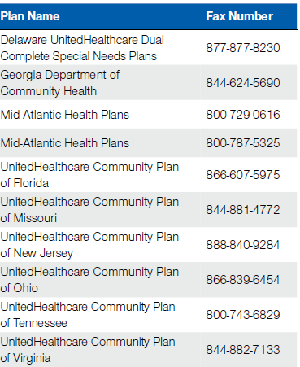
More Fax Numbers Used for
Medical Prior Authorization Retiring May 6, 2019
Instead of faxing your request, use the Prior Authorization and Notification tool on Link ‒ the same website you already use to check eligibility and benefits, manage claims and update your demographic information.
Use Our Online Tools Instead
Access the tool and review resources to help you get started at UHCprovider.com/paan.
Go to UHCprovider.com/priorauth for more information.
Notes:
Feb page 14:
As we continue moving administrative tasks online, another group of fax numbers used for medical prior authorization
will retire on May 6, 2019.

Slide 14
Medical Record Requests:
Volume and Perspective
Payment Integrity has thousands of analytics and algorithms working to detect Fraud, Waste, Abuse, and Errors.
From the medical record reviews that result in a denial:
  94% are attributed to errors that may be subsequently paid as a result of the provider furnishing additional information or submitting a corrected claim.
  6% are attributed to potential waste or abuse and are not resubmitted for payment.
Less than 1% of all the claims submitted result in a request for medical records.

Slide 15
Medical Record Requests:
Documentation to Send
Include a copy of the medical record request letter received
  Contains details that will assist with routing of the records received appropriately
Treatment Records should include, but are not limited to, copies of:
  History and physical
  Presenting symptoms and complaints
  Findings on examination
  Lab test results
  X-rays
  Consultation reports
  Daily progress notes
  Medication records relative to the treatment
  Durable medical equipment records that include copies of the physician orders that list the referring physician’s name, the invoice and the delivery statement showing the date of receipt
  If Applicable, all documentation of any kind of services provided, such as records reflecting date and time spent providing services (e.g. time sheets), ADLs addressed, level of service provided (skilled nursing, home health aide, personal care, etc.)

Slide 16
Peer to Peer Scheduling Process
Network providers who call the P2P Support Team at 800-955-7615 to initiate a P2P request can continue to call OR send a secure email. Providers will speak to a live agent when calling this number who can assist them with scheduling that appt. We are also offering another option to initiate a P2P request through a secure email. The Provider can send a secure email through res.cisco.com/websafe to UHC_PeerToPeer_Scheduling@uhc.com with the following information:
UHC Case Reference Number,
Member ID,
Member’s first and last name,
Physician’s first and last name and the time zone where they reside,
Area code and phone number where physician can be reached, and
The desired date and time for the UHC Medical Directors return call.

Slide 17
Peer to Peer Scheduling Continued
This information can also be found on a P2P Request Form that can be found on UHCprovider.com via the following path: UHCprovider.com > Prior Authorization and Notification > forms > Peer to Peer Request Following Prior Authorization Service Denial Form)
If the Provider is not already set up on the UHC encrypted email site, they can send an email to UHC_PeerToPeer_Scheduling@uhc.com requesting to be set up. They will receive information back with a one-time identification ID and password along with instructions to get registered on the encrypted site.

Slide 18
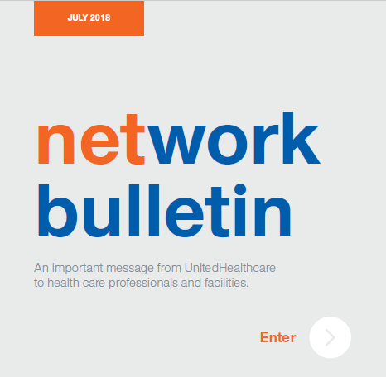
Network Bulletin

Slide 19
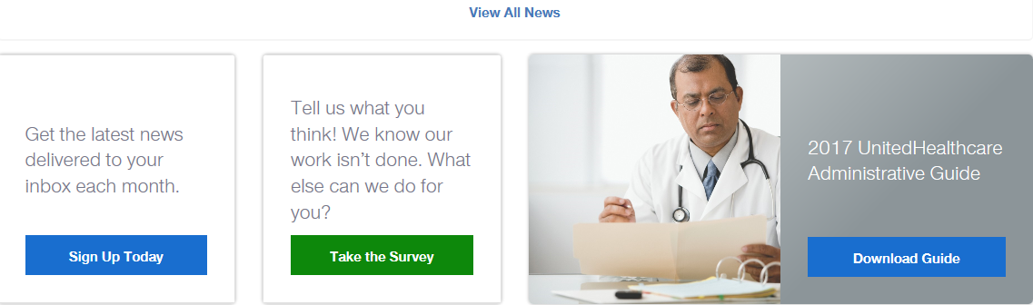
News
Network Bulletins & Admin Guides

Slide 20
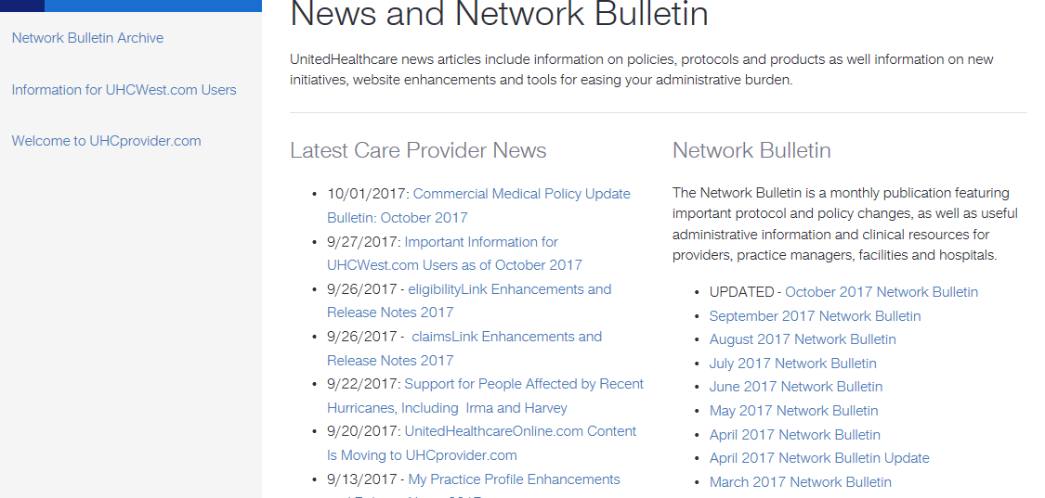
News &
Network Bulletin

Slide 21
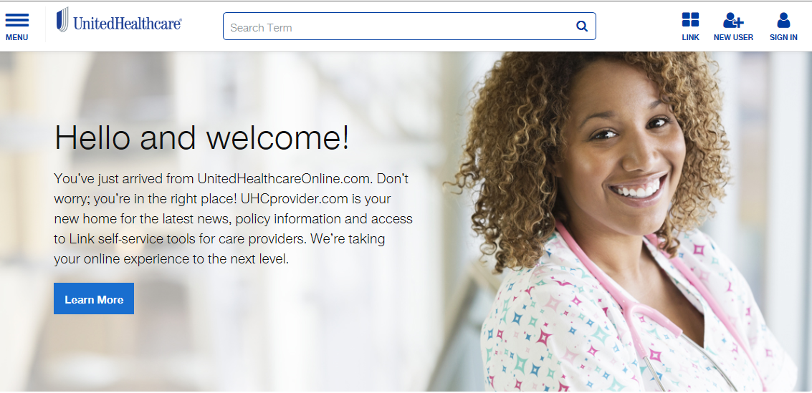
www.UHCprovider.com

Slide 22
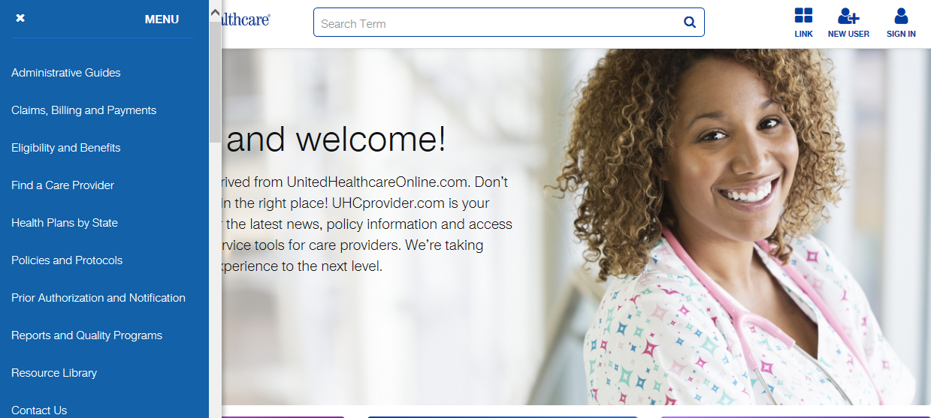
UHCprovider.com – Menu Options

Slide 23
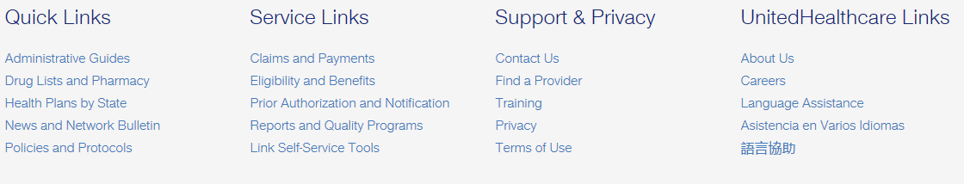
Quick Links,
Support Links, Support & Privacy

Slide 24
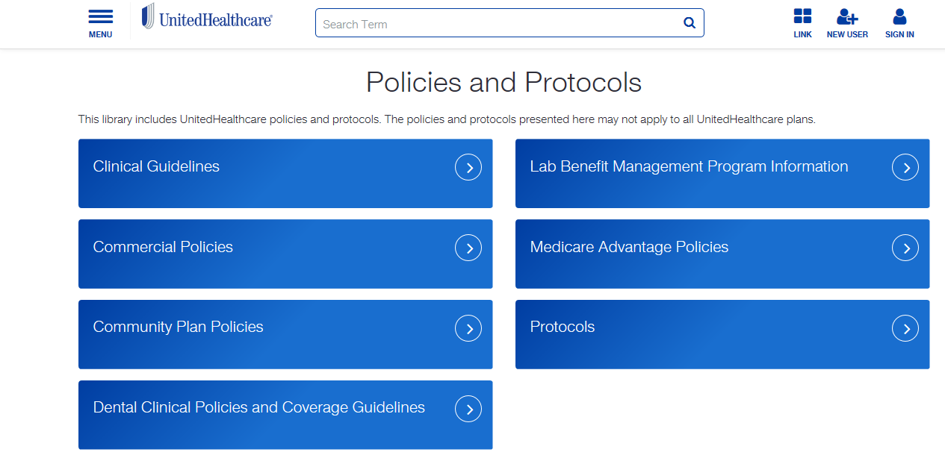
Accessing Policy and Protocols

Slide 25
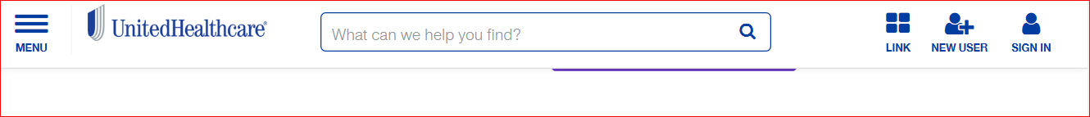
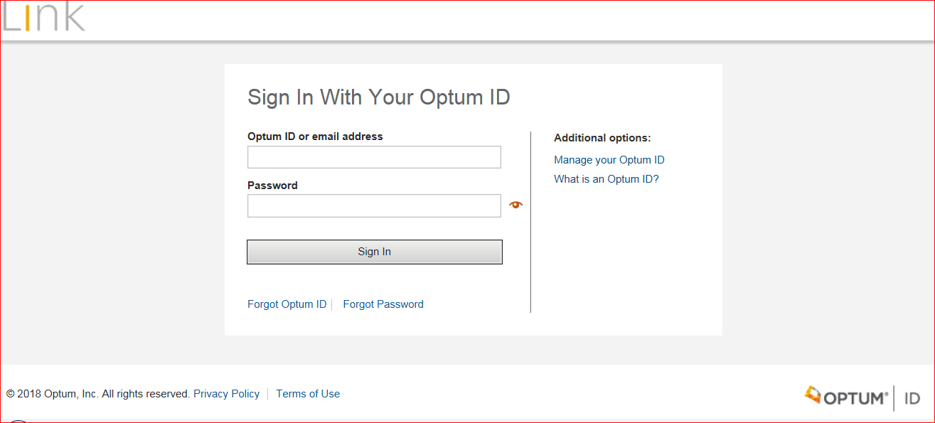
Link is accessible via
UHC provider website

Slide 26
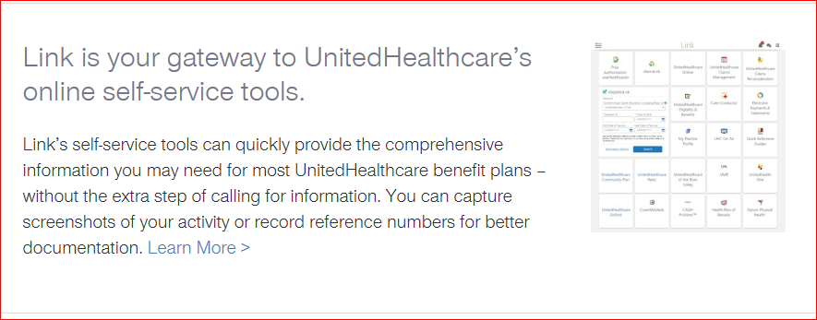
Link Dashboard

Slide 27
Link Self-Service Updates and Enhancements
We’re continuously making improvements to Link tools to better support your needs.
Among the enhancements:
Prior Authorization and Notification tool
  Required fields are now highlighted
  When you access Prior Authorization and Notification from eligibilityLink, the member information will be retained.
  Now you can enter additional contact details
  referralLink
  A “Help” hyperlink has been added to the screen to connect to UHCprovider.com/referrallink for Quick Reference Guides and more.
eligibilityLink
  When you access Prior Authorization and Notification from eligibilityLink, the member information will be retained.
  A “Help” hyperlink has been added to the right navigation and it links to UHCprovider.com/eligibilitylink for Quick Reference Guides and more.
Register for live training webinars at UHCprovider.com/training or watch short tutorials on demand on UHC On Air on Link.
Notes:
December 2018, page 13
An Optum ID is required to access Link and perform online transactions, such as eligibility verification, claims status, claims reconsideration, referrals, prior authorizations and more.
To get an Optum ID, go to UHCprovider.com and click on New User to get started.
UHC On Air is your source for live and on-demand video broadcasts created specifically for UnitedHealthcare providers.
For help with Link, call the UnitedHealthcare Connectivity Helpdesk at 866-842-3278, option 1, from 7 a.m. to 9 p.m. Central Time, Monday through Friday.

Slide 28
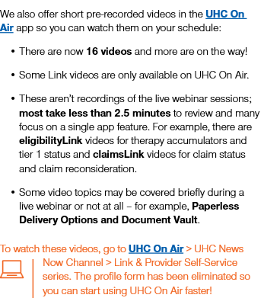
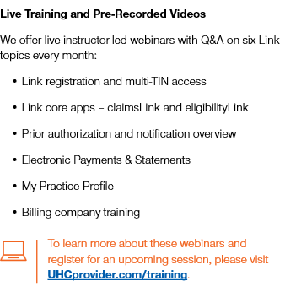
Link Self-Service Updates

Slide 29
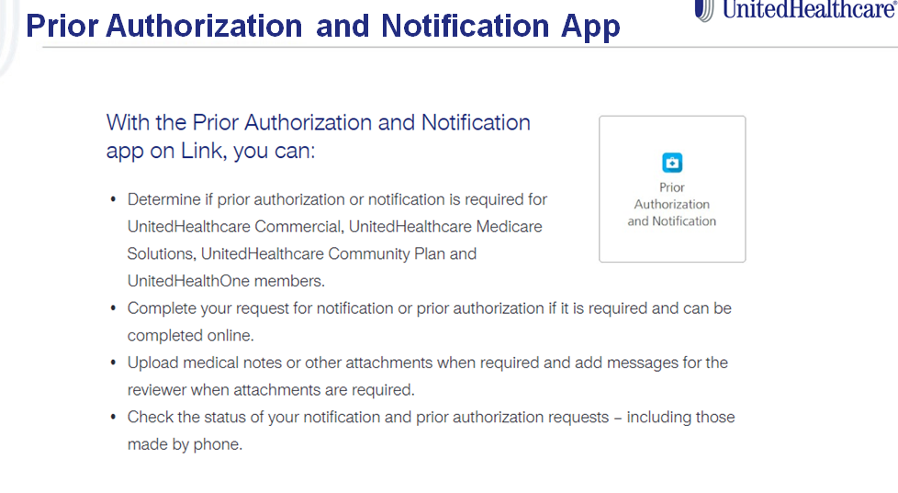

Slide 30
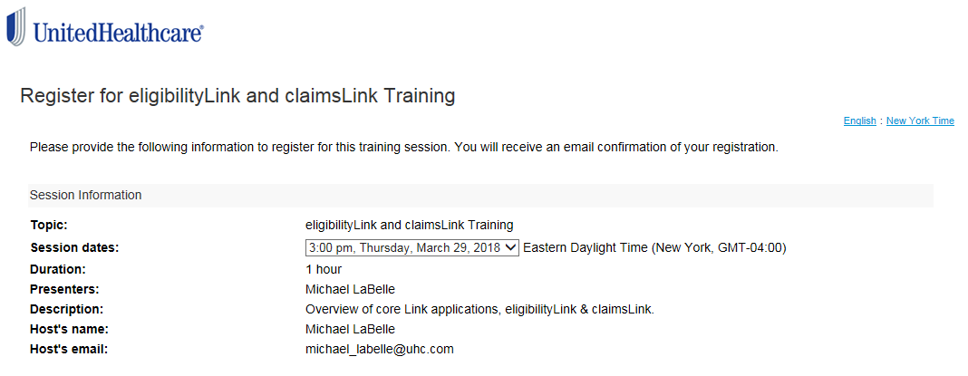
Live Training Sessions Available for Link Applications

Slide 31

Go Paperless
For a Chance to Win $500
Visit UHCprovider.com/paperless to learn how to win $500 for your organization.
You have until May 31, 2019 to enter, but if you go paperless now, you’ll be entered into more of the monthly drawings.
Notes:
January 2019, page 7
All information is given on slide

Slide 32
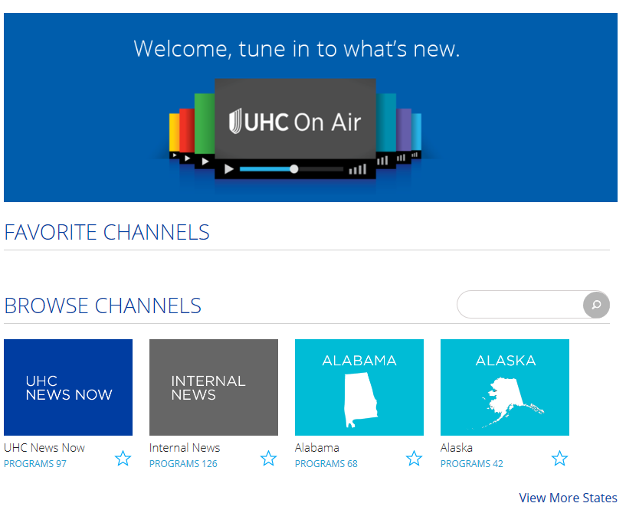
UHC On Air – NJ Channel

Slide 33
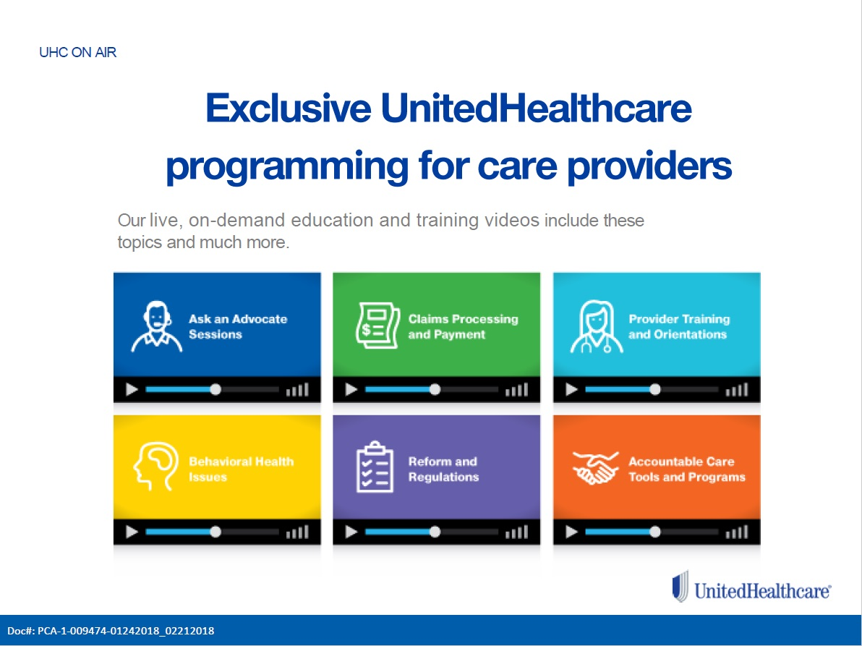

Slide 34
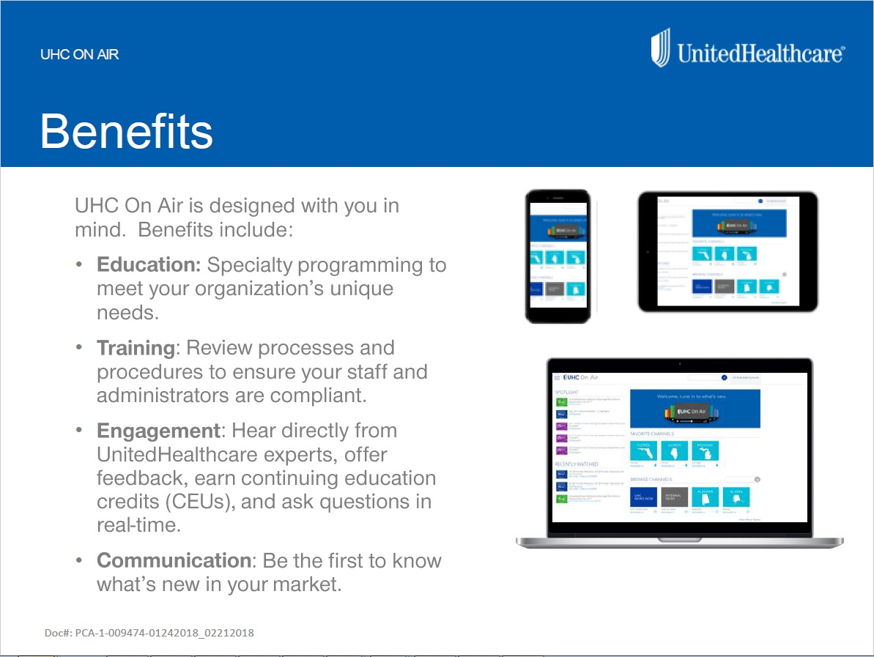

Slide 35

UHC On Air

Slide 36

We Appreciate Your Time & Attendance
THANK YOU !!

